Slide 1

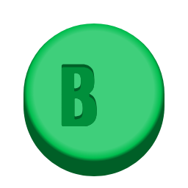

Understanding Gamification
A Practical Approach to Classroom Engagement & Motivation
Anna Contreras, MCC Honors Student
Boyce Wilson, Associate Professor of Business
Notes:
(me)Intro, "Today we will be giving a presentation on a Practical approach to Gamification in the classroom, we will show how this method can help to increase student motivation and engagement"

Slide 2
THE JOURNEY AHEAD
LEVEL 01 INSTRUCTIONS
LEVEL 04 LEARNER MOTIVATION
LEVEL 02 WHAT IS GAMIFICATION
LEVEL 05 GET STARTED GAMING
LEVEL 03 JOURNEY’S END – WHY GAMIFICATION
Notes:
(me)

Slide 3
LEVEL 01
INSTRUCTIONS

Slide 4
RULES OF THE GAME
This is an interactive exploration of gamification theory.
You will be divided into four teams: Team Mario, Team Link, Team DK, & Team Kirby
Each team will give their answer through a single spokesperson (written on the dry-erase board)
Throughout the session, questions will be asked. Teams will score points based on correct responses
The team with the most points at the end of the session wins a prize
Notes:
(boyce)

Slide 5
QUESTION TYPES
THIS OR THAT
2 choices – pick one!
CUT THE WIRE
4 wires – cut the right ones to save your team!
CRACK THE CODE
Only the correct answer opens the door!
Notes:
(boyce)

Slide 6
LEVEL 02
WHAT IS GAMIFICATION
Notes:
(me)

Slide 7
THIS OR THAT
SELECT THE APPROPRIATE TERM FOR THE FOLLOWING DEFINITION: Lesson content is added to a game. The learner plays the game and learns along the way.
A
B
Gamified Learning
Game-based Learning

Slide 8
THIS OR THAT
SELECT THE APPROPRIATE TERM FOR THE FOLLOWING DEFINITION: Lesson content is added to a game. The learner plays the game and learns along the way.
A
B
Gamified Learning
Game-based Learning

Slide 9
THIS OR THAT
SELECT THE APPROPRIATE TERM FOR THE FOLLOWING DEFINITION: Lessons incorporate rewards, points, and leaderboards to engage the learning experience
A
B
Game-based Learning
Gamified Learning
Notes:
(boyce)

Slide 10
THIS OR THAT
SELECT THE APPROPRIATE TERM FOR THE FOLLOWING DEFINITION: Lessons incorporate rewards, points, and leaderboards to engage the learning experience
A
B
Game-based Learning
Gamified Learning

Slide 11
TWO APPROACHES TO GAMIFICATION
GAME-BASED LEARNING | GAMIFIED LEARNING
Uses games to teach | Uses enhanced lessons to teach
Adds lesson content to game | Adds game content to lesson
Requires existence/creation of game platform | Requires creative adaptation of lessons
More complex and often more costly | Less complex with minimal costs
Less preparation time needed for instructor | More preparation time needed for instructor
Notes:
(me)

Slide 12


TWO APPROACHES TO GAMIFICATION
GAME-BASED LEARNING | GAMIFIED LEARNING
Uses games to teach | Uses enhanced lessons to teach
Adds lesson content to game | Adds game content to lesson
Requires existence/creation of game platform | Requires creative adaptation of lessons
More complex and often more costly | Less complex with minimal costs
Less preparation time needed for instructor | More preparation time needed for instructor
Notes:
This slide highlights that one approach is not necessarily better than the other. Instead, we have a “Which came first: the chicken or the egg?” situation. One method does not precede the other – rather, one can lead toward the other if need, opportunity, and resources allow. Instructors must consider resource availability, audience, and how gamification will be implemented within their class. Only then can the best option be selected.

Slide 13
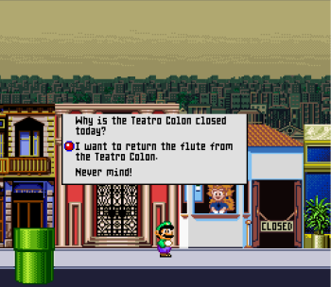
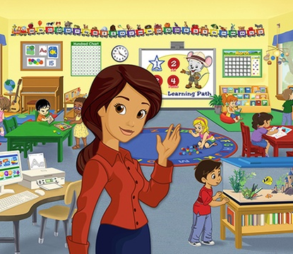
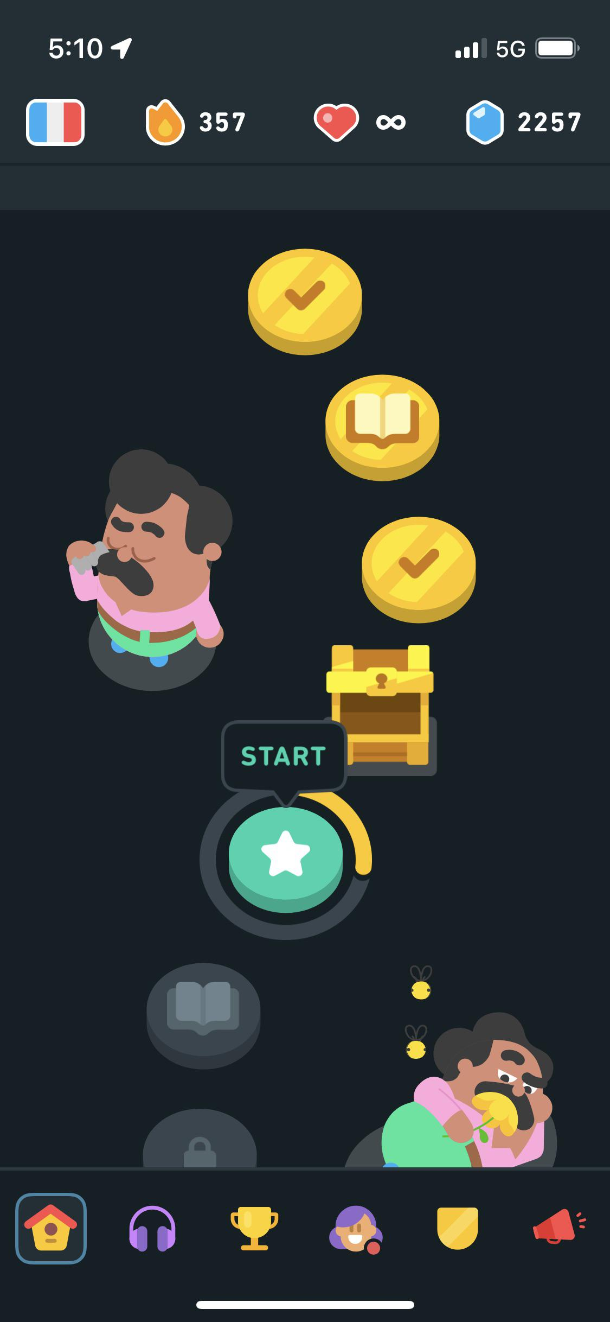
GAME-BASED LEARNING
Mario is Missing (SNES, 1992)
ABC Mouse (PC/Mac, 2010)
Duolingo (iOS/Android, 2012)

Slide 14
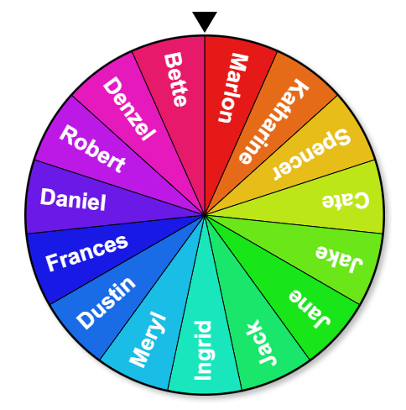

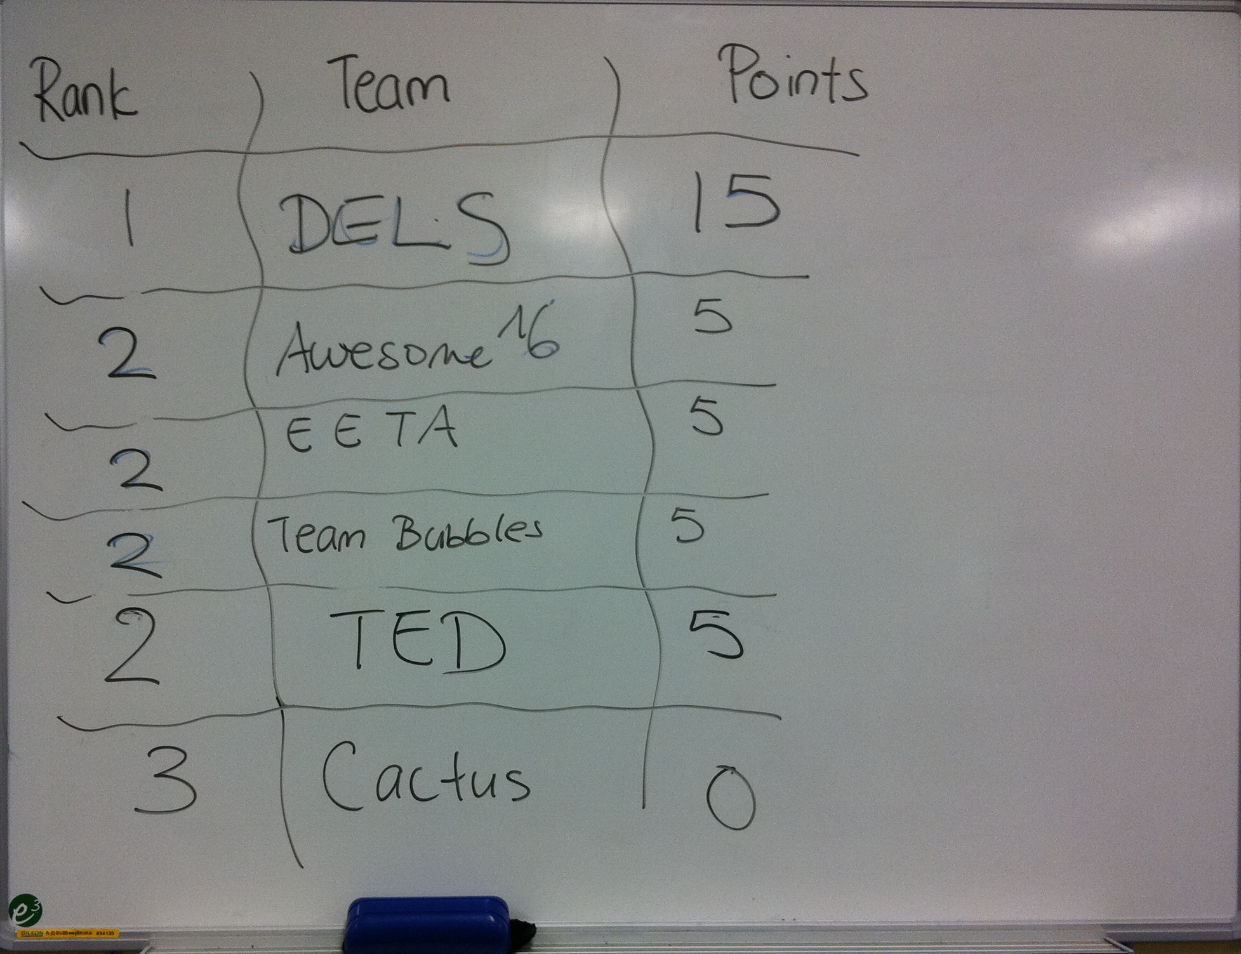
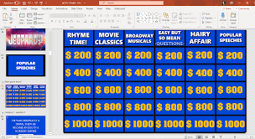
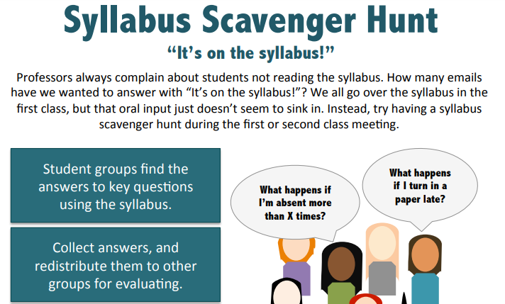
GAMIFIED LEARNING
Randomized Selection
Digital Badges
Leaderboards
Gamified Presentations
Course-related Mini-games

Slide 15
COMMON THEMES
REWARDS
COLLABORATION
ENGAGEMENT
Points, badges, and other incentives offer both extrinsic and intrinsic motivational approaches for students
Most games or activities can be adapted for learner groups
Increased motivation leads to increased engagement in the classroom and with course content

Slide 16


CUT THE WIRE
WHICH WIRE(S) DO YOU CUT? Clue: these videogames influenced the color scheme and design of this presentation
Super Mario Bros.
Pacman
Legend of Zelda
Fallout

Slide 17
CUT THE WIRE
WHICH WIRE(S) DO YOU CUT? Clue: these videogames influenced the color scheme and design of this presentation
Super Mario Bros.
Pacman
Legend of Zelda
Fallout

Slide 18
LEVEL 03
JOURNEY’S END – WHY GAMIFICATION

Slide 19
Success is a journey, not a destination. The doing is often more important than the outcome.
-Arthur Ashe

Slide 20
UNDERSTANDING THE JOURNEY
There is a difference between play-based gaming and serious gaming – educational gaming is often serious in nature.
Characteristics of engaging games:
Satisfies basic psychological needs, such as autonomy, competence, and relatedness
Appropriate level of difficulty (and becomes progressively challenging)
Goal-directed activities
Instant feedback
Sheltered practice
Time on task
Uncertainty of outcome
(Al-Hoorie, 2022)

Slide 21
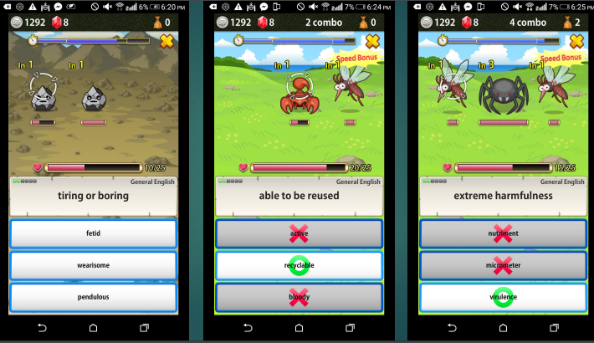
CHOOSING THE RIGHT PATH
Games-based teaching → games designed specifically for teaching
Both expensive and complicated to develop – often outsourced to commercial companies
May not interest students as their interests change over time
Research indicated a statistically significant increase in short- and long-term recall of vocabulary
(Al-Hoorie, 2022)
Notes:
Example: business simulations used in both BUSI 1301 Business Principles and BMGT 1327 Principles of Management

Slide 22
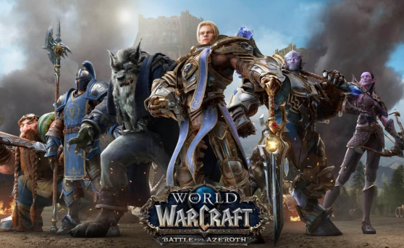
CHOOSING THE RIGHT PATH
Game-enhanced teaching → utilizing games not originally intended for education (a modified form of game-based learning)
Utilization of games such as Minecraft (multiple K12 examples exist)
Less expensive but all participants commonly have a licensing cost
Must ensure appropriateness with student age and culture
Often required interaction with strangers
Under-researched
Bytheway’s (2015) research indicated increased autonomous learning without teacher instruction
(Al-Hoorie, 2022)
Notes:
Example: use of Minecraft to support student learning of basic and intermediate computer programming

Slide 23


CRACK THE CODE
FIND THE RIGHT WORD TO CRACK THE CODE…
With more than 300 million copies sold, _________ is the most purchased video game in history.

Slide 24
CRACK THE CODE
FIND THE RIGHT WORD TO CRACK THE CODE…
With more than 300 million copies sold, _________ is the most purchased video game in history.
MINECRAFT

Slide 25

CHOOSING THE RIGHT PATH
Game-informed teaching → applying gamification principles in everyday instruction
Use of narrative, role-playing, simulation, or other gamification principles
Implementation of a specific time limit
Symbolic rewards (points, challenges, badges, etc.)
Most effective when both competition & cooperation exist (Sailer & Homner, 2020)
Research indicated a statistically significant decrease in student anxiety
(Al-Hoorie, 2022)
Notes:
This is the most common form of gamification in the college classroom (except at institutions who are funding game development as part of their research). It is likely that every instructor in the room has encountered this approach to teaching before and many may already use it to some extent!

Slide 26
BEGINNING THE JOURNEY
We must challenge the belief that students inherently want to avoid the laborious nature of learning
(Al-Hoorie, 2022; Reinhardt, 2019)
Notes:
This statement directs us to the importance of motivation – the single-most important factor in a student’s decision to pursue learning.

Slide 27
LEVEL 04
LEARNER MOTIVATION

Slide 28
CUT THE WIRE
WHICH WIRE(S) DO YOU CUT? Clue: the tendency to participate in an activity because it is fulfilling rather than for reward or punishment
Incentive Motivation
Extrinsic Motivation
Achievement Motivation
Intrinsic Motivation

Slide 29
CUT THE WIRE
WHICH WIRE DO YOU CUT? Clue: the tendency to participate in an activity because it is fulfilling rather than for reward or punishment
Incentive Motivation
Extrinsic Motivation
Achievement Motivation
Intrinsic Motivation

Slide 30
GAMIFICATION FRAMEWORK
Must start with effective planning:
What is being gamified?
Why is it being gamified?
Who are the users?
Then progress toward design:
How is it being gamified (3-Level Model)
Feedback loop (analytics, testing, action, and release of solution leads to continuous improvement)
Primary Considerations
The goal is intrinsic motivation – extrinsic rewards are designed to develop long-term, intrinsic motivation
Allow voluntary participation when possible
Plan for cheaters
Remember the fun
Encourage sociability
(Marczewski, 2014)

Slide 31
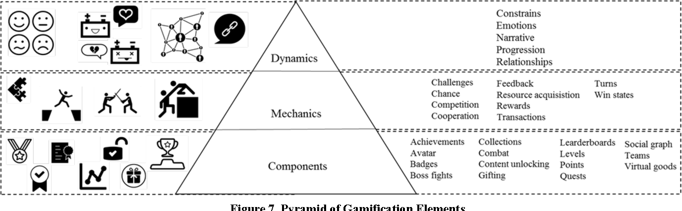
3-LEVEL MODEL
(Werbach & Hunter, 2015)
Notes:
This seems complicated, but is quite logical. The model describes both the process and practice of applying game-based elements to a given environment. More specifically, the model describes “how” we gamify course content. Let’s look at the game of Monopoly – you know, the game that has been destroying family nights since 1906. At the heart of the game are a few components listed in this diagram:
Collections – the goal is to collect as many property cards as possible because they generate money. This is enhanced by the collection of houses and hotels.
Points – while Monopoly doesn’t award points, you get money every time someone lands on your properties (and from a few chance events).
Leaderboards – while there is no official leaderboard, it doesn’t take much to see who has a stack of property cards and a handful of cash…
The components are utilized alongside certain game mechanics: monopoly is turn-based (for the sake of fairness), is driven by competition, and transactions are the single most important metric in determining success. Each of these feed the competitive nature of the game.
These factors feed forward to the dynamics of the game:
Progression – progression is easily tracked by the amount of money or properties
Relationships – the competitive nature of the game results in alliances that rise and quickly fall as players adapt their strategy
Constriants – while progression is most often possible, players are constrained by turn, luck of the roll, and available resources
Emotions – Boyce’s family can’t play Monopoly (or Phase 10) at game night anymore…enough said.

Slide 32
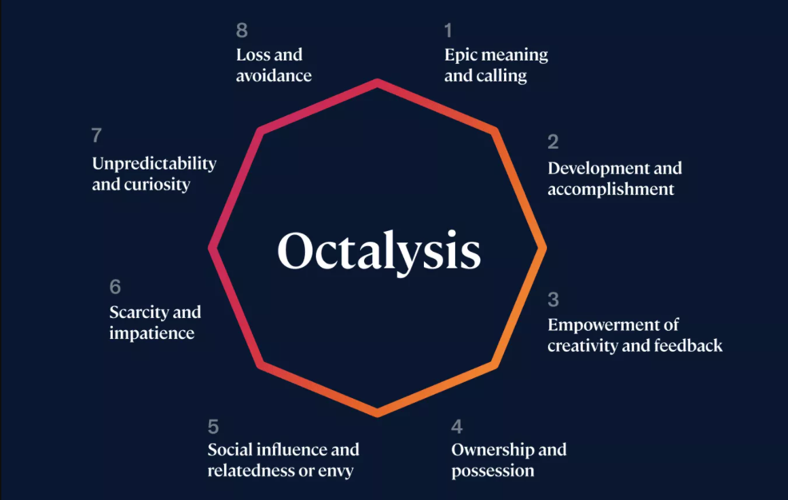
OCTALYSIS MODEL
(Chou, 2023)
Notes:
Chou’s model depicts 8 distinctive motivation drives for those who play games. These drives, however, are not unique to gamers – they likely exist and are being addressed in your own classrooms. For instance, some students are driven for Development and accomplishment. These are the students who thrive when they see grades released that meet their expectations. The drive for empowerment of creativity and feedback is often addressed by innovative classroom projects, such as Becky Parker’s pencil box project. Social influence and relatedness (or envy) is often experienced among online discussion boards – some students desire the direct engagement by faculty or other students. They want others to know they are “right” or “on track.” Lastly, loss and avoidance are alive in every class at MCC – students desire to avoid failure. This drives them to complete work, and in certain circumstances, cheat on an assignment or test in an attempt to prevent failure.

Slide 33
OCTALYSIS MODEL
EXTRINSIC
INTRINSIC
(Chou, 2023)

Slide 34
DESIGNING YOUR GAMES
Focus on the intrinsically motivated students first!
Constantly monitor for cheaters – they will decimate the motivation created by the game for others
Remember that not all rewards are meaningful (and not all rewards need to be costly) – think of the student
Start simple!
(Chou, 2024)

Slide 35
LEVEL 05
GET STARTED GAMING

Slide 36







TOOLS & TOYS
KAHOOT
MIRO
BADGES & CERTIFICATES
H5P
WAKELET
LIFEWIRE
Digital or printed materials that students can keep
Simple digital quizzes for in-class or for study time
Interactive whiteboard platform
Embeddable, custom content for individual study
Online, interactive scavenger hunts
Free downloadable templates for different gameshows

Slide 37
DRAWBACKS
Can be hard to find the “sweet spot” – the area between being “too gamified” and “too difficult” (Loftus & Loftus, 1983)
Rigid textbooks or overly compacted classes can limit the instructor’s ability to implement gamified learning
A lack of resources can also limit the development of gamified lesson content – gamification takes significant time, effort, ingenuity, and passion. Often, our initial ideas are unachievable due to limited knowledge or funding – this is where innovation plays a key role!
Gamification does not guarantee learner success (Zaric et al., 2021) – it is one of many tools in the proverbial toolbox

Slide 38
CRACK THE CODE
FIND THE RIGHT WORD TO CRACK THE CODE…
Gamification takes significant time, effort, ingenuity, and _______

Slide 39
CRACK THE CODE
FIND THE RIGHT WORD TO CRACK THE CODE…
Gamification takes significant time, effort, ingenuity, and _______
PASSION

Slide 40
CRACK THE CODE
FIND THE RIGHT WORD TO CRACK THE CODE…
Chou’s _________ model introduced four practical motivation drives in relation to gamified learning.

Slide 41
CRACK THE CODE
FIND THE RIGHT WORD TO CRACK THE CODE…
Chou’s _________ model introduced eight practical motivation drives in relation to gamified learning.
OCTALYSIS

Slide 42
CRACK THE CODE
FIND THE RIGHT WORD TO CRACK THE CODE…
According to Marczewski, gamification efforts must begin with effective ________

Slide 43
CRACK THE CODE
FIND THE RIGHT WORD TO CRACK THE CODE…
According to Marczewski, gamification efforts must begin with effective ________
PLANNING

Slide 44

OUR WINNER IS…

Slide 45
IN CASE YOU WERE WONDERING
MODIFIED TRUE/FALSE
THIS OR THAT
2 choices – pick one!
CUT THE WIRE
MULTIPLE CHOICE
4 wires – cut the right one to save your team!
CRACK THE CODE
JEOPARDY-STYLE (SHORT ANSWER)
Only the correct answer opens the door!

Slide 46
Questions?
Anna Contreras
MCC Honors Student
sc0507116@students.mclennan.edu
Boyce Wilson
Associate Professor, Business Programs
(254) 299-8688
mwilson@mclennan.edu
References are included in the handout provided in Basecamp

