Slide 1
Leading without a Title
Everyday Leadership for Faculty & Staff

Slide 2
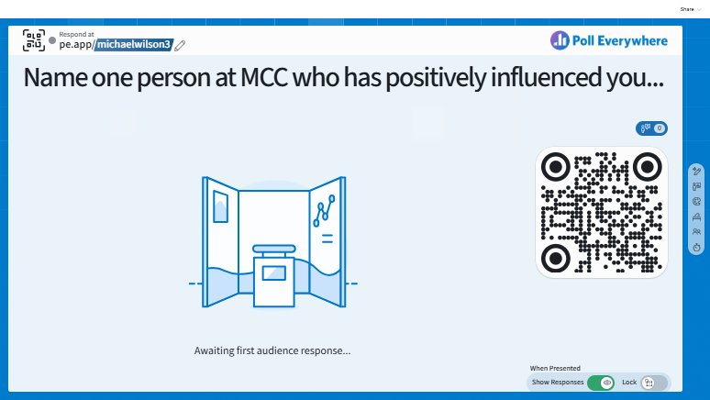

Slide 3
A Practical Reflection
For the person you identified…
  Were they in a formal leadership position?
  What behaviors made them influential?

Slide 4
A Practical Reflection
For the person you identified…
  Were they in a formal leadership position?
  What behaviors made them influential?
Leadership is not defined by title – it is defined by influence!

Slide 5
Current Challenges
Burnout and disengagement among faculty and staff (Maslach & Leiter, 2016; Gallup, 2023)
Organizational trust and psychological safety
  Change leads to uncertainty
Cultural fragmentation

Slide 6
Research Shows…
Informal leadership significantly impacts organizational climate (Hoch et al., 2018)
Employees who feel empowered demonstrate higher engagement and retention (Gallup, 2023)
Psychological safety predicts team performance (Edmondson & Lei, 2014)

Slide 7
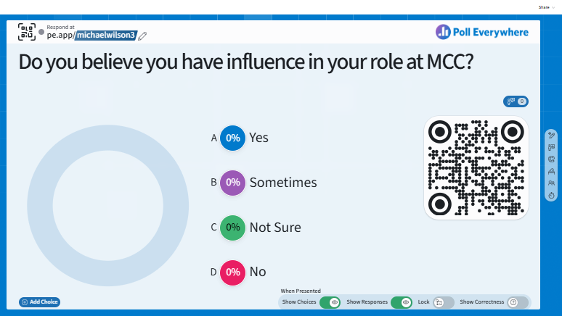

Slide 8
Maxwell’s 5 Levels of Leadership
Position – people follow because they have to
Permission – people follow because they want to
Production – people follow because of what you accomplish
People Development – people follow because of what you do for them
Pinnacle – people follow because of who you are

Slide 9
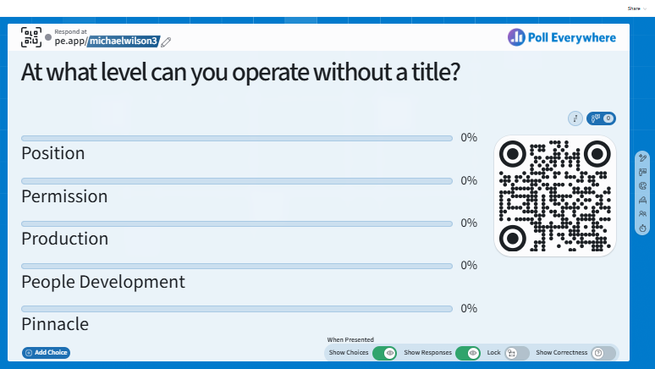

Slide 10
Practical Leadership
1. Modeling Integrity & Competence
  Transformational leadership behaviors increase trust and motivation (Hoch et al., 2018)
  Credibility builds influence

Slide 11
Practical Leadership
2. Building Psychological Safety
  Psychological safety encourages collaboration and innovation (Edmondson & Lei, 2014)
  Behaviors matter: listening, affirming, acknowledging ideas, etc.

Slide 12
Practical Leadership
3. Demonstrating Organizational Citizenship Behaviors (OCB)
  OCB predicts positive organizational culture (Podsakoff et al., 2009)
  Simplicity and consistency matter:
    Helping others
    Volunteerism
    Supportive behaviors

Slide 13
Barriers to Leadership
“It’s not my job…”
Fear of overstepping
Imposter syndrome
Burnout and task overload
Empowerment climates reduce role ambiguity and increase proactive behavior (Seibert et al., 2011)

Slide 14
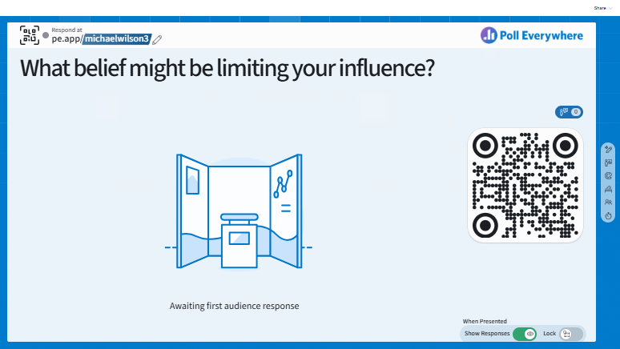

Slide 15
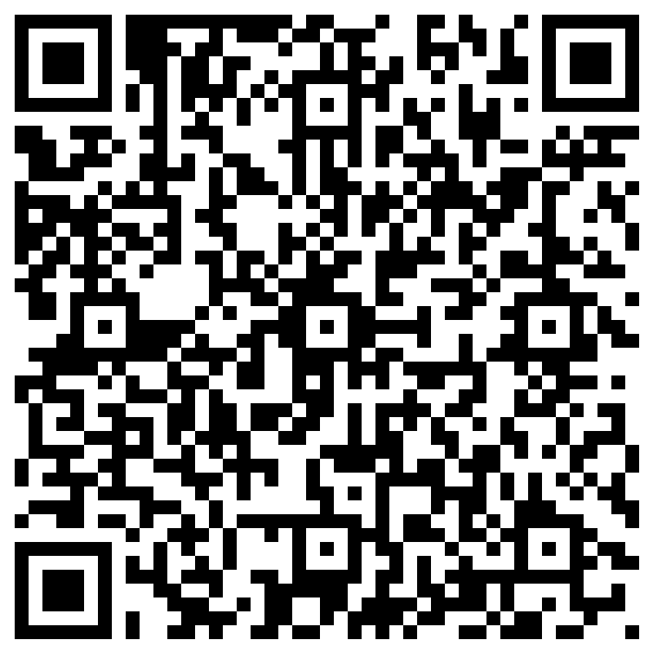
Planning Leadership Influence
One relationship to strengthen
One behavior to model
One initiative

Slide 16
To Conclude…
Leadership is cultural and situational, not positional
Influence compounds across the campus community
Everyday actions shape MCC’s student experience

Slide 17
To Conclude…
Leadership is cultural and situational, not positional
Influence compounds across the campus community
Everyday actions shape MCC’s student experience
Leadership develops daily – not in a day
~ John Maxwell

Slide 18
References
Edmondson, A. C., & Lei, Z. (2014). Psychological safety: The history, renaissance, and future of an interpersonal construct. Annual Review of Organizational Psychology and Organizational Behavior, 1, 23–43. https://doi.org/10.1146/annurev-orgpsych-031413-091305
Gallup. (2023). State of the global workplace 2023 report. Gallup Press.

Slide 19
References
Hoch, J. E., Bommer, W. H., Dulebohn, J. H., & Wu, D. (2018). Do ethical, authentic, and servant leadership explain variance above and beyond transformational leadership? A meta-analysis. Journal of Management, 44(2), 501–529. https://doi.org/10.1177/0149206316665461
Maslach, C., & Leiter, M. P. (2016). Burnout. Wiley.
Maxwell, J. C. (2011). The 5 levels of leadership: Proven steps to maximize your potential. Center Street.

Slide 20
References
Podsakoff, P. M., MacKenzie, S. B., Paine, J. B., & Bachrach, D. G. (2009). Organizational citizenship behaviors: A critical review and recommendations for future research. Journal of Management, 26(3), 513–563.
Seibert, S. E., Wang, G., & Courtright, S. H. (2011). Antecedents and consequences of psychological and team empowerment. Journal of Applied Psychology, 96(5), 981–1003. https://doi.org/10.1037/a0022676

Slide 21
