Slide 1
The Art of Internships
Experiential Learning
Presented by:
Boyce Wilson
Associate Professor, Business Management

Slide 2
Objectives
Explore the value of internships
Review the Business Management internship program
Discuss enhancements to internship curricula to improve student outcomes in other academic areas

Slide 3
The Value of Internships
MCC
Student
Employer

Slide 4
The Value of Internships
MCC
3 hours of course credit (per internship) that aligns directly with the student’s degree plan Earn credit without sacrificing work time
Assistance in establishing direction and training standards for employee training programs
Student
Employer

Slide 5
The Value of Internships
MCC
Initial formation of college- employer relationships based on student’s employment
Student
Employer
Creation of direct value for the employer through work performed during the internship

Slide 6
The Value of Internships
MCC
Continued relationship and identification of industry trends and skill-based needs
Student
Employer
Increased social and professional capital for the employee – value is seen and experienced rather than solely perceived

Slide 7
Success Stories
Tamara T. – billing delinquency prevention at BSW (~20% reduction in delinquent payments)
Cory T. – fundraising event for Aggieland Humane Society ($30,000+ raised)
Corey P. – revision of task training practices ($230,000 operational cost savings/year)

Slide 8
Success Stories
Christine M. – promotion from teller to supervisor
Mark T. – promotion from shift supervisor to operations manager
Anastacia J. – promotion from model to store manager

Slide 9
Management Internships
A Look at Current Practices

Slide 10
Internship Requirements
This may be a paid or unpaid experience.
This course may be repeated if topics and learning outcomes vary.
The work environment is arranged by the student – placement is not offered by MCC.

Slide 11
Internship Requirements
Concerns one of the four functions of management
Creates value for the organization being served.
Provides the student with a learning experience.
Work effort on the project is sufficient to earn three hours of college credit; approximately 120 hours.

Slide 12
Minimum Deliverables
Complete, correct, and signed training plan
Complete journal at the conclusion of the project that accounts for all required hours
Written report or verbal presentation on the experience

Slide 13
Generic Semester Calendar
Weeks 1-4
Development of the training plan
Weeks 5-14
Project-related work in accordance with the training plan
Weeks 15-16
Submission of final course documentation

Slide 14
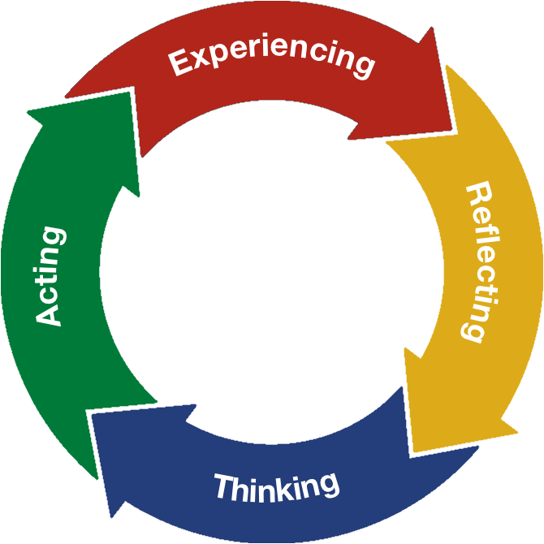
The Internship Model
Kolb, D. A. (1984). Experiential learning: Experience as the source of learning and development. Prentice Hall.

Slide 15
The Internship Model
Management
Explore
Observe
Perform
-OR-
Six Sigma
Define
Measure
Analyze
Improve
Control
Measure

Slide 16
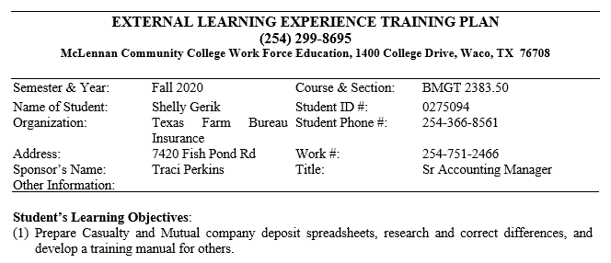
The Training Plan
*Recommend no more than 2 objective
*Student should work with supervisor to determine what skills are to be learned or what problem is to be addressed

Slide 17
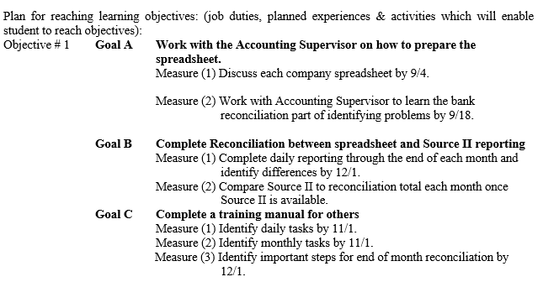
The Training Plan
*Minimum of 3 goals (follows either the Explore, Observe, Perform method or DMAIC)
*Minimum of 2 measurable milestones for each goal

Slide 18
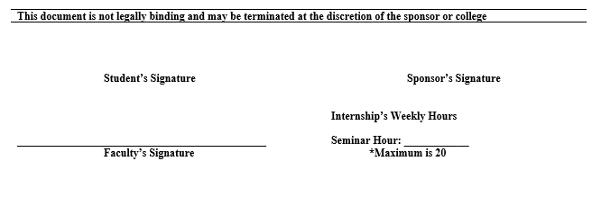
The Training Plan
*Physical signatures are required at present time
*Digital signatures may be acceptable as well, depending on the instructor

Slide 19
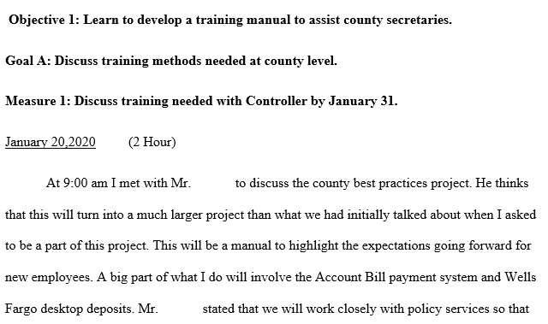
The Journal
*entries separated by measure
*an entry is to be made every time the student works on their project – multiple entries may be necessary if multiple measures were addressed

Slide 20
The Journal
Explain exactly what you did and how long it took.
Who else was there; who helped you; who showed you?
Did it take longer than expected, shorter?
Was it harder than expected, easier than expected?
Did it go smoothly and easily, or were there problems?
What were your thought processes as you were working on this measurement?
What were your feelings at the time of working on this measurement?

Slide 21
Credit Worthiness
Final Project Report (w/ peer review)
15+ pages (not including supporting documentation)
Reflective and analytical in nature
Addresses content of project, what was learned, how the project could have been improved upon, what knowledge/skills/abilities were developed, and what value was created for the company or organization
Final Project Presentation
Poster board visual
Presentation addresses the same content as the written report

Slide 22
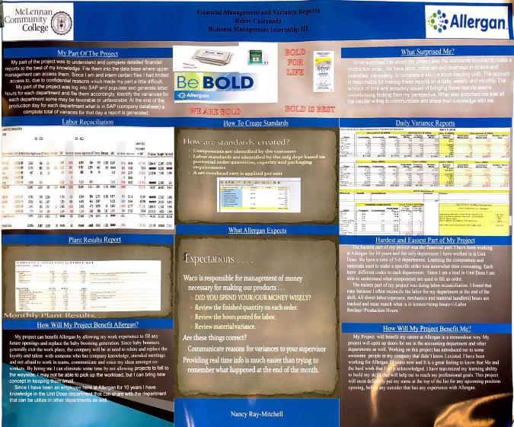
Example Poster

Slide 23
Getting More from the Experience
Value-added Assignments and Activities

Slide 24
Added Value through Assignments
Memo to Supervisor
Formal, written communication to express appreciation and to follow-up after the approval of the training plan
Resume & Mock Interview
Organized presentation of information, industry research (O*Net Online), and interpersonal communication
Student Portfolio
Collection of skill-centric work to demonstrate proficiencies

Slide 25
Added Value through Assignments
Poster Presentations
Development of presentation and visual materials to articulate value of experiences to others
Project Binder
Promotes organizational skills while ensuring that all necessary information is maintained and presented appropriately
Discussion Boards or Article Reviews
Maintain class engagement while encouraging research and writing skills

Slide 26
More on Discussions…
Interns I Interns II Interns III
Time Management
Stress Management
Bullies at Work
Interpersonal Communication
Sexual Harassment
Introverts & Extroverts
Negotiation Skills
Crisis Management Skills
Business Presentation Skills
Meeting Management Skills
Employee Correction Skills
Risk Management Skills
Metacognition
Sleep’s Effect*
Stress’ Effect*
Emotions’ Effect*
Exercise’s Effect*
Positive/Negative Thoughts’ Effect*
* Effect on the Brain

Slide 27
It’s Not All Positive
Think Before You Jump…

Slide 28
Drawbacks
Cannibalization
Student enrollment in internships will cannibalize enrollment in alternative courses
Workload
Internships require significant 1:1 engagement between student and faculty – this takes a significant amount of time
Compensation
Internships pay differently than traditional classes – faculty must buy into the mission, not the compensation

Slide 29


