Slide 1
Burnout to Brilliance
Reigniting Passion for Teaching and Serving Students

Slide 2
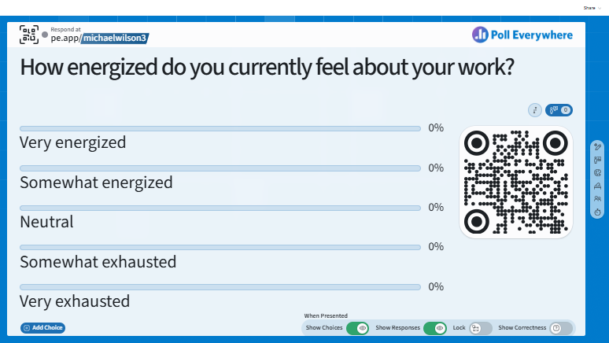

Slide 3
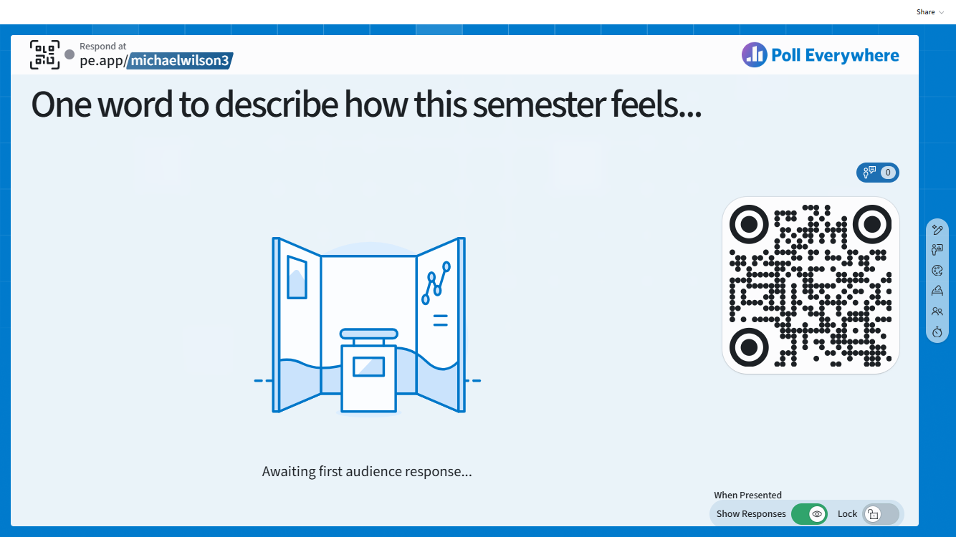

Slide 4
Framing the Discussion
What we do is purpose-driven work.
“…improving [student’s] lives and enriching our community.”
~ excerpt from MCC’s Mission Statement

Slide 5


An Anecdote
Began as an adjunct in August 2016 (average 2 classes per semester)
Left HOTCOG’s Homeland Security/Emergency Preparedness Division to join MCC full-time in August 2018
Promoted to program director in August 2023
Quietly packed my office and submitted notice that I would not be renewing my contract in May 2024

Slide 6
Defining Burnout
A distinct syndrome resulting from chronic, unmanaged workplace stress
Characterized by:
Overwhelming exhaustion
Cynicism and detachment
Sense of ineffectiveness or reduced accomplishment
Burnout is not weakness – it is a predictable response to chronic workplace stress
That which is predictable is also preventable and recoverable!
(Maslach et al., 2001)

Slide 7
The Science of Burnout
Job Demands-Resources (JD-R) Model
Burnout occurs when job demands exceed job resources
Resources (autonomy, support, recognition, etc.) buffer stress
Mismatch Model
Burnout stems from mismatches in:
Workload
Control
Reward
Community
Fairness
Values
(Bakker & Demerouti, 2007)
(Maslach & Leiter, 2017)

Slide 8
You Are Not Alone!
Increase in educator stress post-pandemic (Pressley, 2021)
Emotional labor is linked to higher exhaustion levels
Role overload and lack of autonomy are key predictors(Skaalvik & Skaalvik, 2017)

Slide 9
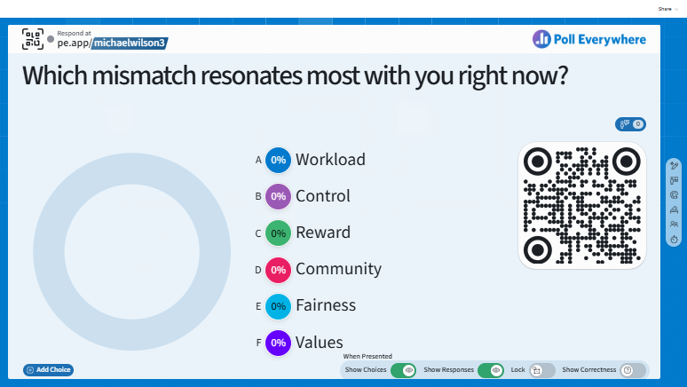

Slide 10
Reframing Burnout: A Leadership Perspective
Organizational culture strongly influences burnout (Maslach & Leiter, 2017)
Psychological safety mitigates emotional exhaustion
Servant leadership is linked to increased employee well-being, as it is rooted in care (Eva et al., 2019; Greenleaf, 1977)

Slide 11
Reflection…
Why did I pursue this career?
What impact did I hope to make?

Slide 12
Reflection…
Why did I pursue this career?
What impact did I hope to make?
Has that purpose changed – or just become buried?

Slide 13
Making the Comeback
Strategy 1: Rebuild Autonomy
Autonomy is one of the strongest predictors of engagement (Bakker & Demerouti, 2007)
Identify 1 decision you can reclaim this semester
Establish micro-boundaries (email cut-off times, grading blocks, etc.)
Decision Point:
What is one small boundary you can implement next week?

Slide 14
Making the Comeback
Strategy 2: Reconnect to Impact
Meaningful work reduces burnout symptoms (Allan et al., 2019)
Keep a brilliance folder with student emails, breakthrough moments, thank you notes, etc.
Journal to recognize the small wins
Reflect:
What is one small win that you have from this week?

Slide 15
Making the Comeback
Strategy 3: Energy Management over Time Management
Sustainable performance is dependent on renewal cycles (Loehr & Schwartz, 2003)
90-minute focus blocks
Walking meetings (or lunch meetings)
Device-free decompression
Decision Point:
When is your peak energy time? What high-impact task can you fit in that window of opportunity?

Slide 16
Making the Comeback
Strategy 4: Build Professional Community
Collegial support reduces depersonalization (Skaalvik & Skaalvik, 2017)
Psychological safety enhances collaboration (Edmondson, 2018)
Accountability partnerships
Normalize asking for help
Reflect:
What prevents you from leaning into community?

Slide 17
A New Mindset
Burnout is not failure – it is an indicator that something needs adjusting
Brilliance is not perfection. Rather, it is:
Sustainable energy
Aligned purpose
Healthy boundaries
Renewed impact

Slide 18
Closing Thought…
If a student remembers you in 5 years, what would you want them to say?

Slide 19
References
Allan, B. A., Batz-Barbarich, C., Sterling, H. M., & Tay, L. (2019). Outcomes of meaningful work: A meta-analysis. Journal of Management Studies, 56(3), 500–528. https://doi.org/10.1111/joms.12406
Bakker, A. B., & Demerouti, R. (2007). The Job Demands-Resources model: State of the art. Journal of Managerial Psychology, 22(3), 309-328. https://doi.org/10.1108/02683940710733115
Edmondson, A. (2018). The Fearless Organization: Creating Psychological Safety in the Workplace for Learning, Innovation, and Growth. Wiley.

Slide 20
References
Eva, N., Robin, M., Sendjaya, S., van Dierendonck, D., & Liden, R. C. (2019). Servant leadership: A systematic review and call for future research. The Leadership Quarterly, 30(1), 111–132. https://doi.org/10.1016/j.leaqua.2018.07.004
Greenleaf, R. K. (1977). Servant Leadership: A Journey into the Nature of Legitimate Power and Greatness. Paulist Press.
Loehr, J., & Schwartz, T. (2003). The Power of Full Engagement: Managing Energy, Not Time, Is the Key to High Performance and Personal Renewal. Free Press.

Slide 21
References
Maslach, C., Schaufeli, W. B., & Leiter, M. P. (2001). Job burnout. The Annual Review of Psychology, 52, 397-422.
Maslach, C., & Leiter, M. P. (2017). Understanding burnout: New models. In The Handbook of Stress and Health: A Guide to Research and Practice (1st Ed.). John Wiley & Sons, Ltd.
Pressley, T. (2021). Factors contributing to teacher burnout during COVID-19. Educational Researcher, 50(5), 325-327. https://doi.org/10.3102/0013189X211004138
Skaalvik, E. M, & Skaalvik, S. (2017). Motivated for teaching? Associations with school goal structure, teacher self-efficacy, job satisfaction and emotional exhaustion. Teaching and Teacher Education, 67, 152-160. https://doi.org/10.1016/j.tate.2017.06.006

Slide 22
