Slide 1
Unit 8:
Course Summary

Slide 2
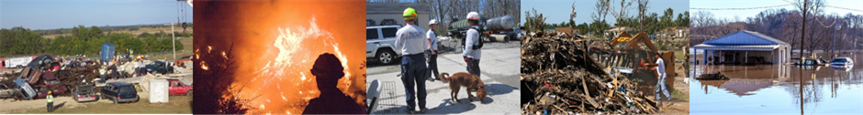
Unit Terminal Objective
Summarize the course objectives.
Visual 8.2

Slide 3
Unit Enabling Objective
  Identify key discussion topics from the course.
Visual 8.3

Slide 4
Review Course Objectives
  Given a simulated situation, identify roles and reporting relationships under a Unified Command that involves agencies within the same jurisdiction and under multijurisdictional conditions. (Unit 2)
  Develop incident objectives for a simulated incident. (Unit 3)
  Create an ICS Form 215, Operational Planning Worksheet, and an ICS Form 215A, Incident Action Plan Safety Analysis, using the strategies and tactics from a given scenario. (Unit 4)
  Create a written IAP for an incident/event using the appropriate ICS forms and supporting materials, and use the IAP to conduct an operational period briefing. (Unit 5)
  Explain the principles and practices of incident resources management. (Unit 6)
  Identify demobilization considerations for a given scenario. (Unit 7)
Visual 8.4

Slide 5
Review Course Expectations
Did the course meet your expectations?
Did the course meet your expectations?
Visual 8.5

Slide 6
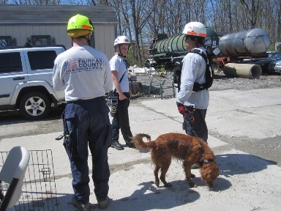
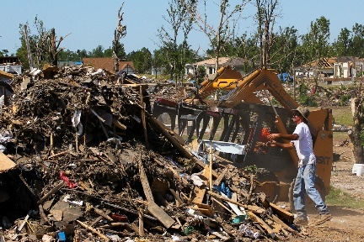
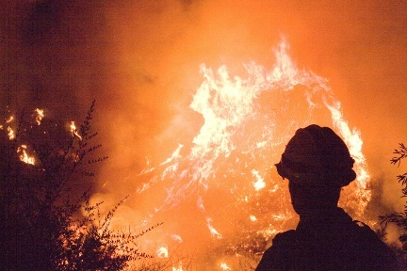
Final Exam
Visual 8.6

Slide 7

Feedback
Please complete:
  ICS Form 214 for the final day of training
  Overall Course Evaluation
Visual 8.7

