Slide 1
Unit 7:
Demobilization, Transfer of Command, Closeout, and Transition to Recovery

Slide 2
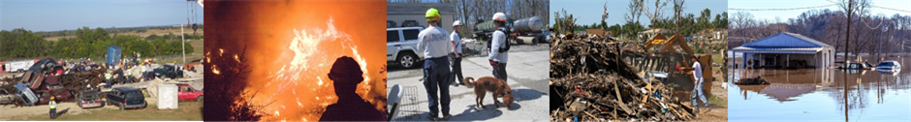
Unit Terminal Objective
Identify demobilization considerations for a given scenario.
Visual 7.2

Slide 3
Unit Enabling Objectives
  Explain the importance of demobilization planning.
  Identify the impact of agency-specific policies, procedures, and agreements upon demobilization planning.
  Identify the ICS titles of personnel who have responsibilities in developing and implementing the Demobilization Plan.
  List the major sections in a Demobilization Plan.
  Identify the need for transfer of command or closeout.
  Explain the process involved in a closeout meeting.
  Explain the transition from Response to Recovery.
Visual 7.3

Slide 4

Demobilization
  The release and return (or reassign) of resources that are no longer required.
  Incident staff must collaborate to plan how resources are managed.
  It may occur at any time during the life cycle of the incident/event.
Visual 7.4

Slide 5
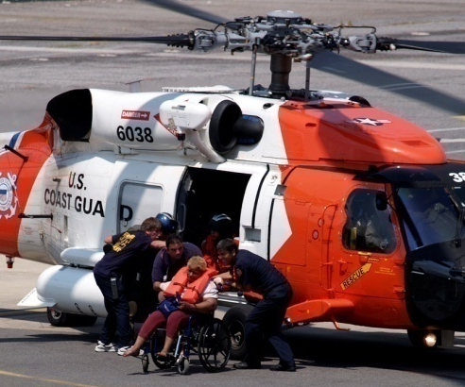
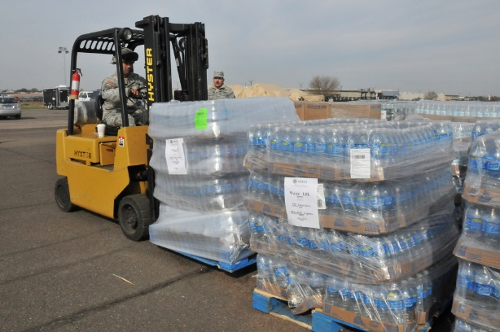
Demobilizing Nonexpendable and Expendable Resources
Nonexpendable Resources
  Account for resources returned.
  Restore resources to functional capability.
  Replace broken and/or lost items.
Expendable Resources
  Account for resources used.
  Reimburse for expendable items used.
  Return and restock items.
Visual 7.5

Slide 6
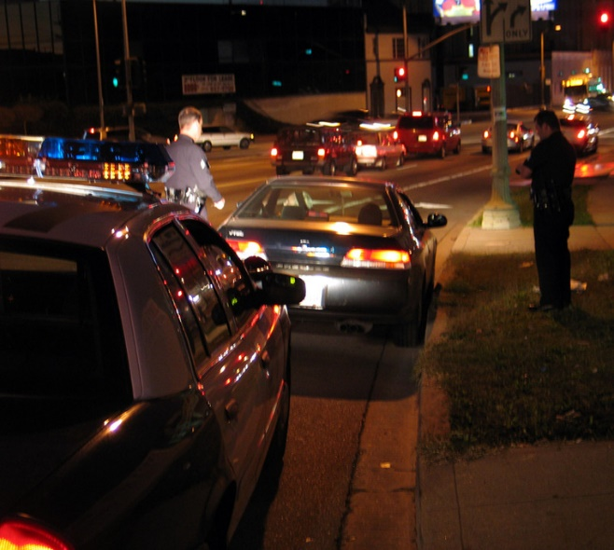
Demobilization Challenges
Planning for demobilization is often overlooked, leading to problems such as disgruntled responders or tragic accidents en route home.
As incidents wind down,
personnel may be anxious to return
home.
Fiscal concerns require
verification of total time that a
resource is assigned to an incident.
Any non-expendable supplies that
were provided to incident must be returned.
Sufficient rest provided to personnel before driving home.
Visual 7.6

Slide 7

Demobilization Planning Benefits
Demobilization planning helps to:
  Ensure a safe, controlled, efficient, and cost-effective release process.
  Eliminate waste.
  Eliminate potential fiscal and legal impacts.
Visual 7.7

Slide 8
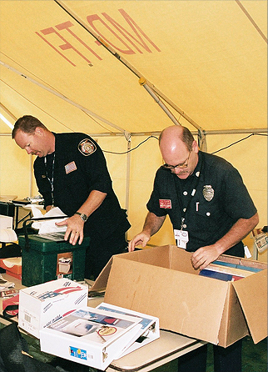
Agency Policies and Procedures
Demobilization policies and procedures depend on size of incident and may involve:
  Fiscal/legal policies and procedures.
  Work rules.
  Special license requirements.
  Other requirements.
Visual 7.8

Slide 9
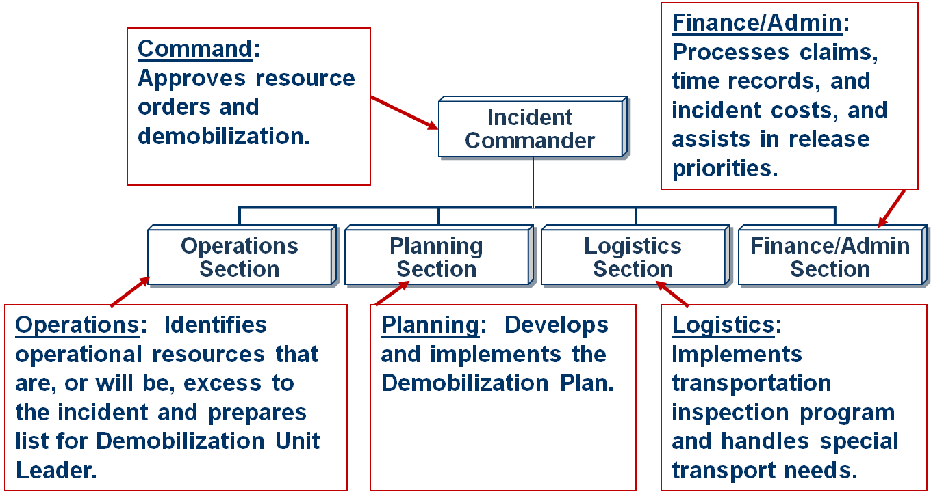
Demobilization: Who Does What?
Visual 7.9

Slide 10
Demobilization Plan: Information Needs
What Information Is Needed? | Who Provides?
Excess resources; release priorities | All supervisory personnel
Plan development; resource information; demobilization process | Planning Section
Continuing needs for tactical resources | Operations Section
Transportation availability; communications; maintenance | Logistics Section
Claims, time records, and costs of individual resources that are a factor in release | Finance/Admin Section
Agreements regarding other agency resources | Liaison Officer
Physical condition of personnel; physical needs; adequacy of transportation | Safety Officer
Return and reassignment of resources | Agency Dispatch/Ordering Centers
Visual 7.10

Slide 11

Demobilization Plan Sections
Handout 7-1: Sample Demobilization Plan
General Information
Responsibilities
z
Release Procedures
zz
Demobilization Plan
Release Priorities
Travel Information
Handout 7-1: Sample Demobilization Plan
Visual 7.11

Slide 12
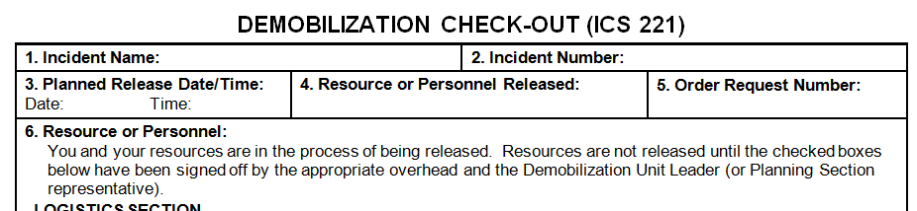
ICS Form 221, Demobilization Check-Out
ICS Form 221 ensures that resources checking out of the incident have completed all appropriate incident business, and provides the Planning Section information on resources released from the incident.
Visual 7.12

Slide 13
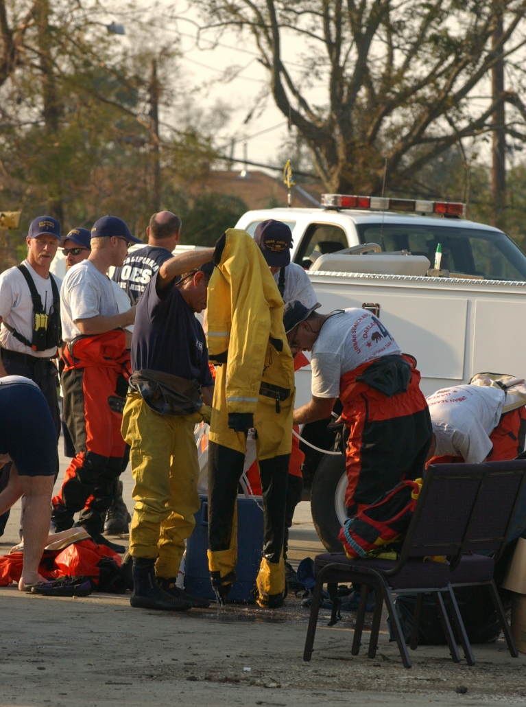
Transfer of Command in Stabilizing or De-Escalating Incidents
When an incident stabilizes or de-escalates:
  The IMT type may be reduced, and
  The need for a transfer of command may occur if the Agency Administrator agrees.
Visual 7.13

Slide 14

Incident Command and Closeout
The Incident Commander position will remain staffed until the conclusion of the incident.
Team demobilization may include a formal “closeout” with the Agency Administrator.
Visual 7.14

Slide 15
Agency Administrator Closeout Meeting
An AA closeout meeting includes the following information:
  Incident summary.
  Major events that may have lasting ramifications.
  Documentation, including components that are not finalized.
  Opportunity for the agency officials to bring up concerns.
  Final evaluation of incident management by the agency executive/officials.
Visual 7.15

Slide 16
Agency Administrator Closeout
Think about the ongoing
scenario from the past units. Given this scenario, what agenda items would you include in a closeout briefing?
Visual 7.16

Slide 17
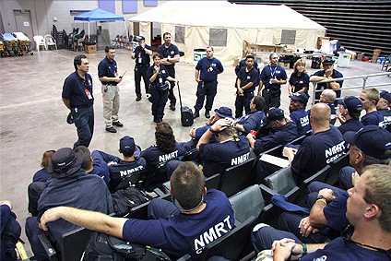
Team Closeout Meeting
  IMTs or other teams may hold a closeout meeting to discuss team performance.
  These meetings (aka After-Action Review) may result in “lessons learned” summary report.
Visual 7.17

Slide 18
Conducting an After-Action Review
An after-action review answers the following questions:
  What did we set out to do?
  What actually happened?
  Why did it happen?
  What are we going to do differently next time?
  Are there lessons learned that should be shared?
  What follow-up is needed?
  Handout 7-2: AAR Tips
Handout 7-2: AAR Tips
Visual 7.18

Slide 19
Activity 7.1: Applied Activity
Allotted Time: 30 minutes
Visual 7.19

Slide 20

Definition: Recovery
  Recovery is focused on a timely restoration, strengthening, and revitalization of:
  Infrastructure.
  Housing.
  Sustainable economy.
  Health, social, cultural, historic, and environmental fabric of communities affected by a catastrophic incident.
  Source: National Preparedness Goal
Visual 7.20

Slide 21
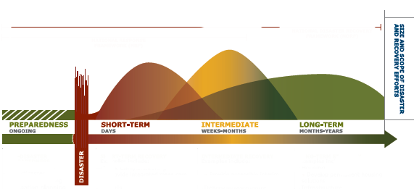
Transition to Recovery
At what point does recovery start?
Handout 7-3: Recovery Continuum
Handout 7-3: Recovery Continuum
Visual 7.21

Slide 22
Recovery Core Capabilities
The National Preparedness Goal identifies eight Core Capabilities for Recovery:
  Planning
  Public Information
  and Warning
  Operational Coordination
  Economic Recovery
Health and Social Services
Housing
Infrastructure Systems
Natural and Cultural Resources
Visual 7.22

Slide 23
Recovery Support Functions
Organizational structures for key functional areas.
Outlined in the National Disaster Recovery Framework.
Promote effective recovery from disasters before and after disasters strike.
Visual 7.23

Slide 24
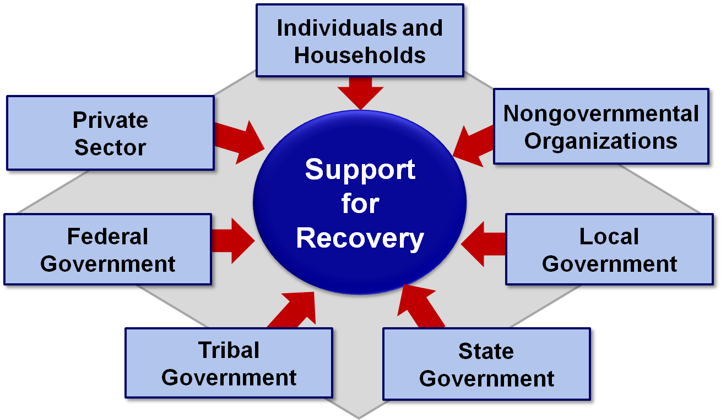
Whole Community Partnership
Visual 7.24

Slide 25
Objectives Review
  Why is planning for demobilization important?
  What are the impacts of agency-specific policies and procedures on demobilization planning?
  Who is responsible for developing and implementing the Demobilization Plan?
  What are the 5 sections of the Demobilization Plan?
  When does transfer of command occur?
  What is the process of the closeout meeting?
  Explain the transition from Response to Recovery.
Visual 7.25

