Slide 1
Unit 6:
Incident Resource Management

Slide 2
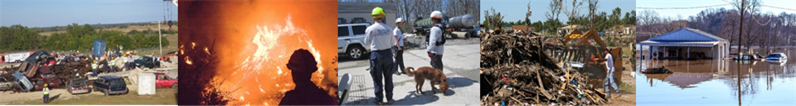
Unit Terminal Objective
Explain the principles and practices of incident resources management.
Visual 6.2

Slide 3
Unit Enabling Objectives
  Identify the progression and associated considerations involved in the Incident Resource Management Process.
  Recall the authorities or organizational elements that can order resources.
  Contrast the differences and motives between single-point and multipoint resource ordering.
Visual 6.3

Slide 4
Unit Enabling Objectives (Cont.)
  Explain the scope and purpose of an Incident Management Team.
  Explain the evaluation process for resources.
  Choose interventions for common resource performance issues.
Visual 6.4

Slide 5
NIMS Resource Management Preparedness
Two parts of Resource Management process:
  Preparedness
  During an Incident
Preparedness tasks:
Identifying and Typing Resources
Qualifying, Certifying, and Credentialing Personnel
Planning for Resources
Acquiring, Storing, and Inventorying Resources
Mutual Aid Agreements and Compacts
Visual 6.5

Slide 6
Resource Management During an Incident
Visual 6.6

Slide 7
Identify Requirements
Visual 6.7

Slide 8
Evaluating Resource Needs
  Initial incident needs exceed resources.
  Resources sufficient to control incident.
  Incident decline results in excess resources.
2
3
Resources
Incident Needs
Resources Mobilized
1
Time
Visual 6.8

Slide 9
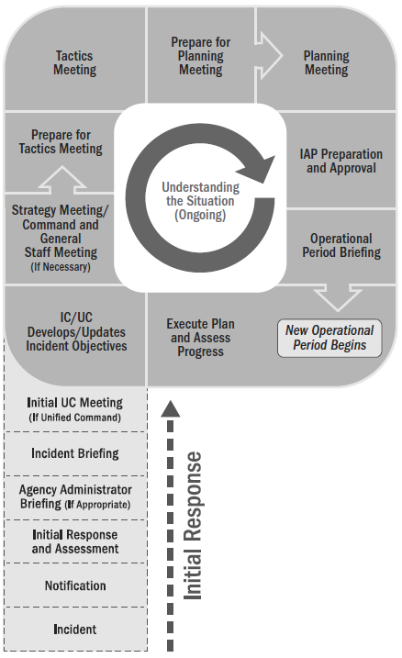
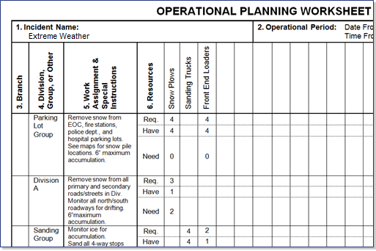

Identifying Requirements: Tactics Meeting
Operational Planning Worksheet, ICS Form 215
Visual 6.9

Slide 10

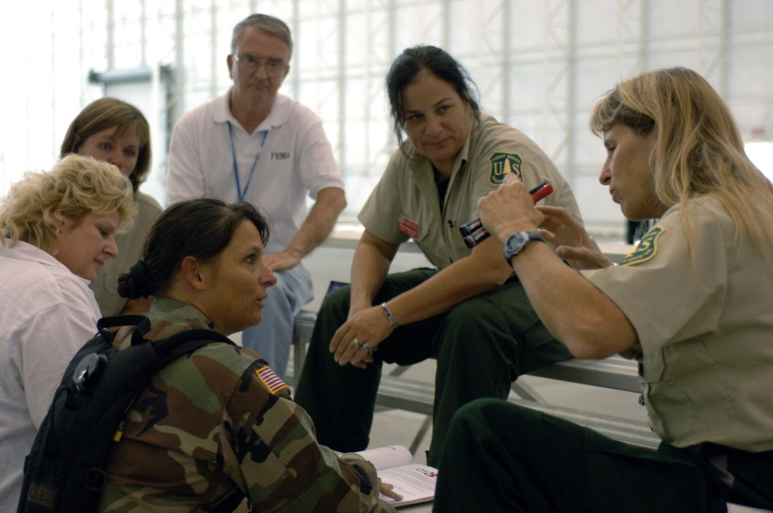
Incident Management Team (IMT)
A comprehensive resource to either:
  Augment ongoing operations through provision of infrastructure support, or
  When requested, transition to an incident management function to include all components/ functions of a
  Command and General Staff.
  Handout 6-1: Incident Management Teams
Handout 6-1: Incident Management Teams
Visual 6.10

Slide 11
Incident Management Assistance Teams
Some IMTs are referred to as Incident Management Assistance Teams (IMAT) to clarify that they support on-scene personnel and/or the affected jurisdiction(s).
Visual 6.11

Slide 12
Order and Acquire
Visual 6.12

Slide 13
Survivors as Resources
Before emergency responders can mobilize and arrive, neighbors and bystanders are often the first people to provide life-saving assistance.
Visual 6.13

Slide 14
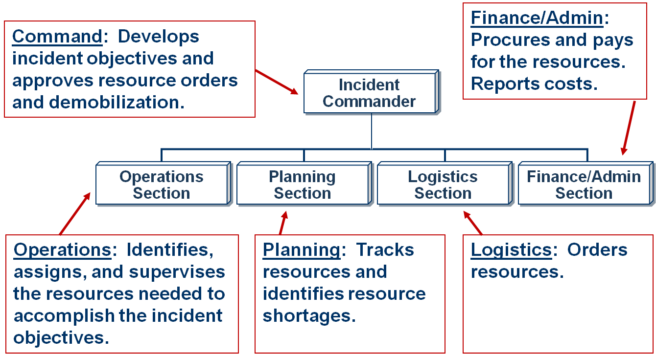
Order and Acquire Resources
Visual 6.14

Slide 15
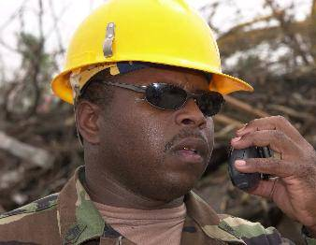
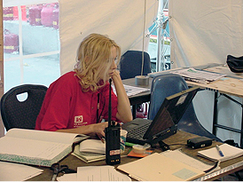
Authority To Order Resources
  Approving Orders: The Incident Commander/Unified Command approves all resource orders.
  Placing Orders: The IC, LSC, SPUL, and ordering manager are authorized to place orders.
  Approving Orders: The Incident Commander/Unified Command approves all resource orders.
  Placing Orders: The IC, LSC, SPUL, and ordering manager are authorized to place orders.
Visual 6.15

Slide 16

Resource Ordering: Small Incidents
On smaller incidents, where only one jurisdiction or agency is involved, the resource order is typically:
  Prepared at the incident,
  Approved by the IC/UC, and
  Transmitted from the incident to the jurisdiction or Agency Ordering Point (AOP).
Incident Site
Visual 6.16

Slide 17
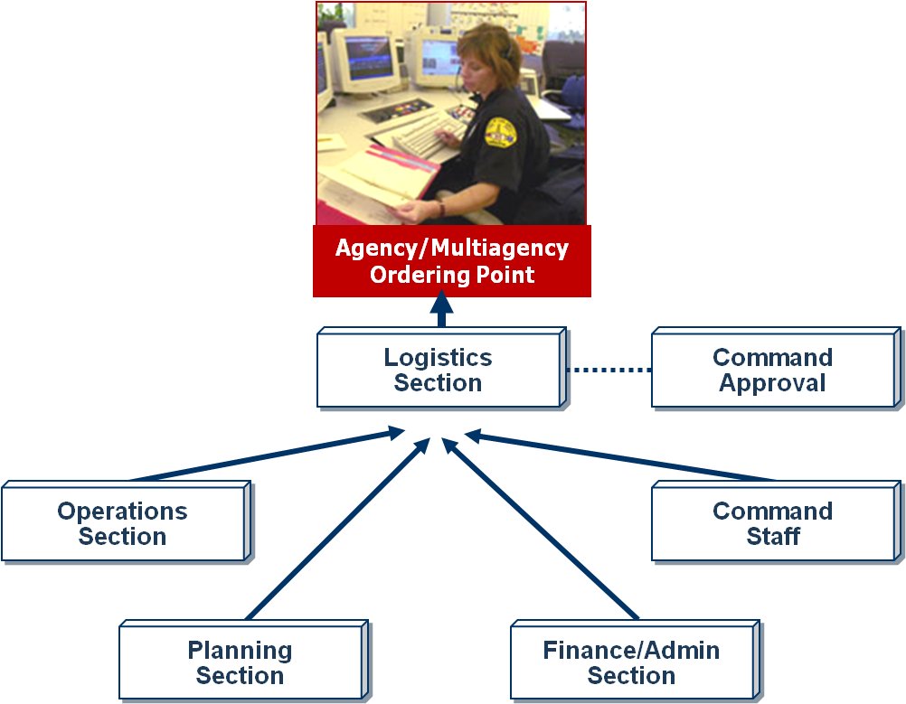
Single-Point Ordering
In single-point ordering,
the burden of finding the requested resources is placed on the responsible ordering point and not on the incident organization.
Visual 6.17

Slide 18
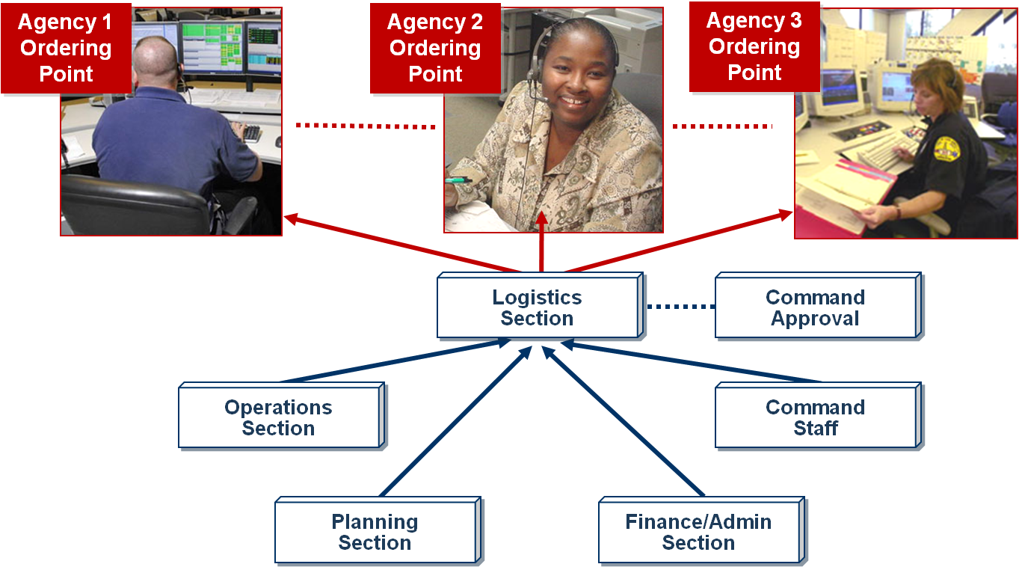
Multipoint Ordering
Visual 6.18

Slide 19

Resource Requests: Information Elements
  Complete item description
  Arrival date and time
  Delivery or reporting location
  Position title resource should report to
  Health or safety concerns (incident specific)
Visual 6.19

Slide 20
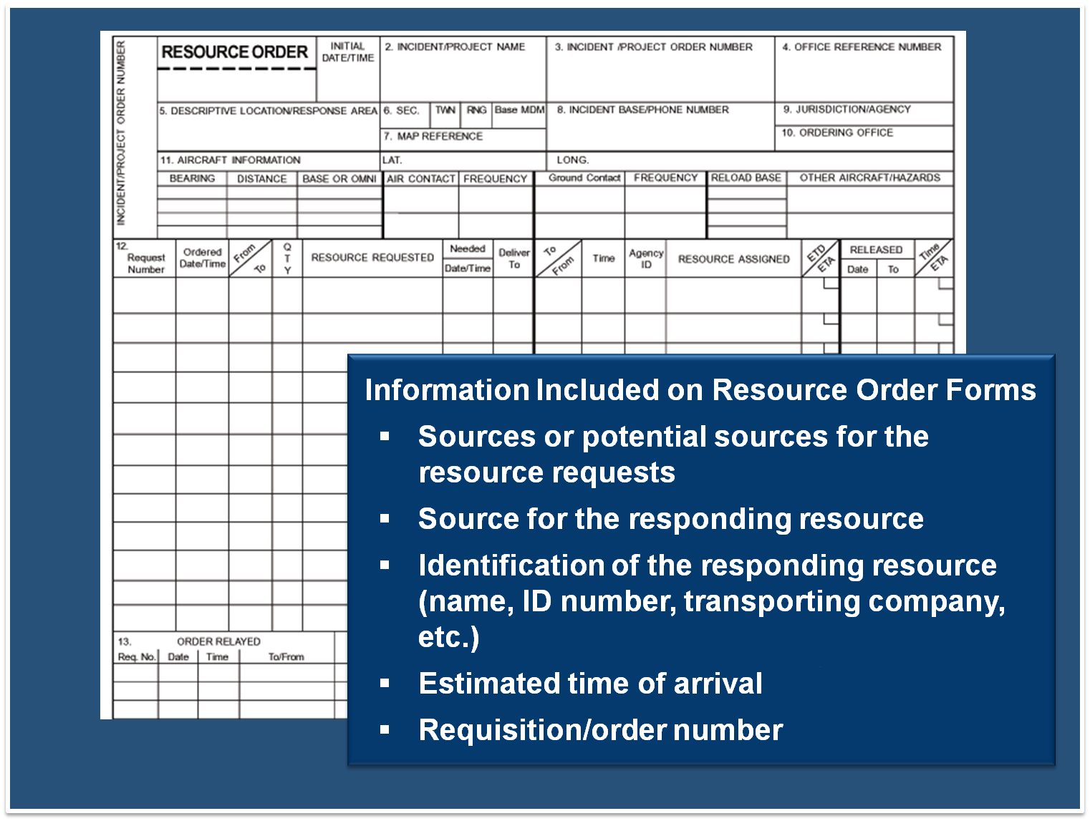
Resource Requests: Information Elements (Cont.)
Information Included on Resource Order Forms
Sources or potential sources for the resource requests
Source for the responding resource
Identification of the responding resource (name, ID number, transporting company, etc.)
Estimated time of arrival
Requisition/order number

Slide 21
Mobilize
Visual 6.21

Slide 22
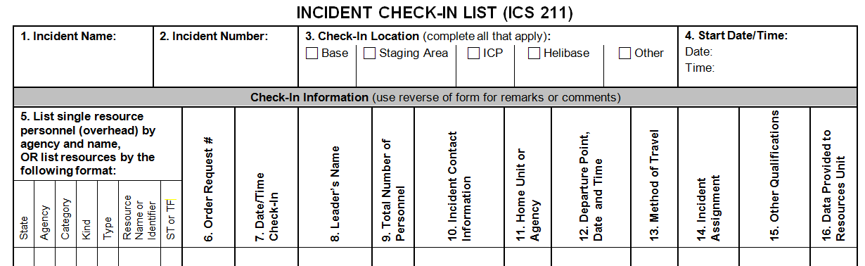
Mobilization: Check-In Process
  ICS Form 211, Check-In List, is used to document the check-in process.
  Check-in recorders report check-in information to the Resources Unit.
Visual 6.22

Slide 23

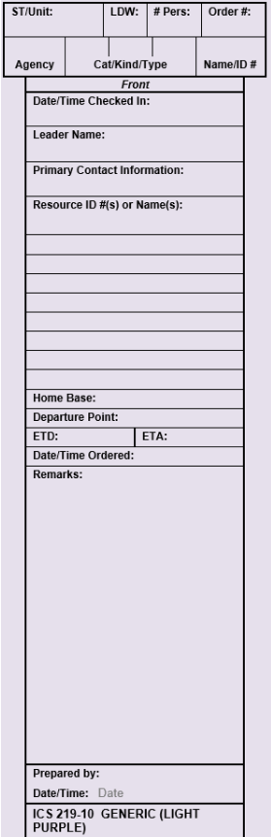
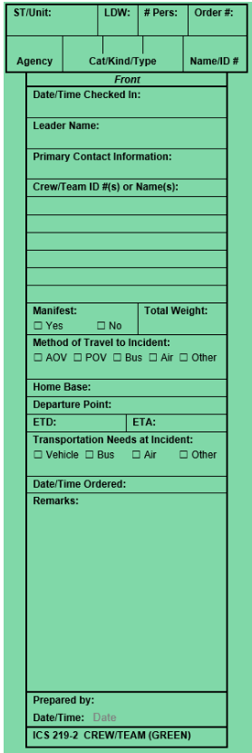
Resource Status Card (ICS Form 219)
Used by the Resources Unit to record status and location information on resources, transportation, and support vehicles and personnel.
Provides a visual display of the
status and location of resources
assigned to the incident.
Referred to as T-Cards.
Visual 6.23

Slide 24
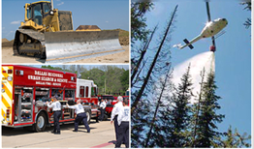
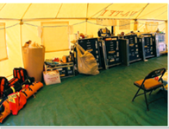
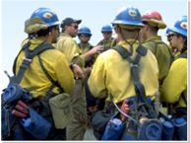
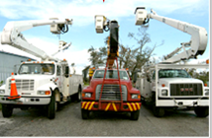
Incident Assignment and Resource Status
Incoming Tactical Resources
Out-of-Service: Sent to Incident Base (equipment) or Camp (personnel)
Assigned: Sent to incident site.
Available: Sent to Staging Area
Visual 6.24

Slide 25
Assigned: Direct Assignment to Scene
  On fast-moving or rapidly expanding incident, tactical resources may report to an on-scene Task Force or Strike Team immediately.
  As soon as possible, these resources should be checked-in.
  If check-in is not done,
  resources must check in
  after tactical assignment.
Visual 6.25

Slide 26
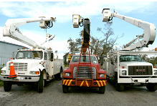
Available: Resources in Staging Area
Resources are sent to Staging Area when resources are:
  Assigned during the current Operational Period.
  Needed to provide a
  reserve force for
  contingencies.
  Formed into TF and/or ST/
  RT prior to assignment on-scene.
Visual 6.26

Slide 27
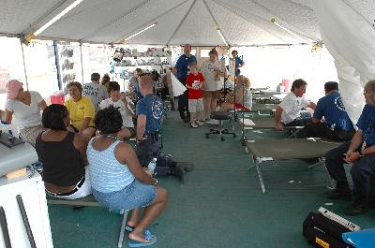
Out-of-Service to Incident Base or Camp
  Often done when the tactical resources are not scheduled for assignment on-scene during the current Operational Period.
  For resources who have traveled a long distance, being in Out-of-Service status allows a rest period.
Visual 6.27

Slide 28
Track and Report
Visual 6.28

Slide 29
Tracking Resources: Responsibilities
Resource tracking responsibilities are shared as follows:
  Planning Section is responsible for tracking ALL resources assigned to the incident and their status (assigned, available, out of service).
  Operations Section is responsible for tracking the movement of resources within the Operations Section.
  Finance/Administration Section is responsible for tracking the costs associated with resources.
Visual 6.29

Slide 30
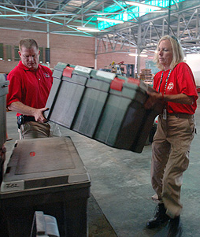
Changing Resource Status
  Change in resource status:
  May be made by the IC/UC, Operations Section Chief, Branch Director, or Division/Group Supervisor.
  Changes in resource status must be communicated using the chain of command.
Visual 6.30

Slide 31
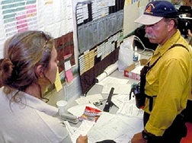
Ongoing Resource Tracking
  Manual recordkeeping
  on ICS forms
  Card systems
  Magnetic symbols on
  maps or status boards
  Computer systems
Visual 6.31

Slide 32
Monitoring and Assessing Resources
Resource use is:
  Monitored on an ongoing basis.
  Assessed before objectives are set for the next Operational Period.
Visual 6.32

Slide 33

Resource Performance Evaluation
Resources should be evaluated:
  On an ongoing basis as
  part of resource monitoring.
  At demob, upon the
  achievement of assigned tactical objectives.
  During after-action
  reporting.
Visual 6.33

Slide 34
Addressing Poor Performance
Management actions may contribute to poor performance.
Failure at the tactical level may reflect a failure in the planning process.
Ongoing evaluation and corrective action are made throughout the incident.
Visual 6.34

Slide 35
Activity 6.1:
Improving Performance Effectiveness
Allotted Time: 30 minutes
Visual 6.35

Slide 36
Demobilize, Reimburse, Restock
Visual 6.36

Slide 37

Resource Demobilization
  Excess resources must be released in a timely manner to reduce costs and to "free them up" for reassignments.
  Demob planning should begin as soon as practical.
  Demob planning begins with the tactical resources assigned to the Operations Section. As tactical resources are demob, support resources may also be demob.
Visual 6.37

Slide 38
Activity 6.2: Applied Activity
Allotted Time: 1 hour
Visual 6.38

Slide 39
Objectives Review
  What are the tasks in the Incident Resource Management Process?
  Who can order resources?
  When is single-point and multipoint resource ordering used?
  What is the purpose of an IMT?
  What process is used to evaluate resources?
  What are some approaches to common resource performance issues?
Visual 6.39

