Slide 1
Unit 5:
Planning Process, IAP, and Operations Briefs

Slide 2
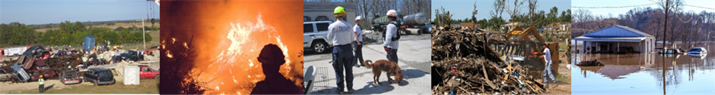
Unit Terminal Objective
Create a written IAP for an incident/event using the appropriate ICS forms and supporting materials and use the IAP to conduct an Operational Period briefing.
Visual 5.2

Slide 3
Unit Enabling Objectives
  Explain the purpose of the Planning Meeting.
  Identify the role and use of ICS forms and supporting materials included in an Incident Action Plan.
  Explain the purpose of the Operational Period Briefing.
Visual 5.3

Slide 4

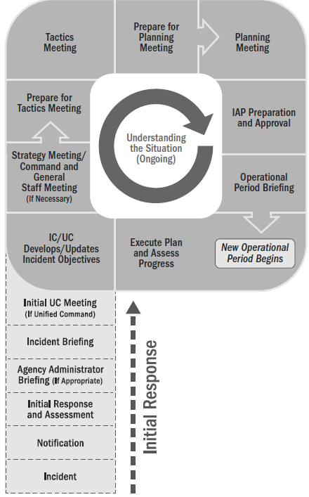
Preparing for the Planning Meeting
  Analyze the ICS 215 developed in Tactics Meeting.
  Finalize Incident Action Plan Safety Analysis (ICS 215A).
  Assess current operations effectiveness and resource efficiency.
  Gather info to support incident management decisions.
  Handout 5-1: Preparing for the Planning Meeting
Visual 5.4

Slide 5
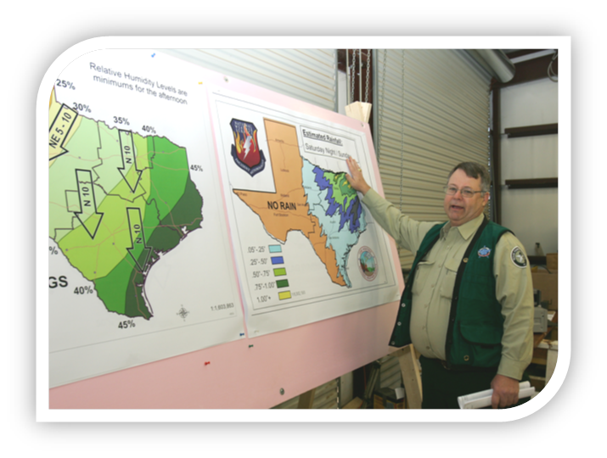
Planning Meeting Displays
Incident Objectives
Maps
ICS Form 215
Agenda
ICS Form 215A
Visual 5.5

Slide 6

The Planning Meeting
  Purposes: Review/validate the Operational Plan; identify resource requirements
  Who Attends:
    Command and General Staffs
    Other incident management personnel
    Agency Administrator
    Cooperating/assisting agency personnel
  Who Leads: Planning Section Chief
Visual 5.6

Slide 7
Handout 5-2
The Planning Meeting Agenda
Visual 5.7

Slide 8
Planning P Video: Planning Meeting
Visual 5.8

Slide 9
IAP Preparation and Approval
  After the Planning Meeting:
  Organizational elements prepare IAP assignments and submit them to the Planning Section.
  Planning Section collates, prepares, and duplicates the IAP document for the operational period briefing.
  Resources Unit coordinates with the Logistics Section to acquire the amount and type of resources.
  Incident Commander approves the IAP.
Visual 5.9

Slide 10
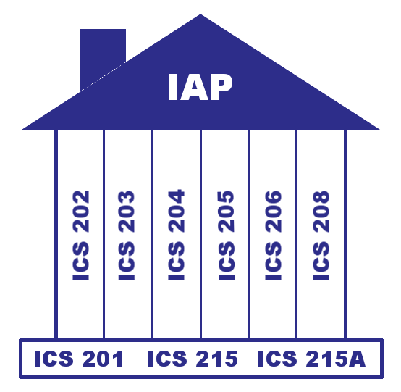
Forms and Supporting Documents: Overview
Handout 5-3: ICS Forms
Visual 5.10

Slide 11
Facilitated Activity:
Review of an IAP
Visual 5.11

Slide 12
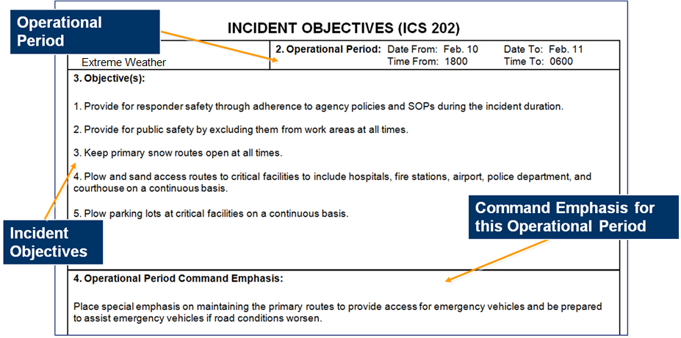
ICS Form 202, Incident Objectives
Visual 5.12

Slide 13
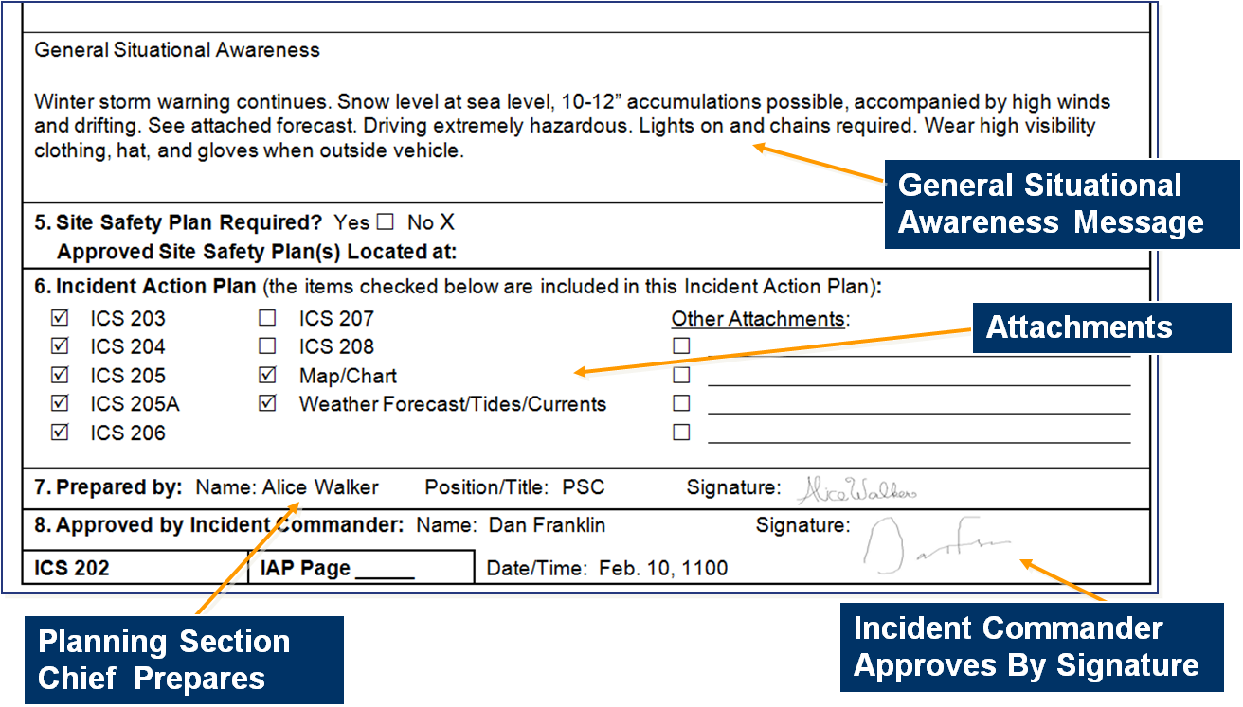
ICS Form 202, Incident Objectives (Cont.)
Visual 5.13

Slide 14
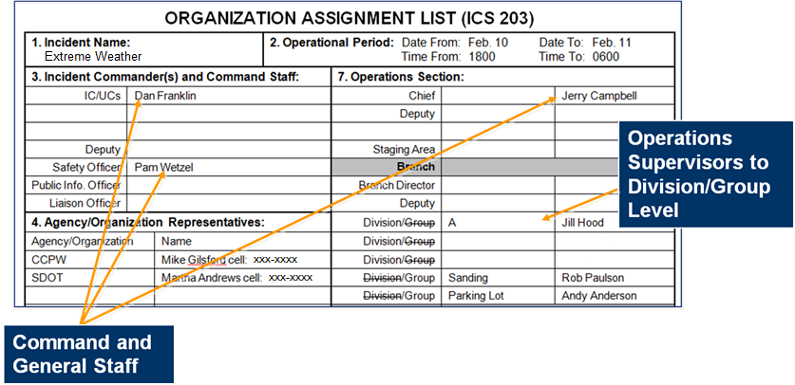
ICS Form 203, Organization Assignment List
ICS Form 203 provides a full accounting of incident management and supervisory staff for the operational period:
Visual 5.14

Slide 15
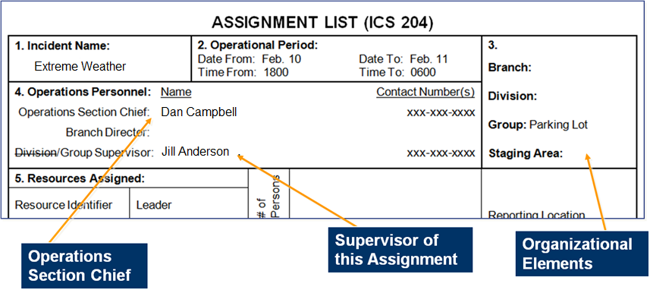
ICS Form 204, Assignment List (1 of 4)
ICS Form 204 specifies the Operations Section structure for the Operational Period:
Visual 5.15

Slide 16
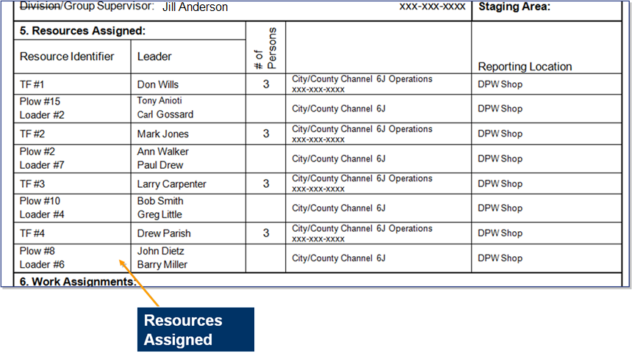
ICS Form 204, Assignment List (2 of 4)
Visual 5.16

Slide 17
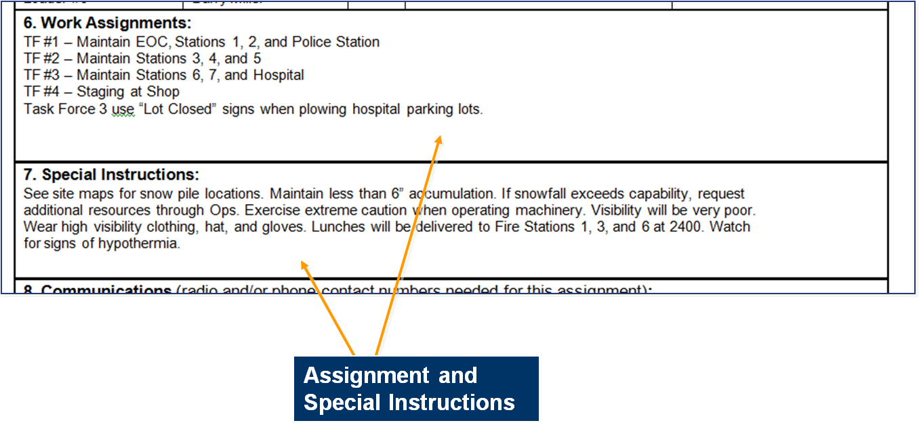
ICS Form 204, Assignment List (3 of 4)
Visual 5.17

Slide 18
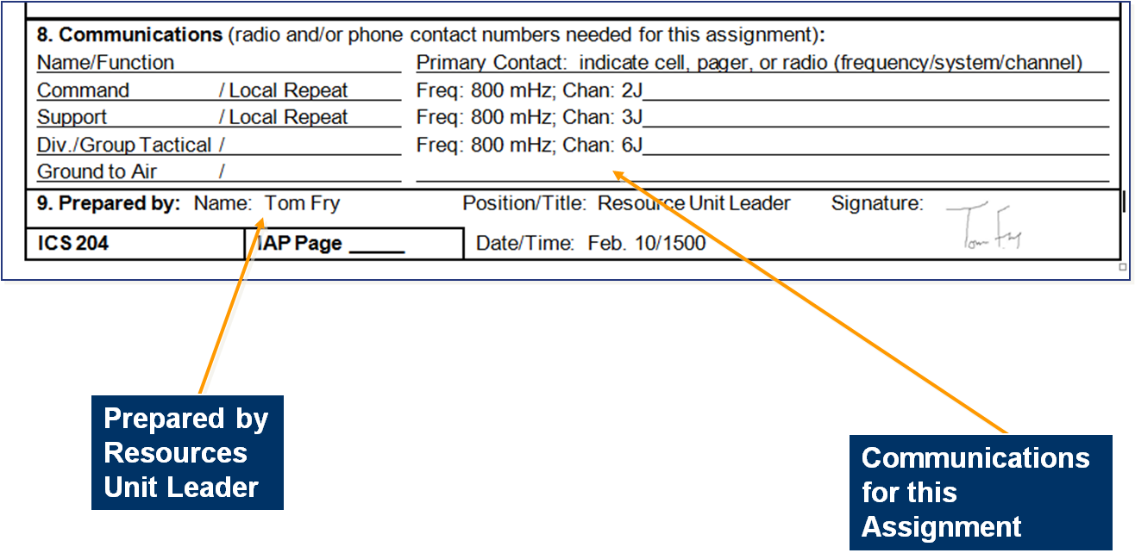
ICS Form 204, Assignment List (4 of 4)
Visual 5.18

Slide 19
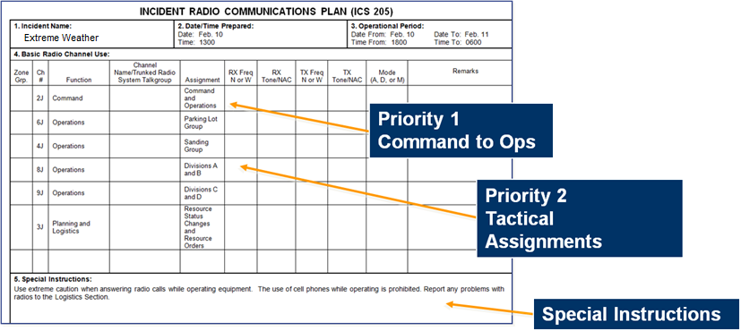
ICS Form 205, Incident Communications Plan
ICS Form 205 presents the communications plan for the entire incident:
Visual 5.19

Slide 20
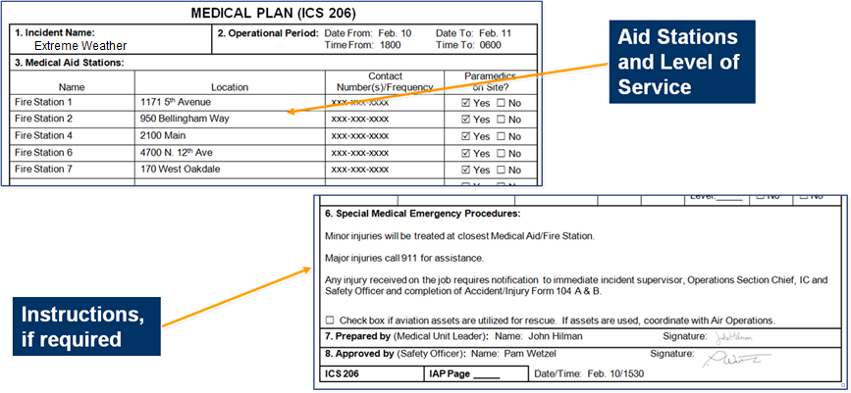
ICS Form 206, Medical Plan
ICS Form 206 describes the medical care to be provided in case of responder medical emergencies:
Visual 5.20

Slide 21
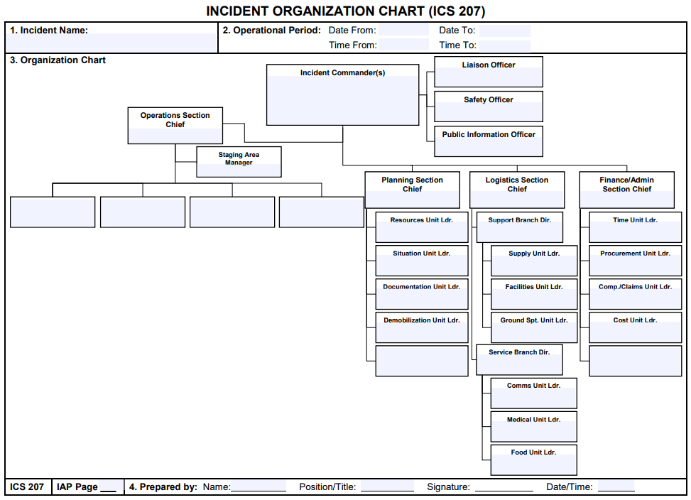
ICS Form 207, Incident Organization Chart
Visual 5.21

Slide 22
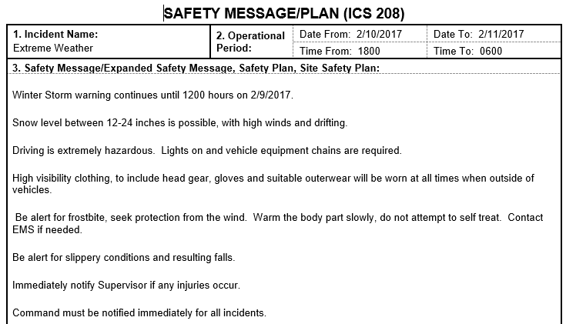
ICS Form 208, Safety Message/Plan
Visual 5.22

Slide 23
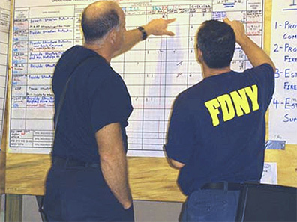

Additional Supporting Documents
  Weather forecasts
  Incident traffic plan
  Other important information for operational supervisors
Visual 5.23

Slide 24
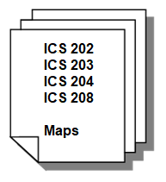
Are All Forms Used?
For less complex incidents, the IC may only require the Incident Objectives (ICS 202), Organization Assignment List (ICS 203), Assignment List (ICS 204), Safety Messages (ICS 208), and a map of the incident area.
Visual 5.24

Slide 25

IAP Approval
The Incident Commander/Unified Command reviews and approves the IAP.
Planning Section staff assemble the plan and ensure it is ready for the Operational Period Briefing.
Visual 5.25

Slide 26
Activity 5.1: Applied Activity –
Part 1
Allotted Time: 1 hour 30 minutes
Visual 5.26

Slide 27
Operations Briefing
  The Operations Briefing:
  Is conducted at the beginning of each operational period.
  Presents the IAP to supervisors of tactical resources.
  Should be concise.
Visual 5.27

Slide 28
Sample Operations Briefing Agenda
Agenda Item | Who
Introduction and Welcome | Planning Section Chief
Review of Incident Objectives | Incident Commander
Review of Current Incident/ Objective Status | Operations Section Chief Technical Specialists (as necessary)
Incident Boundaries, Branch/Division Locations, and Group Assignments (Map) | Operations Section Chief
Visual 5.28

Slide 29
Sample Operations Briefing Agenda (Cont.)
Agenda Item | Who
Review of Division/Group Assignments (ICS 204) | Operations Section Chief
Review of Safety Issues, Safety Message | Safety Officer
Logistics (Communications and Medical Plans) | Logistics Section Chief (Communications Unit Leader/Medical Unit Leader)
Other personnel | Incident Dependent (Finance Section Chief, Liaison Officer, Public Information Officer, etc.)
Closing Remarks | Agency Administrator/Incident Commander
Conclusion | Planning Section Chief
Visual 5.29

Slide 30
Executing and Assessing the Plan
  Supervisors conduct team briefings with their assigned resources to implement operational assignments.
  Operations Section Chief assesses the IAP implementation, incident objectives, strategies, and tactics prior to the next Operational Period.
Visual 5.30

Slide 31
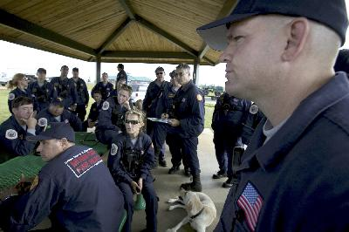
Other Types of Meetings
  Team Meetings
  Section Meetings
  Team Closeout
  Public Meetings
  Special Planning Meetings
  Transition Meetings
Visual 5.31

Slide 32
Activity 5.1: Applied Activity –
Part 2
Allotted Time: 1 hour
Visual 5.32

Slide 33
Objectives Review
  What is the purpose of the Planning Meeting?
  Name a characteristic of a strong IAP.
  Name a characteristic of a weak IAP.
  How should you use the ICS forms and supporting materials included in an Incident Action Plan?
  What is the purpose of the Operational Period Briefing?
Visual 5.33

