Slide 1
Unit 4:
Implementing an Operational Planning Process

Slide 2
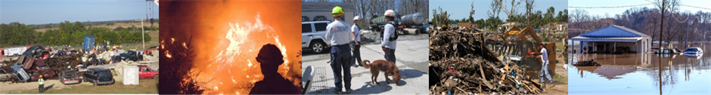
Unit Terminal Objective
Create an ICS 215, Operational Planning Worksheet, and an ICS 215A, Incident Action Plan Safety Analysis, using a given scenario.
Visual 4.2

Slide 3
Unit Enabling Objectives
  Explain the operational planning steps including logistical concerns, cost-benefit analysis, and appropriate strategies and tactics to meet incident objectives.
  Identify the scope and results of the Tactics Meeting.
  Explain the purpose and use of ICS Form 215, Operational Planning Worksheet.
  Explain the purpose and use of ICS Form 215A, Incident Action Plan Safety Analysis.
Visual 4.3

Slide 4
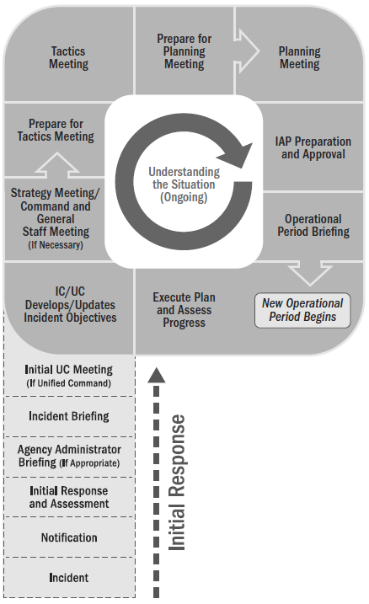

The Tactics Meeting: Overview
  Purpose
  Preparation
  Who Attends
  Who Leads
Visual 4.4

Slide 5
Assessing Current Objectives
  Is the incident stable, or is it increasing in size and complexity?
  What are the current incident objectives, strategy, and tactics?
    Are there any safety issues?
    Are the objectives effective? Is a change of course needed?
    How long will it be until the objectives are completed?
  What is current status of resources? Are resources sufficient and in good condition?
Visual 4.5

Slide 6
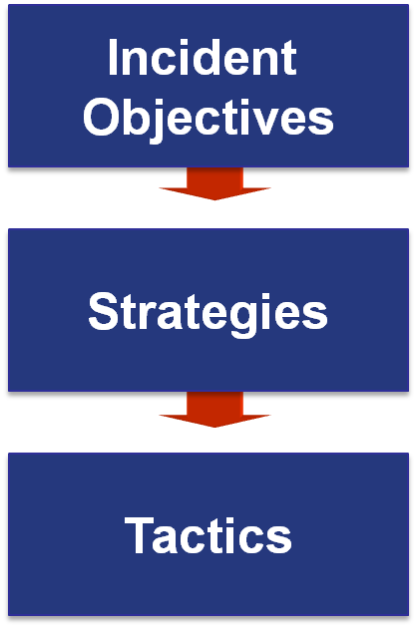
Objectives, Strategies, and Tactics
State what will be accomplished.
Establish the general plan or direction for accomplishing the incident objectives.
Specify how the strategies will be executed.
Visual 4.6

Slide 7
Developing Strategies
  Generate a list of strategies.
  Select the strategy that:
    Is within acceptable safety norms.
    Makes good sense (feasible, practical, and suitable).
    Is cost effective.
    Is consistent with sound environmental practices.
    Meets political considerations.
Visual 4.7

Slide 8

Executing Tactical Direction
  Establish Tactics: Describe what must be done.
  Assign Resources: Determine and assign the kind and type of resources needed for the selected tactics.
  Monitor Performance: Determine if the tactics and resources selected for the various strategies are both valid and adequate.
Visual 4.8

Slide 9
Sample Strategy and Tactics
Objective: Reduce reservoir level to 35 feet by 0800 on 2/10.
Strategy #1: Reduce/divert inflow.
Strategy #2: Release water from spillways.
Selected Strategy: Pump water from reservoir.
Tactics: Use truck-mounted pumps working from the road into spillway, and portable pumps on the east side discharging into Murkey Creek.
Resources: 5 crews with (3) 1,500-gpm truck-mounted pumps &
(2) 500-gpm portable pumps
Visual 4.9

Slide 10
Logistics Support Factors
When determining tactical operations, consider the following personnel and logistical support factors:
If the required tactical resources will not be available, then an adjustment should be made to the tactics and operations planned for the Operational Period.
Lack of logistical support can mean the difference between success and failure.
Visual 4.10

Slide 11
Cost-Benefit Analysis
What are factors that you should consider when assessing the costs and benefits of proposed tactical assignments?
Visual 4.11

Slide 12
Cost-Benefit Factors
What alternatives are available to accomplish the selected tactic?
What are the estimated costs of these alternatives?
What are the benefits of each alternative?
What are the safety factors of these alternatives?
What are the time variables of these alternatives?
Which of the alternatives has the highest cost-benefit ratio? (A ratio of 1:1 would indicate the cost of the alternative equals the benefits derived from using that alternative.)
Visual 4.12

Slide 13

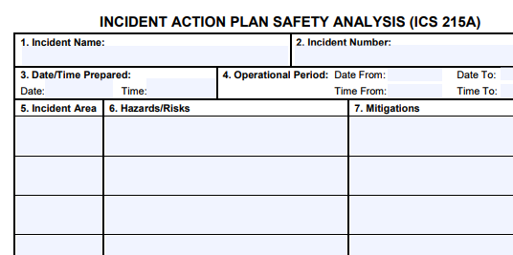
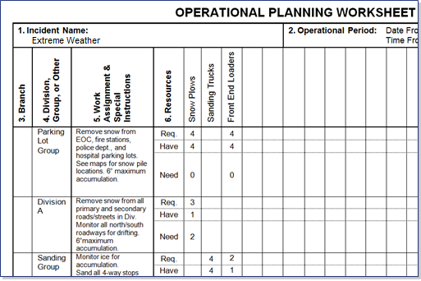
Tactics Meeting Documentation
Visual 4.13

Slide 14
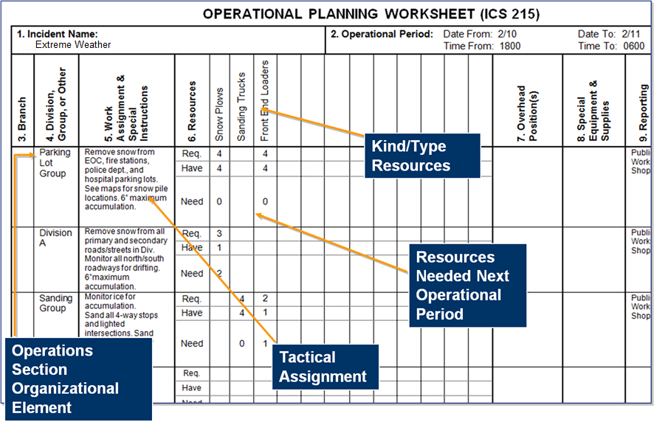
ICS 215 Form
Visual 4.14

Slide 15
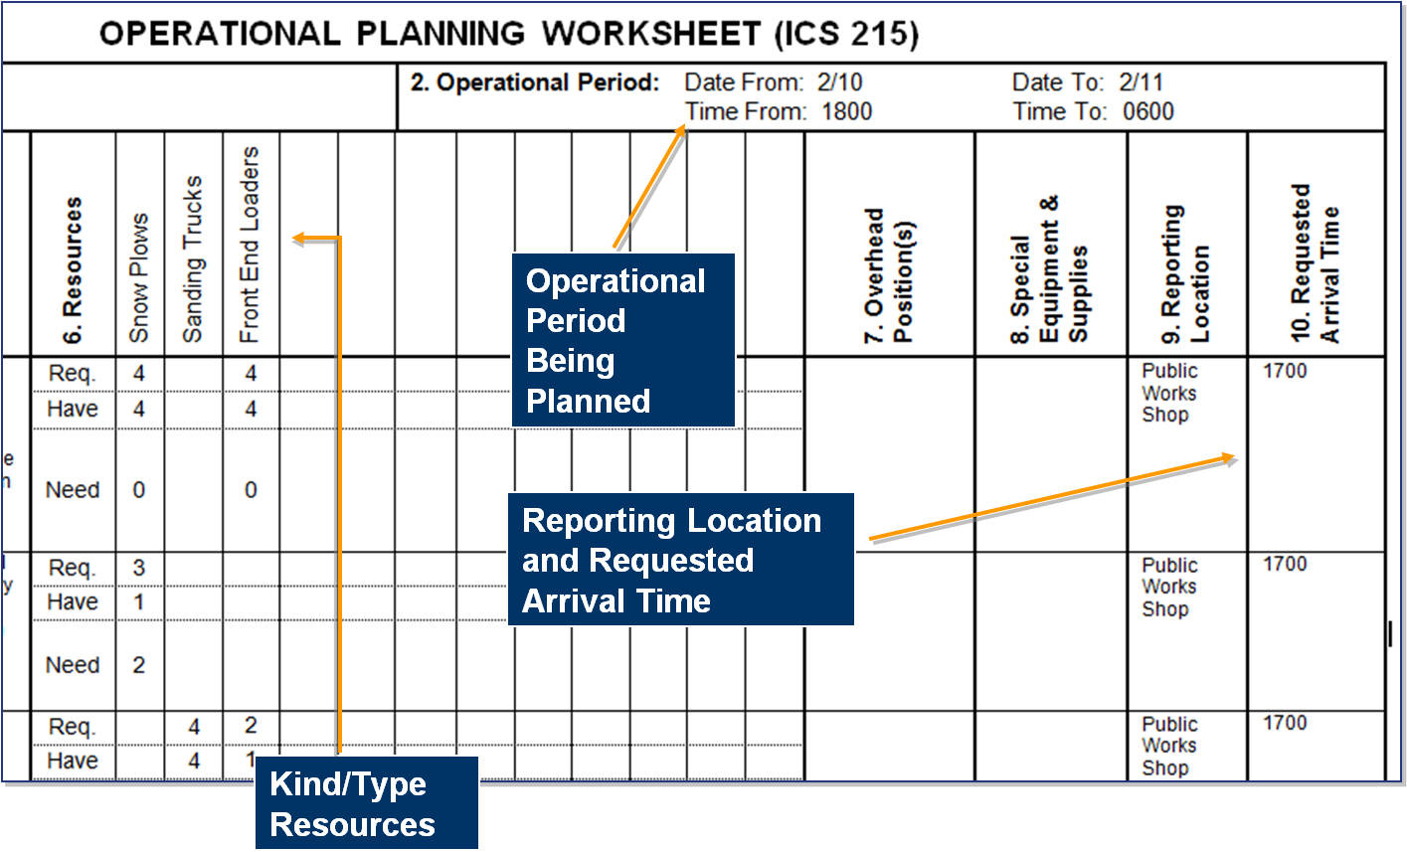
ICS 215 Form (Cont.)
Visual 4.15

Slide 16

Incident Safety
Incident management must ensure the safety of:
  Responders to the incident.
  Persons injured or threatened by the incident.
  Volunteers assisting at the incident.
  News media and the general public who are on scene observing the incident.
Visual 4.16

Slide 17
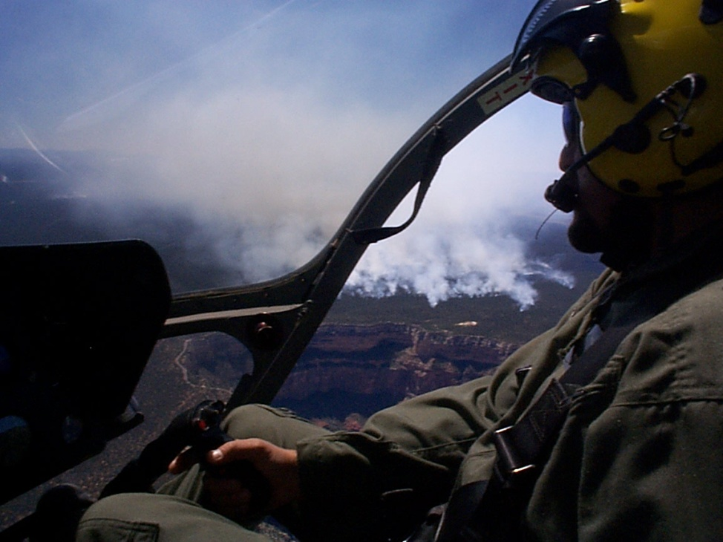
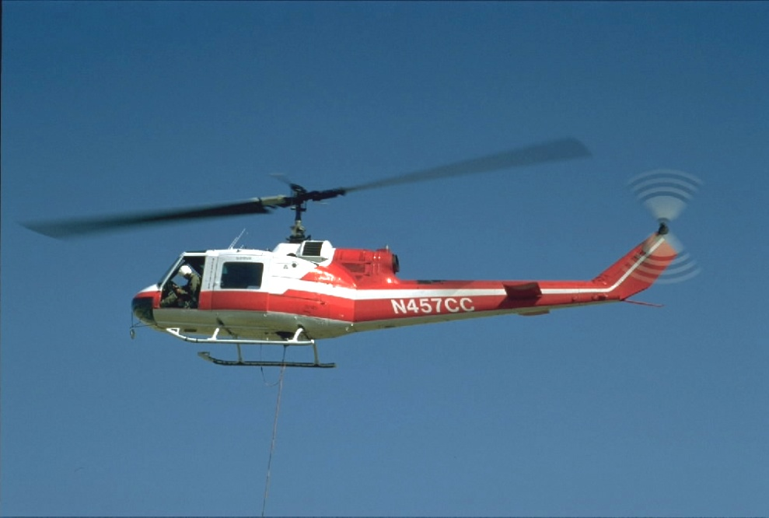

Aviation Safety
If there is aviation, there must be a separate aviation Safety Officer assigned.
Visual 4.17

Slide 18
Incident Safety Analysis
The Incident Safety Analysis is used to:
  Identify, prioritize, and seek options to mitigate the hazards and risks of each incident work location by operational period.
  Identify high-risk tactics so that alternatives may be considered.
  Determine the safety implications for the types of resources required.
Visual 4.18

Slide 19
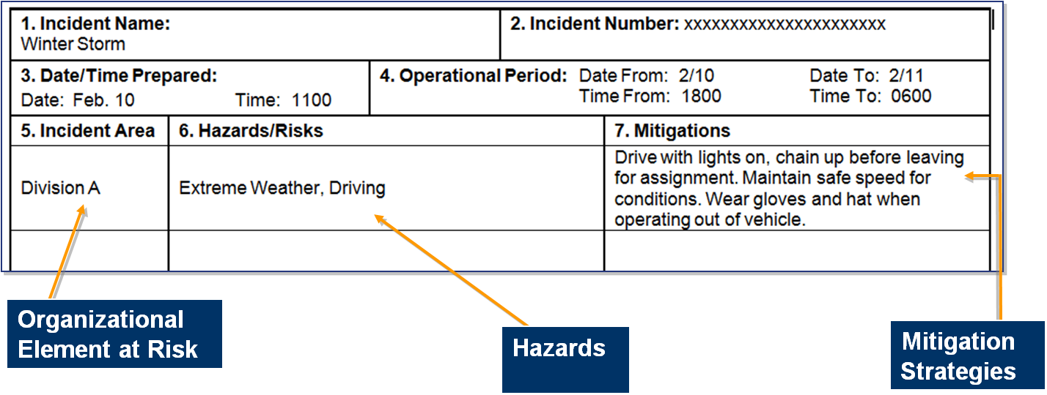
ICS Form 215A, Incident Action Plan Safety Analysis
The Safety Officer and Operations Section Chief complete Safety Analysis using ICS 215A for . . .
Visual 4.19

Slide 20
Activity 4.1: Applied Activity
Allotted Time: 90 minutes
Visual 4.20

Slide 21
Objectives Review
  What are the operational planning steps to meet incident objectives?
  What are the scope and results of the Tactics Meeting?
  What is the purpose and use of ICS Form 215?
  What is the purpose and use of ICS Form 215A?
Visual 4.21

