Slide 1
Unit 3:
Initial Actions for Unified Command

Slide 2
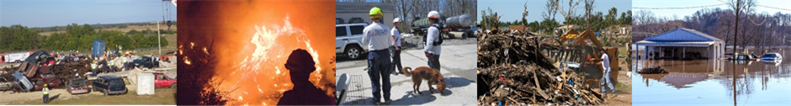
Unit Terminal Objective
Develop incident objectives for a
simulated incident.
Visual 3.2

Slide 3
Unit Enabling Objectives
  Identify the importance of planning for incidents / events.
  Contrast the differences between planning for incidents and events.
  Identify methods and tools used to assess incident / event complexity.
  Identify agency policies and guidelines that influence management of incident or event activities.
  Explain the process for developing incident objectives, strategies, and tactics.
  Identify the steps in transferring and assuming incident command.
Visual 3.3

Slide 4
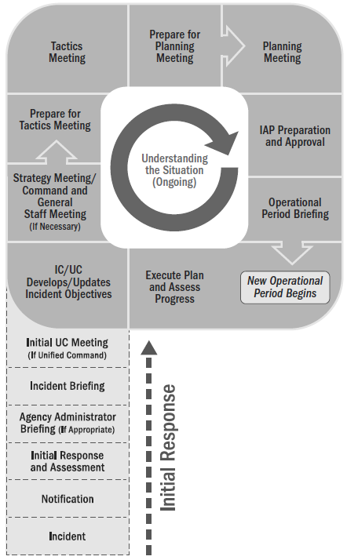
Planning “P” and Unified Command
This unit covers:
IC/UC objectives meeting.
Command and General Staff meeting
Agency Administrator Briefing
Visual 3.4

Slide 5
Incidents vs. Events
Incident: An unexpected occurrence that requires immediate response actions through an ICS organization.
Event: A scheduled non-emergency activity (sporting events, concerts, parades, and other events requiring special security).
Visual 3.5

Slide 6

Planning for Complex Incidents
Time is of the essence (time criticality)
The situation is unstable
The incident has the potential to expand rapidly
Communications and information may be incomplete
Staff on scene may be experienced in control measures, but are not necessarily experienced in managing expanding incidents
Visual 3.6

Slide 7
Planning for Events
The planners of an event should know:
  Type of event
  Location, size, expected
  duration, history, and
  potential in order to project
  incident objectives
  Number of agencies
  involved
  Single or multijurisdictional
  Command Staff needs
  Kind, type, and number of
  resources required
  Projected aviation operations
  Staging Areas required
  Other facilities required
  Kind and type of logistical support needs
  Financial considerations
  Known limitations or restrictions
  Available communications
Visual 3.7

Slide 8
Initial Response Actions
Assessment and Safety
Planning and Resource Management
Visual 3.8

Slide 9
Agency Administrator Briefing
Incident Description and Summary
Location/Population threatened
Jurisdictions involved
AA Priorities and Delegation of Authority
Resource Ordering Process
Public Information Release Policies, Procedures
Schedule to Transfer Command
Visual 3.9

Slide 10
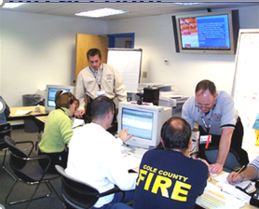
Authorities, Policies, and External Stakeholders
In addition to information collected during size up, Incident Commander takes into account:
Authorities
Policies and Guidelines
External Stakeholders
Visual 3.10

Slide 11
Agency Policies and Guidelines
What are some examples of agency policies and guidelines that can affect your management of an incident?
Visual 3.11

Slide 12
Policies and Guidelines: Examples
  Pre-incident plans
  Standard operating procedures
  Emergency operations plans
  Continuity of operations plans
  Community preparedness plans
  Mutual aid and assistance agreements
  Wildland Fire Situation Analysis (WFSA)
  Wildland Fire Implementation Plan (WFIP)
  Corrective action plans
  Mitigation plans
  Recovery plans
  Tribal, State, regional, and national mobilization guides
  Field operations guides
  Delegations of authority
Visual 3.12

Slide 13
Planning “P” and Incident Briefing
Following the
Initial Assessment and AA Briefing, an Incident Briefing
is conducted.
Visual 3.13

Slide 14
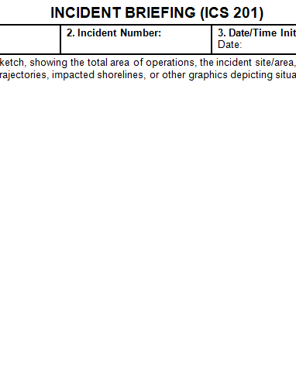
Incident Briefing (ICS Form 201)
  Provides staff with information about incident situation and resources allocated to incident.
  Serves as a permanent record of initial response to incident.
  Can be used for transfer of command.
  Incident situation (maps, significant events)
  Incident objectives
  Summary of current actions
  Status of resources assigned or ordered
Visual 3.14

Slide 15

Activity 3.1:
ICS Form 201
Allotted Time: 10 minutes
Visual 3.15

Slide 16
Complete the ICS 201…
A building exploded; its cause is unknown. There is significant damage to the building and several injuries have been reported. It is unknown if people are trapped in the building. The fire department and police department have been notified. Two chiefs (Thomas and Jones), two fire aerial ladders with pump (Q15 and Q17), three fire engines (E15, E25, and E14), one heavy rescue (R1), two medical units (M601 and M630), one police Lieutenant (Patrick) with two police squad cars (1-12 and 1-13) have responded and are on-scene.

Slide 17
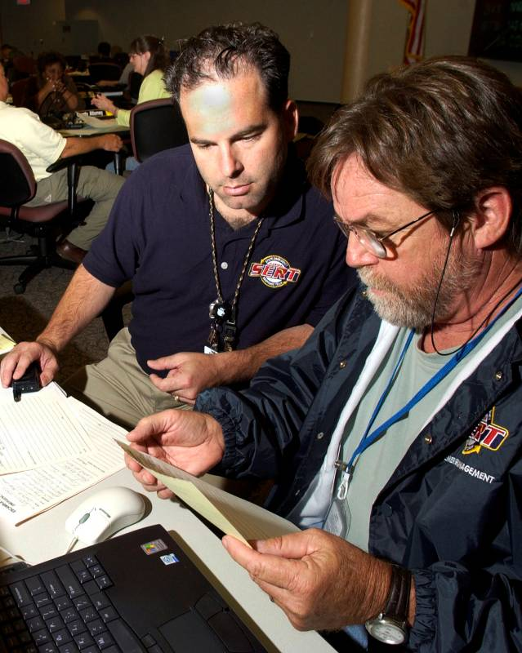
Transfer of Command
Process of moving responsibility for incident command from one Incident Commander/Unified Command to another.
Visual 3.17

Slide 18
Steps in Transfer of Command
Incoming IC (Assuming) | Outgoing IC (Transferring)
Assess situation with current IC. | Assess situation with incoming IC.
Receive briefing (ICS 201). | Deliver briefing (ICS 201).
Determine appropriate time for transfer of command. | Determine appropriate time for transfer of command.
Notify others of change in command. | Notify others of change in command.
Reassign or demobilize current IC. | Accept new assignment or demobilize.
Visual 3.18

Slide 19

Transfer of Command Briefing
Current situation
resources remaining and status
Areas of concern (political, community interest, etc.)
Logistical Support needed or retained
Turnover of appropriate incident documentation
Future outlook
Visual 3.19

Slide 20
Transfer of Command Pitfalls
  Compromised responder safety.
  Inefficient use of resources.
  Ineffective transfer of information.
  Attitude (egos, complacency, resignation).
Visual 3.20

Slide 21
Transfer of Command Considerations
  A deliberate transfer of command plan may be required.
  Allow sufficient, dedicated time to conduct Transfer of Command.
  Communicate professionally and effectively.
  Verify that key information is understood.
Visual 3.21

Slide 22
Initial Unified Command Meeting
The Initial Unified Command Meeting:
  Includes all members of the Unified Command.
  Takes place before the first operational period planning meeting.
  Provides the responsible agency officials with an opportunity to discuss and concur on important issues prior to joint incident planning.
Visual 3.22

Slide 23
What’s an Operational Period?
  The schedule for executing a given set of operation actions, as specified in the IAP.
  Operational periods can be of various lengths, although usually they last 12-24 hours.
  Length depends on:
    Nature of incident
    Complexity
Visual 3.23

Slide 24
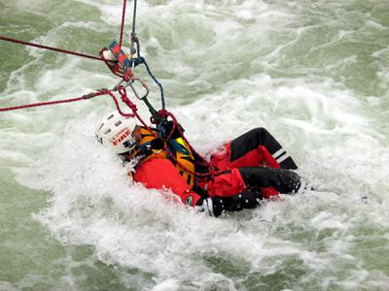
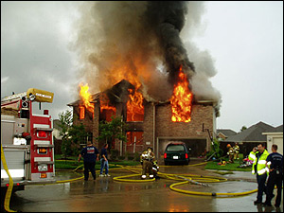
Priorities of Response
Save lives
Protect property and the environment
Stabilize the incident
Provide for basic human needs
Visual 3.24

Slide 25
Situational Awareness
  To maintain situational awareness, incident personnel:
  Continuously update incident information through collection, validation, and analysis
  Disseminate updated incident information that is shared between all appropriate parties
Visual 3.25

Slide 26
Situational Awareness Skills
  Validate and analyze information.
  Understand critical information requirements.
  Recognize atypical situations and take correct actions.
  Seek and provide information before acting.
  Continue collecting information about incident and assignments.
  Assess your own task performance.
  Communicate your SA to all team members!
  Handle, document, and store information properly.
Visual 3.26

Slide 27
Situational Awareness and Decision Support
Information supports decision-making.
All participants in the Unified Command must share the same information.
Utilizing a common presentation format supports Situational Awareness and effective decision making.
Not all information can be shared with everyone, displayed openly, or released to outside entities.
Visual 3.27

Slide 28
Loss of Situational Awareness
How might you know if you are experiencing loss of situational awareness within
the Unified Command?
How can it be avoided?
Visual 3.28

Slide 29
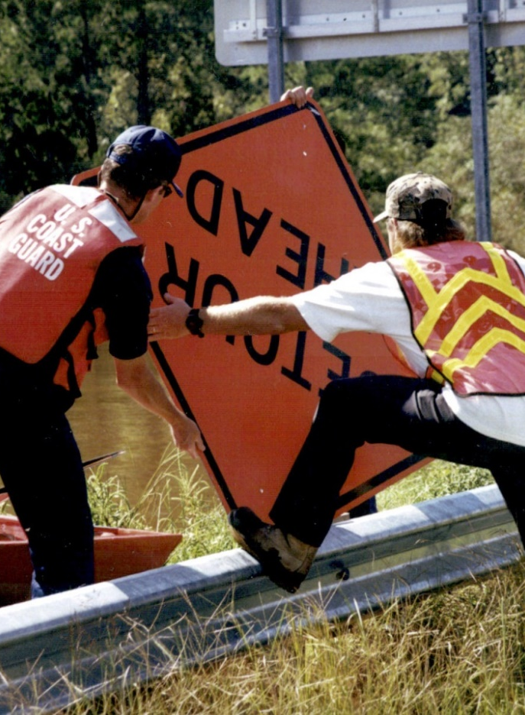
Complexity Analysis Factors
  Impacts to life, property, and the economy.
  Community and responder safety.
  Expected duration.
  Number of resources involved.
  Potential hazardous materials.
  Weather and other environmental influences.
  Likelihood of cascading events or incidents.
Visual 3.29

Slide 30
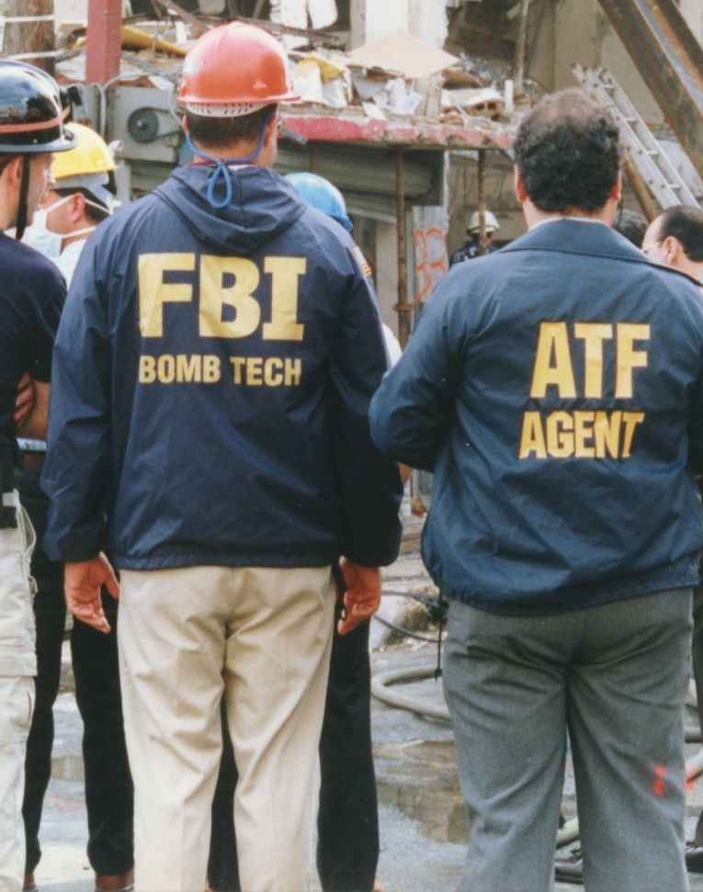
Complexity Analysis Factors (Cont.)
  Potential crime scene (including terrorism).
  Political sensitivity, external influences, and media relations.
  Area involved, jurisdictional boundaries.
  Availability of resources.
Visual 3.30

Slide 31
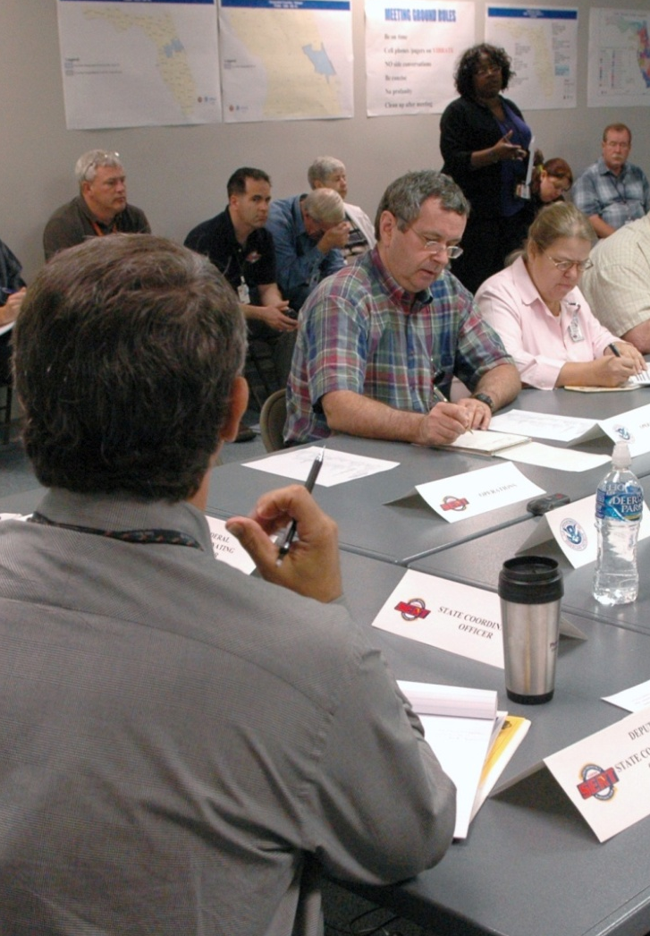
Considerations for Developing Objectives
  The UC is responsible for developing incident objectives.
  The C&G Staff normally contribute to the development of incident objectives.
Visual 3.31

Slide 32
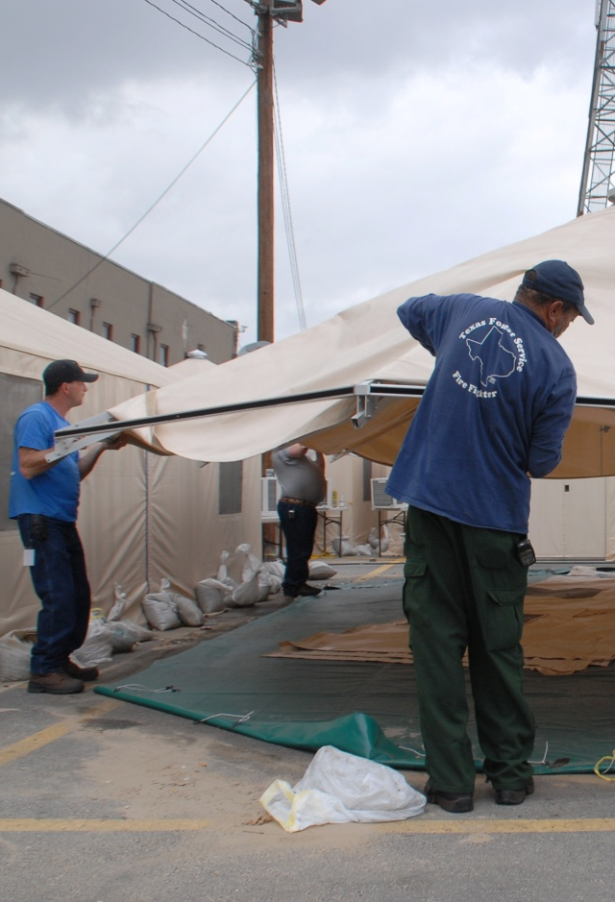
Considerations for Developing Objectives (Cont.)
  Objectives should consider demob requirements. Demobilization will occur during the life cycle of the incident/event.
  Demobilization of resources
  Planning ahead for final demobilization
Visual 3.32

Slide 33
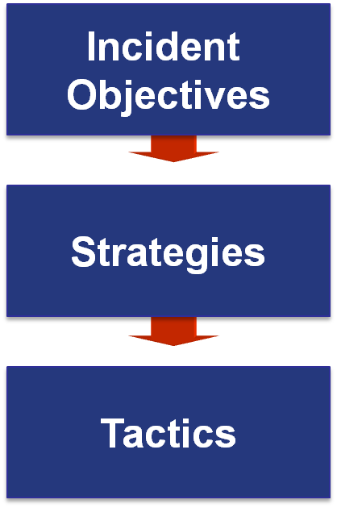
Objectives, Strategies, and Tactics
State what will be accomplished.
Establish the general plan or direction for accomplishing the incident objectives.
Specify how the strategies will be executed.
Visual 3.33

Slide 34
Writing “SMART” Objectives
  Specific – Are words precise & unambiguous?
  Measurable – How will achievements be measured?
  Action Oriented – Is an action verb used to describe expected accomplishments?
  Realistic – Is the outcome achievable with given available resources?
  Time Sensitive – What is the timeframe (if applicable)?
Visual 3.34

Slide 35
Sample Objectives
  Complete evacuation of residents to the Walnford High School reception center by 1700 hours.
  Complete Preliminary Damage Assessments of all damaged residential structures in Anytown by 0800 hours on 3/21.
  Restore potable water to the business district.
  Contain fire within existing structures by 1800 hours on 3/21.
Visual 3.35

Slide 36
Activity 3.2:
SMART Objectives
Allotted Time: 10 minutes
Visual 3.36

Slide 37
Is it SMART?
Scenario: It’s midnight and heavy rains have caused localized flooding. In one neighborhood, residents are becoming trapped in their homes.
Objective: As needed, provide assistance to those who might have localized flooding problems.

Slide 38
Is it SMART?
Scenario: Blocked storm drains are causing standing water on major roadways.
Objective: Notify public works of storm drain blockages causing standing water, or clear the drains to prevent traffic accidents.

Slide 39
Strategy/Command and General Staff Meeting
Share incident objectives and solicit input.
Announce Operational Period and meeting schedule.
Discuss key decisions and concerns.
Share information.
Also known as a Strategy Meeting.
Visual 3.39

Slide 40
Activity 3.3: Applied Activity
Allotted Time: 1 hour
Visual 3.40

Slide 41
Objectives Review
  Why is planning for incidents and events important?
  What is the difference between planning for an incident and an event?
  How can one assess incident complexity?
  What policies and guidelines influence incident management activities?
  What is the process for developing incident objectives, strategies, and tactics?
  How is transfer of command carried out?
Visual 3.41

