Slide 1
Unit 2:
ICS Fundamentals Review

Slide 2
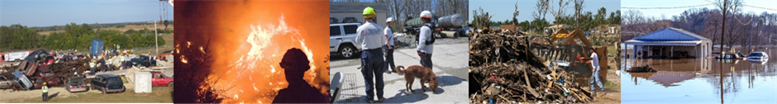
Unit Terminal Objective
Given a simulated scenario, identify roles and reporting relationships under a Unified Command that involves agencies within the same jurisdiction and under multijurisdictional conditions.
Visual 2.2

Slide 3
Unit Enabling Objectives
  Explain how ICS fits into the Command and Coordination component of NIMS.
  Explain reporting relationships and information flow within the organization.
  Identify ICS supervisory positions and titles.
Visual 2.3

Slide 4
Unit Enabling Objectives (Cont.)
  Explain considerations for developing an organizational structure that supports the incident and delegating authority to the lowest practical level.
  Identify the primary features of Unified Command.
  Explain how Unified Command functions on a multijurisdictional or multiagency incident.
Visual 2.4

Slide 5


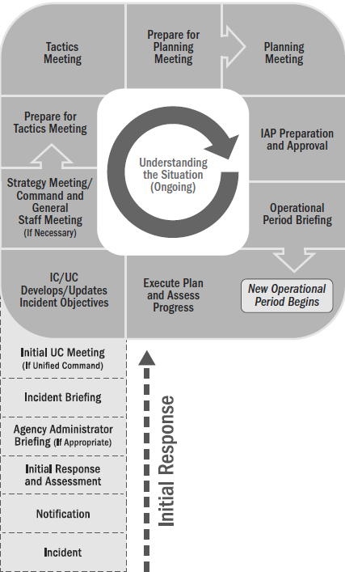
Incident Action Planning Process
Handout 2-1: Operational Period Planning Cycle
(Planning P)
Visual 4.5

Slide 6
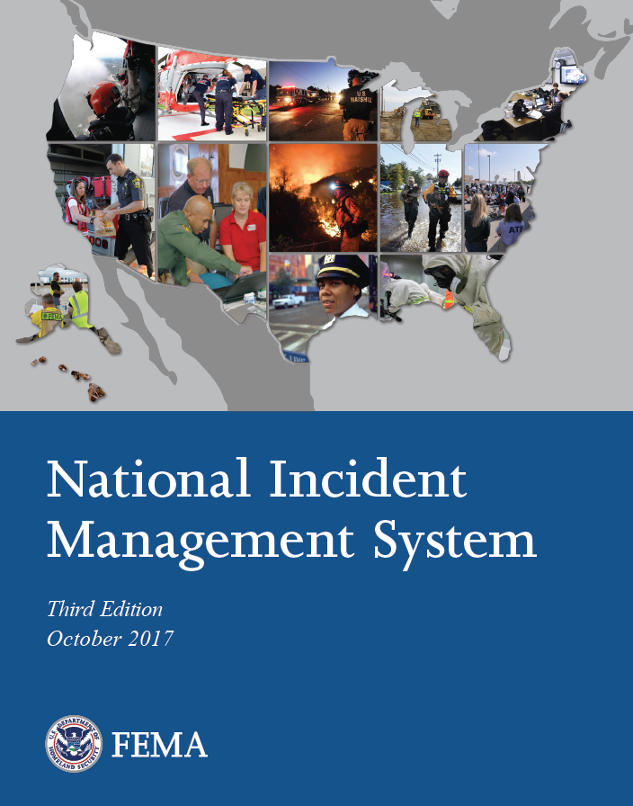
NIMS Components & ICS
Incident Command System
Emergency Operations Center
Resource Management
Command and Coordination
Multiagency Coordination Group
Communications and
Information Management
Joint Information Systems
Visual 2.6

Slide 7
NIMS Management Characteristics
14 foundational characteristics of incident command and coordination under NIMS:
Common Terminology
Management by Objectives
Manageable Span of Control
Comprehensive Resource Management
Establishment and Transfer of Command
Chain of Command and Unity of Command
Dispatch/Deployment
Modular Organization
Incident Action Planning
Incident Facilities and Locations
Integrated Communications
Unified Command
Accountability
Information and Intelligence Management

Slide 8
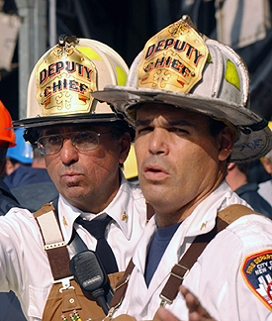
Unity of Command
Under unity of command, personnel:
  Report to only one supervisor.
  Receive work assignments and take directions only from that one person.
  Don’t confuse unity of command with Unified Command!
Don’t confuse unity of command
with Unified Command!
Visual 2.8

Slide 9
“Unity” vs. “Unified”
What’s the difference between
unity of command and Unified Command?
Visual 2.9

Slide 10
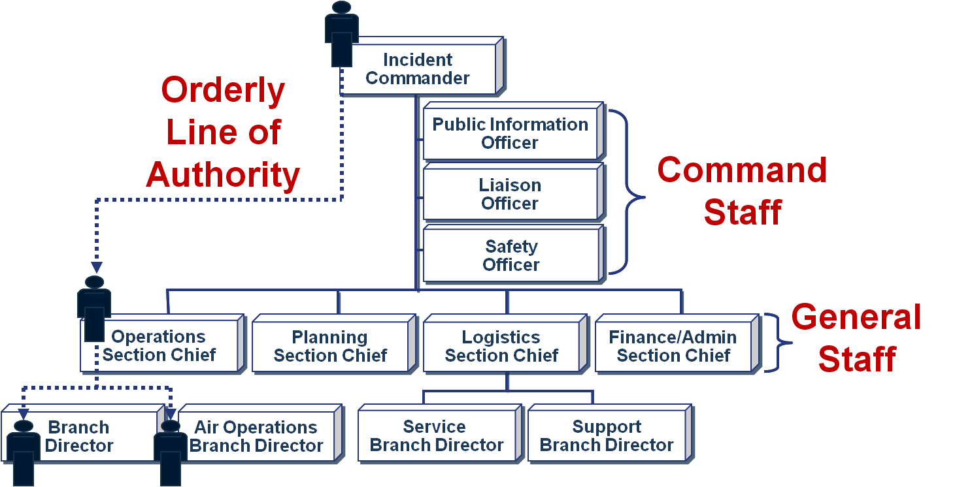
Chain of Command
Visual 2.10

Slide 11
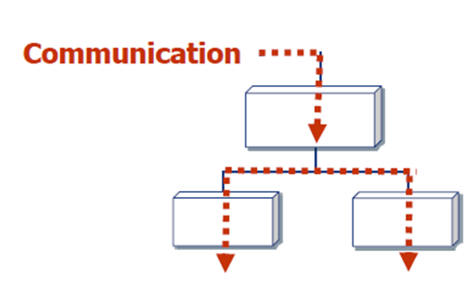
Formal Communication
Formal Communication follows the
chain of command.
Visual 2.11

Slide 12
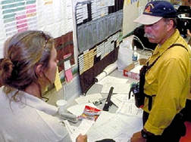
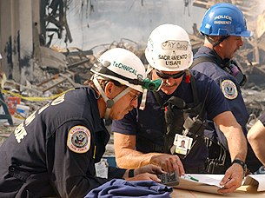
Formal Communication (Cont.)
Use formal communication when:
  Receiving and giving work assignments.
  Requesting support or additional resources.
  Reporting progress of assigned tasks.
Visual 2.12

Slide 13
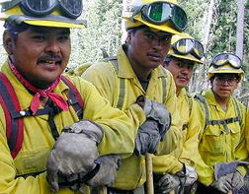
Informal Communication
  Used to only exchange incident or event information.
  NOT used for:
    Formal requests for additional resources.
    Tasking work assignments.
    Within the ICS organization, critical information
    must flow freely!
Within the ICS organization, critical information
must flow freely!
Visual 2.13

Slide 14
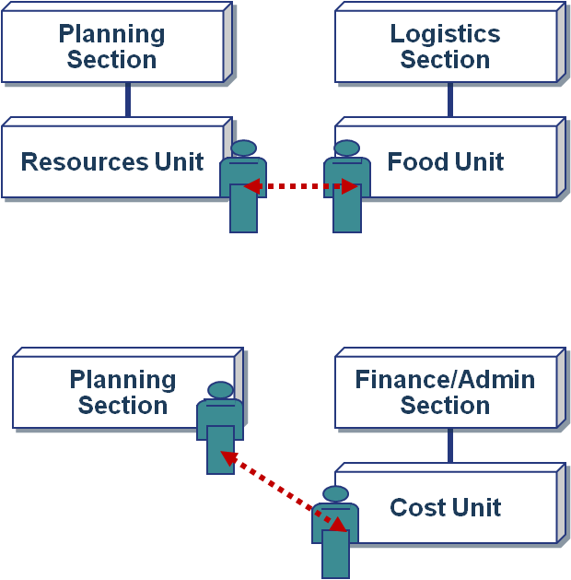
Informal Communication: Examples
Visual 2.14

Slide 15
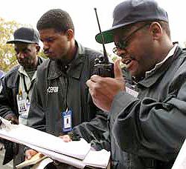
Common Terminology
Using common terminology helps to define:
  Organizational functions.
  Incident facilities.
  Resource descriptions.
  Position titles.
Visual 2.15

Slide 16
Incident Management Roles
Incident Commander | EOC Director and Staff
Manage the incident at the scene Keep the EOC/ MAC Group informed on all important matters pertaining to the incident | Support the Incident Commander and the MAC Group: Provide Resources Plan for Resource Requirements Facilitate Situational Awareness
Joint Information System | Senior Officials/ MAC Group
Enable communication between incident personnel Provide Critical Information to the Public | Provide the Incident Commander and the EOC staff: Authority Mission & Strategic direction Policy
Visual 2.16

Slide 17
Modular Organization
Incident command organizational structure is based on:
  Size, type, and complexity
  of the incident.
  Specifics of the hazard
  environment created by
  the incident.
  Incident planning process
  and incident objectives.
  Handout 2-2: Incident Complexity
Visual 2.17

Slide 18
Modular Expansion
  Develop organizational structure to support function or task to be performed
  Staff only the organizational elements needed to perform those functions or tasks
  Ensure manageable span of control
  Next higher supervisor performs any function for which a subordinate has not been activated
  Demobilize organizational elements that are no longer needed
Visual 2.18

Slide 19
Delegating ICS Supervisors
Designating subordinate Command and General Staff supervisors allows the Incident Commander to:
  Delegate the IC’s leadership responsibilities to subordinates.
  Maintain a manageable span of control.
Visual 2.19

Slide 20
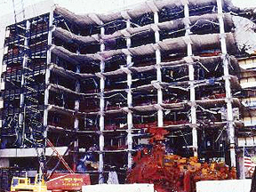
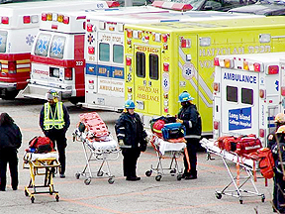
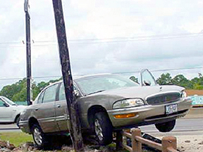
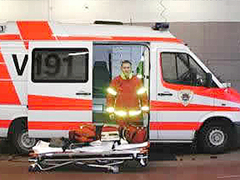
Incident Complexity and Resource Needs
Incident Complexity Resource Needs ICS Structure
Complexity
Visual 2.20

Slide 21
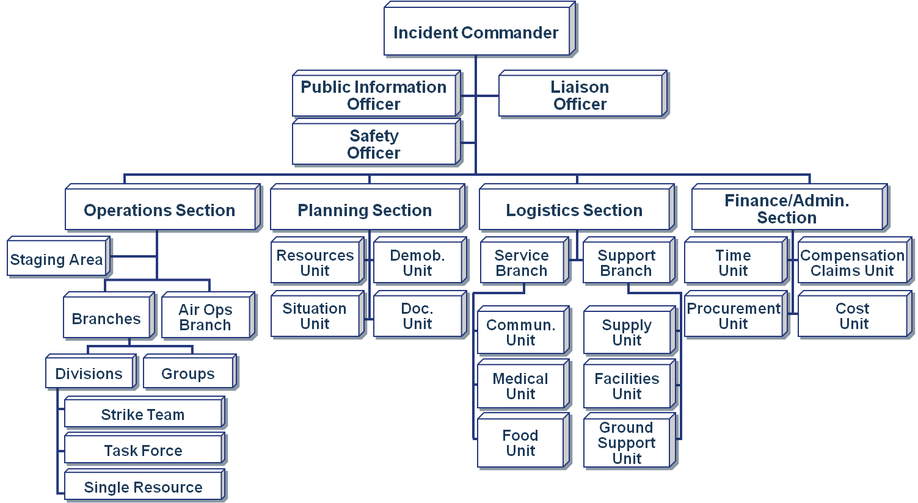
ICS Organizational Components
Visual 2.21

Slide 22
Intelligence/Investigations Function
Based on incident needs, the Intelligence and Investigations Function may be activated as a fifth Section, as an element within the Operations or Planning Sections, or as part of Command Staff.
Visual 2.22

Slide 23
ICS Supervisory Position Titles
Organizational Level | Title | Support Position
Incident Command | Incident Commander | Deputy
Command Staff | Officer | Assistant
General Staff (Sections) | Chief | Deputy
Branch | Director | Deputy
Division /Group | Supervisor | n/a
Unit | Leader | Manager
Strike Team/Resource Team/Task Force | Leader | Single Resource Boss
Visual 2.23

Slide 24
Facilitated Activity:
Matching Position Titles
Visual 1.24

Slide 25
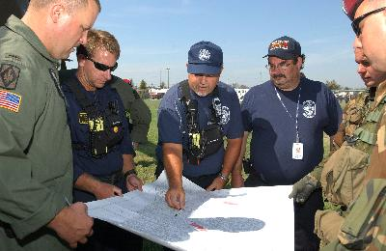
Unified Command Definition
  Provides guidelines to enable agencies with different legal, geographic, and functional responsibilities to coordinate, plan, and interact effectively.
Visual 2.25

Slide 26
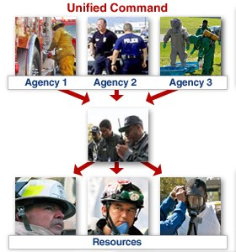
Unified Command Advantages
  Enables all agencies with responsibility to manage an incident together by establishing a common set
  of incident objectives and strategies.
  Allows members of the Unified Command to make joint decisions by establishing a single command structure.
  Maintains unity of command. All tactical resources report to one Operations Section Chief.
Visual 2.26

Slide 27
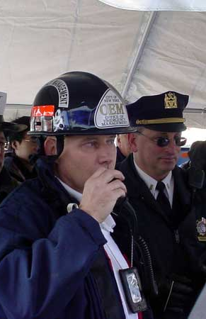
Unified Command Features
  A single integrated incident organization.
  Collocated (shared) facilities
  One set of incident objectives, single planning process, and IAP.
  Integrated General Staff.
  Coordinated process for resource ordering.
Visual 2.27

Slide 28
Unified Command Principles
Policies: Established by participating jurisdiction and/or agency authorities.
Objectives: Set by members of Unified Command.
Organization: Participating jurisdictional or agency on-scene senior representatives operate in a Unified Command structure.
Resources: Supplied by the jurisdictions and agencies that have functional or jurisdictional, legal, and financial responsibility.
Operations: Directed by the Unified Command’s Operations Section Chief, who controls tactical resources.
Visual 2.28

Slide 29
Planning “P” and Unified Command
The members of the Unified Command meet
During Initial Response to:
  Assess the situation
  Set objectives and priorities
  Discuss authorities
  Establish the ICS organization
Again at the beginning of each Operational Period planning cycle to develop or update objectives
Visual 2.29

Slide 30
Advantages of Unified Command
What are the advantages of using Unified Command?
What are the advantages of using Unified Command?
Visual 2.30

Slide 31
Advantages of Using Unified Command: Overview
  Single set of objectives developed for entire incident.
  Collective approach develops strategies to achieve objectives.
  Improved information flow and coordination between jurisdictions and agencies.
  All agencies understand joint priorities and restrictions.
  Agency’s legal authorities not compromised or neglected.
  Single Incident Action Plan combines efforts and optimizes assignment performances.
Visual 2.31

Slide 32
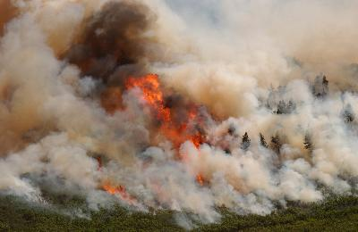
Unified Command: Multiple Jurisdictions
Incidents that impact more than one political jurisdiction
Example: A wildland fire starts in one jurisdiction and burns into another jurisdiction. Responding agencies from each jurisdiction have the same mission (fire suppression), and it is the political and/or geographical boundaries that mandate multiagency cooperation and involvement.
Example: A wildland fire starts in one jurisdiction and burns into another jurisdiction. Responding agencies from each jurisdiction have the same mission (fire suppression), and it is the political and/or geographical boundaries that mandate multiagency cooperation and involvement.
Visual 2.32

Slide 33
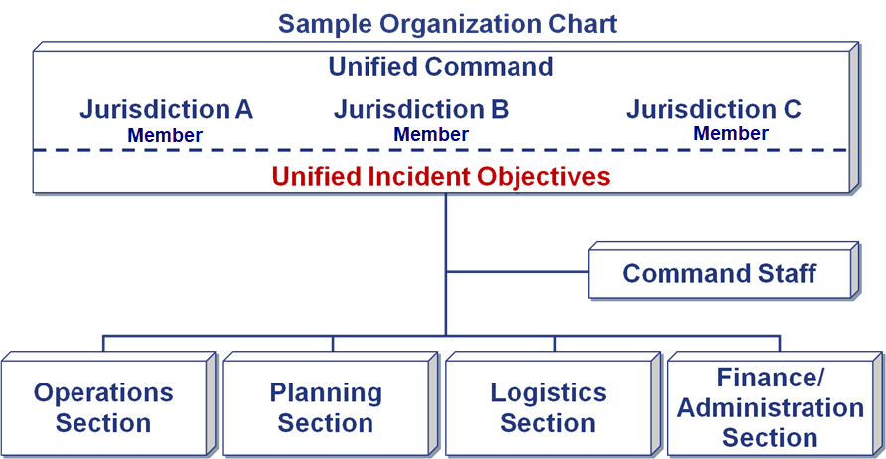
Multijurisdictional Incident
Visual 2.33

Slide 34
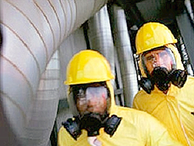
Unified Command: Multiple Agencies/Single Jurisdiction
Incidents involving multiple agencies/departments within the same political jurisdiction
Example: During a hazardous materials incident, the fire department has responsibility for fire suppression and rescue, the police department has responsibility for evacuation and area security, and public health agencies and others have responsibility for site cleanup.
Example: During a hazardous materials incident, the fire department has responsibility for fire suppression and rescue, the police department has responsibility for evacuation and area security, and public health agencies and others have responsibility for site cleanup.
Visual 2.34

Slide 35
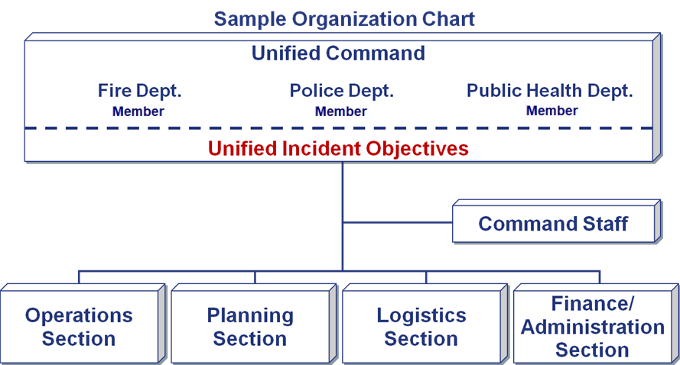
Multiagency/Single Jurisdiction Incident
Visual 2.35

Slide 36
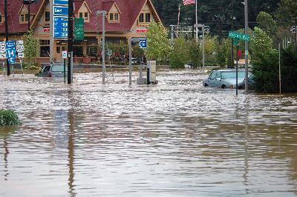
Unified Command: Multiagency/Multijurisdictional
Incidents that impact on (or involve) several political and functional agencies
Example: Severe weather, earthquakes, wildland fires, some special events, and terrorist threats involve large numbers of local, State, and Federal agencies. These incidents cross political boundaries and involve multiple
functional authorities.
Example: Severe weather, earthquakes, wildland fires, some special events, and terrorist threats involve large numbers of local, State, and Federal agencies. These incidents cross political boundaries and involve multiple
functional authorities.
Visual 2.36

Slide 37
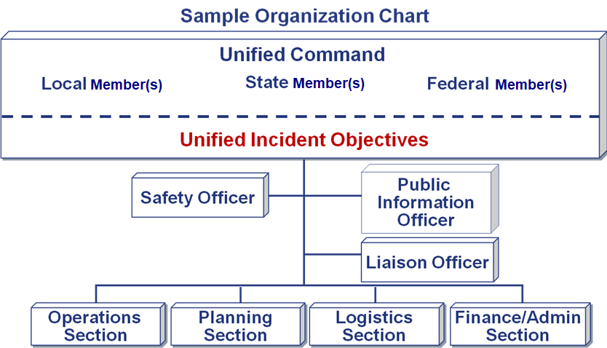
Multiagency/Multijurisdictional Incident
Visual 2.37

Slide 38
Activity 2.1:
Unified Command Roles and Relationships
Allotted Time: 1 hour 30 minutes
Visual 2.38

Slide 39
Objectives Review
  How does ICS fit into the Command and Coordination component of NIMS?
  What are the reporting relationships and information flow within the organization?
  Can you match ICS supervisory positions with titles?
  What are considerations for developing an organizational structure and delegating authority to the lowest practical level that enable management of an incident?
  What are the primary features of UC?
  How does UC function on a multiagency incident?
Visual 2.39

