Slide 1
E/L/G 300 Intermediate Incident Command System for Expanding Incidents, ICS 300

Slide 2
Unit 1:
Course Introduction

Slide 3
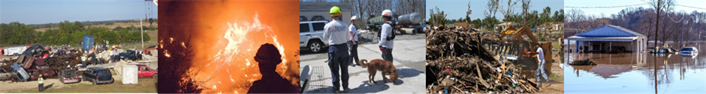
Unit Terminal Objective
Identify the course scope, objectives,
and classroom logistics.
Visual 1.3

Slide 4
Unit Enabling Objectives
Identify the course scope and objectives.
Explain how assigned groups will function during the course activities.
Visual 1.4

Slide 5
Administrative Considerations
  Lodging
  Transportation
  Safety Procedures
  Smoking Policy
  Message and Telephone Location
  Cell Phone, Texting and Email Policies
  Restrooms and Drinking Fountains
  Other Local Information
  Facility Safety
  Lunches / Breaks
Visual 1.5

Slide 6

Introductions
Instructor and student introductions
Incident response experiences
Disaster experience
Course pre-test.
Visual 1.6

Slide 7
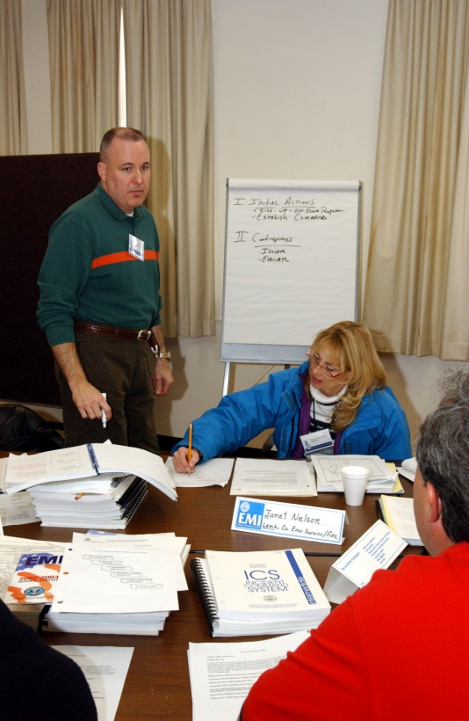
Expectations
  Instructional Team
  Student
Visual 1.7

Slide 8
Course Objective
By the end of this course, students will be able to demonstrate through activities and a Final Exam, the duties, responsibilities, and capabilities of an effective ICS in expanding incidents.
Visual 1.8

Slide 9
Course Terminal Learning Objectives
  Given a simulated situation, identify roles and reporting relationships under a Unified Command that involves agencies within the same jurisdiction and under multijurisdictional conditions. (Unit 2)
  Develop incident objectives for a simulated incident. (Unit 3)
  Create an ICS Form 215, Operational Planning Worksheet, and an ICS Form 215A, Incident Action Plan Safety Analysis, using the strategies and tactics from a given scenario. (Unit 4).
Visual 1.9

Slide 10
Course Terminal Learning Objectives (Cont.)
  Create a written IAP for an incident/event using the appropriate ICS forms and supporting materials and use the IAP to conduct an Operational Period Briefing. (Unit 5)
  Explain the principles and practices of incident resources management. (Unit 6)
  Identify demobilization considerations for a given scenario. (Unit 7)
  Summarize the course objectives. (Unit 8)
Visual 1.10

Slide 11

Course Structure
  Unit 1 – Course Introduction
  Unit 2 – ICS Fundamentals Review
  Unit 3 – Initial Actions for Unified Command
  Unit 4 – Implementing an Operational Process
  Unit 5 – Planning Process, IAP, and Operations Brief
  Unit 6 – Incident Resource Management
  Unit 7 – Demobilization, Transfer of Command, Closeout, and Transition to Recovery
  Unit 8 – Course Summary
  Handout 1-1: Course Agenda
Visual 1.11

Slide 12
Course Design
Course length of 3 days.
Combination of lecture, discussion, and activities.
Prerequisites –
  IS-0100.c
  IS-0200.c
  IS-0700.b
  IS-0800
Closed-book Final Exam.
Visual 1.12

Slide 13

Successful Course Completion
  Participate in unit activities.
  Achieve 75% or higher on the Final Exam.
  Daily Check-in List.
  Create an IAP and associated documentation.
  Complete end-of-course evaluation.
Visual 1.13

Slide 14
Activity 1.1:
Group Formation
Allotted Time: 20 minutes
Visual 1.14

Slide 15
Objectives Review
  What is the course scope? Objective?
  How will your assigned group operate during this course?
Visual 1.15

