Slide 1
Unit 6: Course Summary

Slide 2
Unit Terminal Objective
Summarize the course objectives.
Visual 6.2

Slide 3
Unit Enabling Objectives
Identify key discussion points/topics and expectations from the course.
Visual 6.3

Slide 4
Review ICS 400 Course Objectives
Identify the course scope, objectives, and classroom logistics.
Given a scenario and review materials, apply key NIMS doctrine concepts (NIMS Management Characteristics, Unified Command, Incident Command System structure and functional area responsibilities, IAP Preparation and the Operational Period Planning Cycle, and incident complexity) to the management of a complex incident or event.

Slide 5
Review ICS 400 Course Objectives (Cont.)
Apply the appropriate structural option to manage a complex incident.
Given a scenario, develop an Area Command organization.
Identify the complex incident management issues that can result from a lack of multiagency coordination.
Summarize the course objectives.

Slide 6
Review Course Expectations
Did the course meet your expectations?
Did the course meet your expectations?

Slide 7
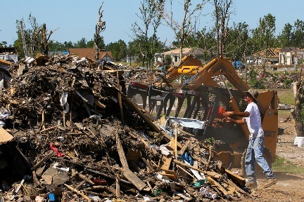
Final Exam
Visual 6.7

Slide 8
Feedback
Please complete the course evaluation form.
Your comments are important!
Visual 6.8

