Slide 1
Unit 5: Interconnectivity of NIMS Command and Coordination Structures

Slide 2
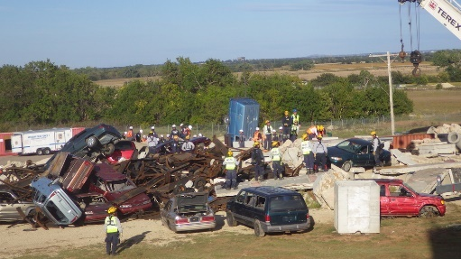
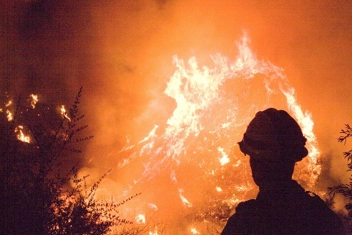
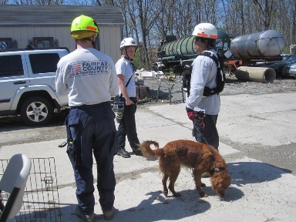
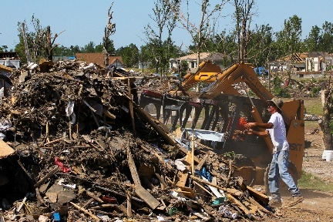
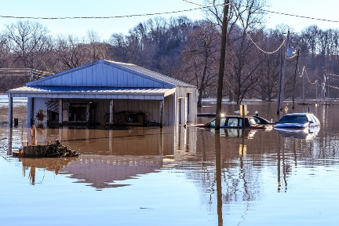
Unit Terminal Objective
Identify the complex incident management issues that can result from a lack of multiagency coordination.

Slide 3
Unit Enabling Objectives
Define essential terms related to multiagency coordination.
Identify examples of the different levels at which multiagency coordination is commonly accomplished.
Explain the NIMS functional groups within a Multiagency Coordination System.
Identify examples of organizations that may provide multiagency coordination.
List the responsibilities of EOCs and MAC Groups.
Describe the respective roles of Incident Command, Area Command, Unified Command, EOCs, and MAC Groups.

Slide 4
Response Coordination Challenges
Increasing incident complexity
Complex and confusing legal authorities
Increasing litigation
Increasing response costs
High property and economic losses
Life, health, safety issues
Deteriorating public view of government
Intense media and public scrutiny
Political, legislative, and budgetary ramifications

Slide 5
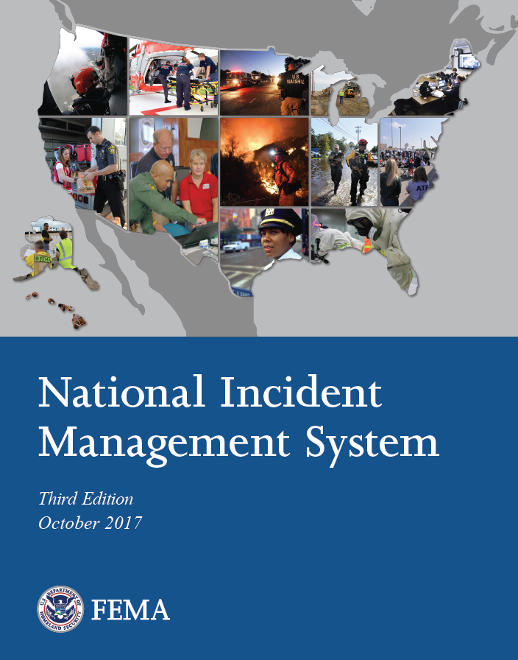

NIMS Components Review
Incident Command System
Emergency Operations Center
Resource Management
Command and Coordination
Multiagency Coordination Group
Communications and
Information Management
Joint Information Systems
Visual 5.5

Slide 6
Command vs. Coordination
What is the difference between command and coordination?

Slide 7
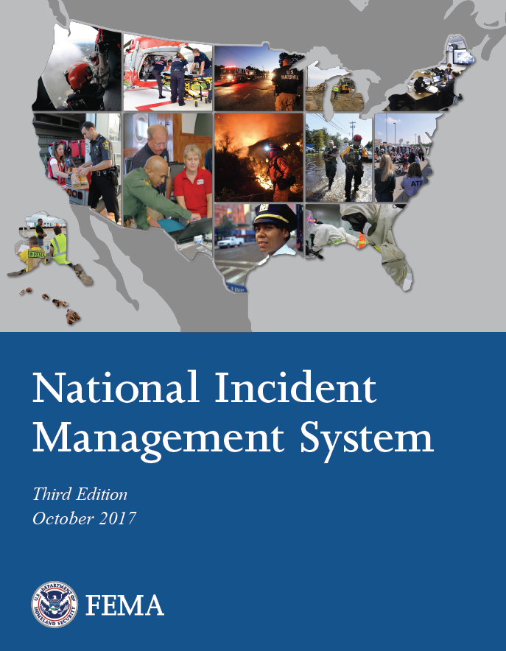
NIMS: Command
Command: The act of directing, ordering, or controlling by virtue of explicit statutory, regulatory, or delegated authority.
Who has the explicit authority for the management of all incident operations?
Who has the explicit authority for the management of all incident operations?

Slide 8
NIMS: Coordination
Coordination is the exchange of information systematically among principals who have or may have a need to know certain information to carry out specific incident management responsibilities.
An entity/individual may have “command and control” over resources and policies without being in command of the incident scene.
An entity/individual may have “command and control” over resources and policies without being in command of the incident scene.

Slide 9
Terminology Review
How does Area Command differ from
an EOC?
Where is Unified Command
How does Area Command differ from
an EOC?
Where is Unified Command applied?

Slide 10
Unity of Command & Unity of Effort
MAC Groups
Local
Emergency
Ops Center
(EOC)
State
Emergency
Ops Center
(EOC)
Federal Emergency Ops Center (EOC)
Unity of
Effort
Policy, Coordination, and Support
Command
Unity of
Command
Area
Command
NIMS Command and Coordination (Multiagency Coordination System)
Incident
Commander
1
Incident
Commander
2
Incident
Commander
3

Slide 11

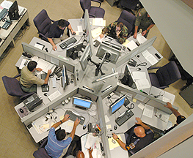
MAC System
A MAC System:
May be as simple as a teleconference, or
May require an assembled group and associated support systems.

Slide 12

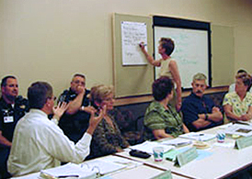

Common Coordination Organizations
  MAC Group
  Crisis Action Teams
  Policy Committees
  Agency Executives
  Dispatch Centers
  Emergency Operations Centers (EOCs)
  Department Operations Center (DOCs)
  National Operations Center
Decisionmakers
Facilities/Ops Support
Notes:
Added hyphen to inter-incident.

Slide 13
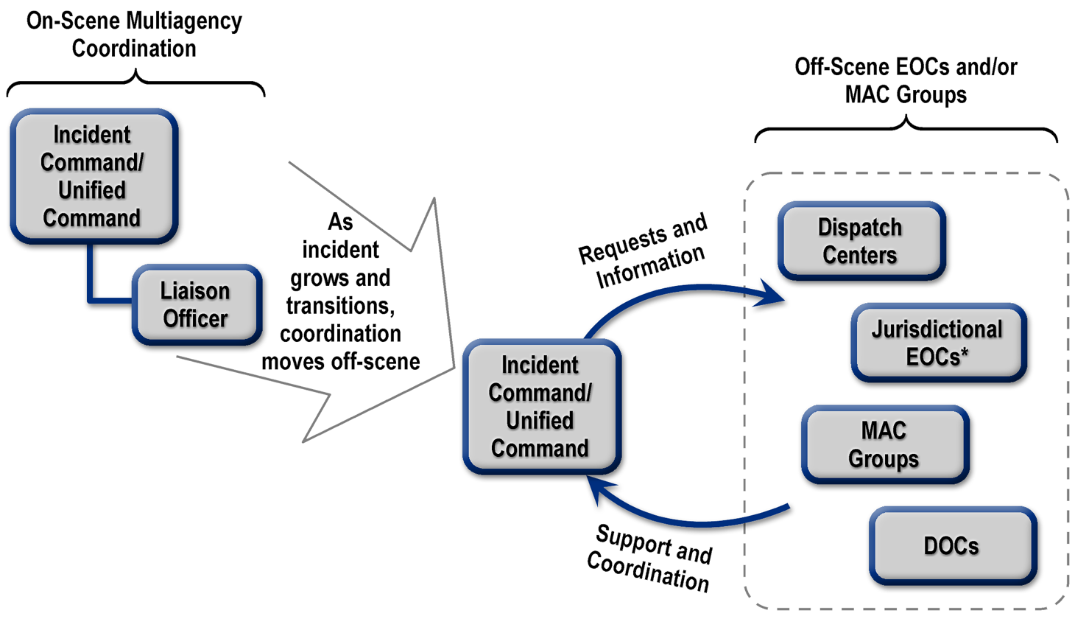
Interconnectivity of NIMS Command and Coordination Structures

Slide 14
Emergency Operations Centers (EOC)
EOCs are locations where staff from multiple agencies typically come together to address imminent threats and hazards and to provide coordinated support to incident command, on-scene personnel, and/or other EOCs.
EOCs may be fixed locations, temporary facilities, or virtual structures with staff participating remotely.

Slide 15
EOCs vs. DOCs: What’s the Difference?
Departmental operations center (DOC) staff coordinate their agency or department’s activities. While they communicate with other organizations and EOCs and may exchange liaisons with other agencies, DOC staff are primarily inward looking, focusing on directing their own assets and operations.
Unlike DOCs, the EOCs addressed in NIMS are inherently multidisciplinary activities.

Slide 16
Modular EOC Organizations
Common ways of organizing EOC teams:
ICS-like EOC Structure
Incident Support Model (ISM) EOC Structure
Departmental EOC Structure

Slide 17
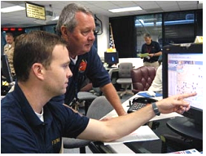
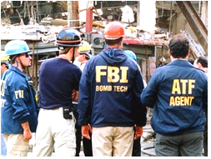
EOC Activation
EOCs frequently have multiple activation levels to allow for a scaled response, delivery of the needed resources, and a level of coordination appropriate to the incident.

Slide 18
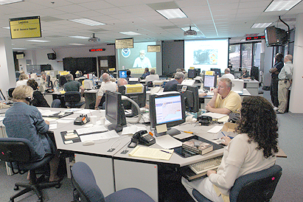

Primary EOC Coordination Functions
Collect and analyze information
Share information
Support resource needs and requests
Coordinate plans and determine current and future needs
Provide coordination and policy direction

Slide 19
Enhanced Situational Awareness and Decision Support
Situational awareness (SA) and decision support can be enabled by using single, identical summary/presentation of critical incident information that is shared by all responders and organizations.
What are the potential challenges in maintaining SA? What info required for decision support?
What can an EOC do to address those challenges?
What can an EOC do to address those challenges?
What are the potential challenges in maintaining SA? What info required for decision support?

Slide 20
Multiagency Coordination Group (MAC Group)
MAC Groups (policy groups):
Part of the off-site incident management structure of NIMS.
Consist of representatives from stakeholder agencies or organizations.
Established and organized to make cooperative multiagency decisions.

Slide 21
Discussion Question
What can the policymakers within a MAC Group do to facilitate their decision making process?

Slide 22
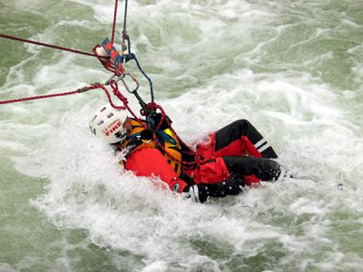
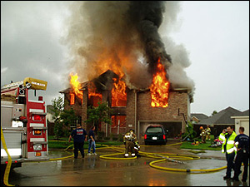
Prioritization Considerations for MAC Groups
Saving lives
Protecting property and the environment
Stabilizing the incident
Providing for basic human needs
Legality
Funding
Public and media concerns
Other “political” issues.

Slide 23

Role of the MAC Group
Interagency decision-making related to:
Incident management policies and priorities.
Logistics support and critical resource tracking.
Resource allocation.
Coordinating incident-related information.
Coordinating interagency and intergovernmental issues regarding incident management policies, priorities, and strategies.

Slide 24
MAC Group Organization Example
MAC Group
Agency
Representatives
MAC Group
Coordinator
MAC Group
Situation
Assessment
Unit
MAC Group Resource Status Information
Unit
Joint Information Center
(JIC)

Slide 25
Joint Information System
The Joint Information System (JIS):
  Ensures that the public receives a consistent and comprehensive message.
  Consists of the processes, procedures, and tools to enable communication to the public, incident personnel, the media, and other stakeholders.
  Integrates incident information and public affairs into a cohesive organization to provide coordinated and complete information before, during, and after incidents.

Slide 26
JIS: Public Information Officer
Public Information Officer:
Key members of ICS and EOC organizations
Work closely with senior officials represented in MAC Groups.
Create coordinated and consistent messages to the public and media.

Slide 27

Joint Information Center
The Joint Information Center (JIC):
Is a physical location used to coordinate crisis communications, critical emergency information, and public affairs functions.
May be established at each level of incident management, as required.
Must include representatives
of all stakeholders.

Slide 28
Federal Support to Response and Recovery Activities
The Federal Government becomes involved with a response:
When state governors or tribal leaders request Federal assistance and the requests are approved;
When Federal interests are involved; or
As statute authorizes or requires.

Slide 29
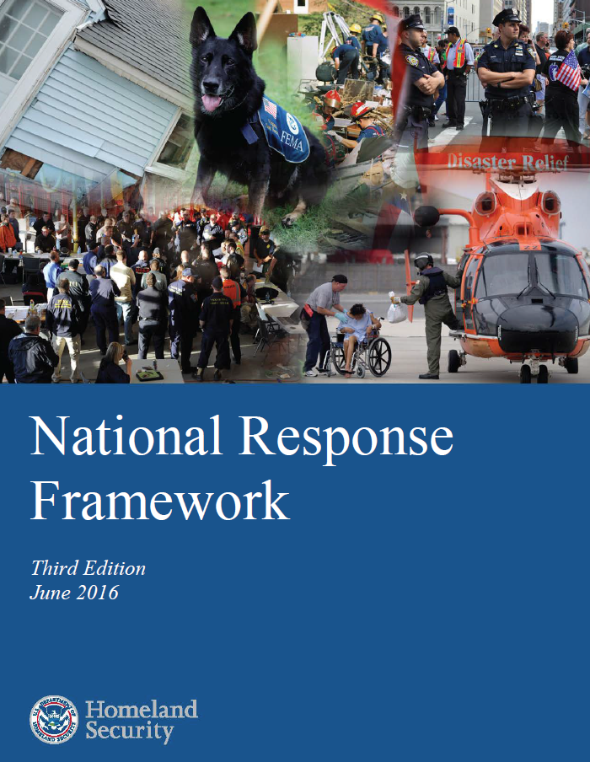
National Response Framework
Establishes a comprehensive, national, all-hazards approach to domestic incident response.
Defines principles, roles, and structures.

Slide 30
NRF Emphasizes Partnerships
Federal Government Last Resort!
State Government Provides Support
Local Government First Response!
Individuals and Households
Private Sector
Nongovernmental Organizations
Federal Government Last Resort!
State Government Provides Support
Local Government First Response!
Individuals and Households
Private
Sector
Nongovernmental Organizations

Slide 31
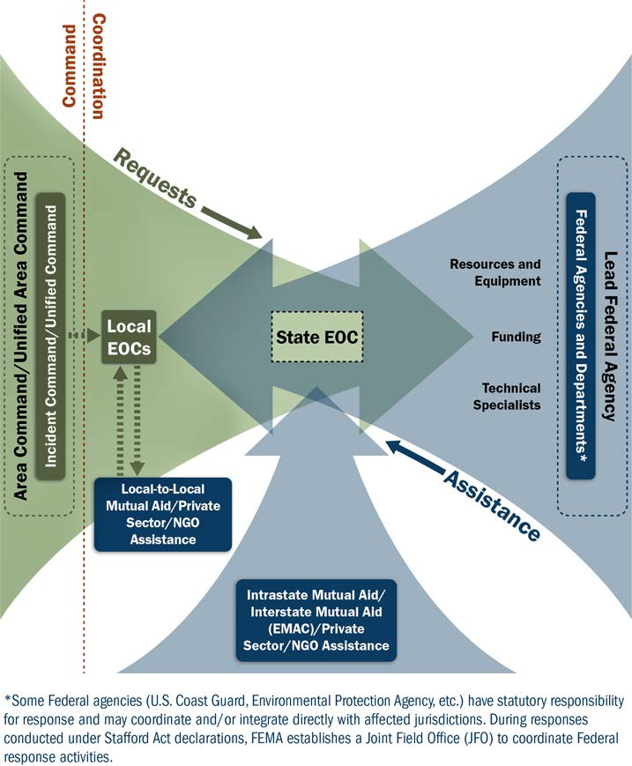
Federal Support to Response Activities

Slide 32
Mutual Aid and Assistance Agreements
Allow one jurisdiction to provide resources, facilities, services, and other needed support to another jurisdiction during an incident.
Intrastate Mutual Aid
Interstate Mutual Aid (EMAC)
Local-to-Local Mutual Aid

Slide 33
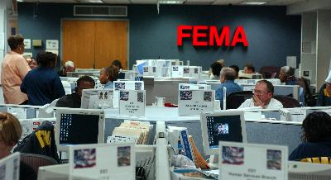
National Operations Center (NOC)
The National Operations Center serves as the primary, national-level hub for:
situational awareness,
shared situational picture,
information fusion,
information sharing,
executive
communications.

Slide 34
National Response Coordination Center
The FEMA National Response Coordination Center (NRCC) is a multiagency emergency operations center that coordinates the overall Federal support for major incidents and emergencies at the national level.
The NRCC coordinates with the affected region(s) and provides resources and policy guidance in support of the incident.

Slide 35
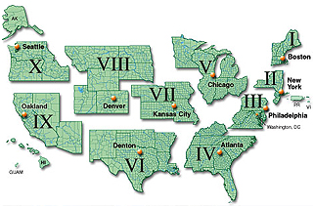
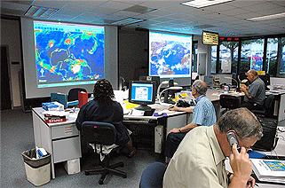
Regional Response Coordination Center
Coordinate regional response efforts, including:
Establishing initial Federal objectives.
Providing Federal support to the affected States.
Deploying teams to establish the Joint Field Office that will assume these functions.

Slide 36
Joint Field Office
JFO Unified
Coordination Group
Federal Coordinating Officer (FCO)
State Coordinating Officer (SCO)
Senior Federal Officials (SFOs)
Chief of Staff
External Affairs
Safety Officer
Defense Coordinating
Element
Operations Section
Planning
Section
Logistics
Section
Finance/Admin Section
Emergency Support Functions

Slide 37
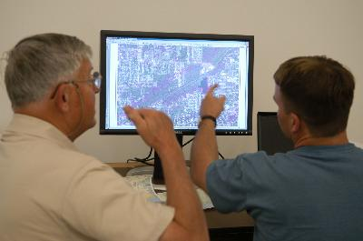
Emergency Support Functions (ESFs)
Primary Federal-level mechanism to provide assistance.
Organized around functional capabilities (e.g., public health, search and rescue, etc.).
Composed of primary
and supporting
agencies.

Slide 38
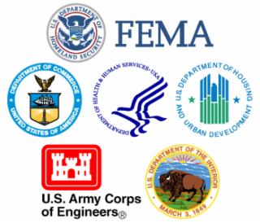
Recovery Support Functions (RSFs)
Represent the Coordinating Structure for Federal Recovery Support.
Support local governments.
Each RSF has a coordinating
agency, primary agencies,
and supporting organizations.

Slide 39
Capstone Activity:
Organize a Complex Incident
Allotted Time: 60 minutes

Slide 40
Objectives Review
What are essential terms related to multiagency coordination?
What are a few examples of the different levels at which multiagency coordination is commonly accomplished?
What are the NIMS functional groups within a Multiagency Coordination System?

Slide 41
Objectives Review (Cont.)
What are examples of organizations that may provide multiagency coordination?
What are the responsibilities of EOCs and MAC Groups?
Briefly describe the roles of Incident Command, Area Command, Unified Command, EOCs, and MAC Groups.

