Slide 1
Unit 4:
Area Command

Slide 2
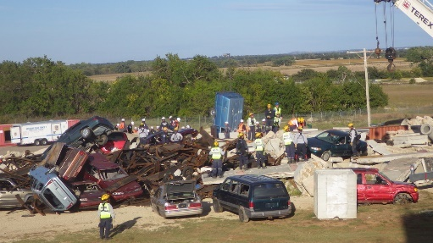
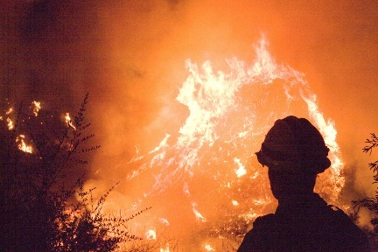
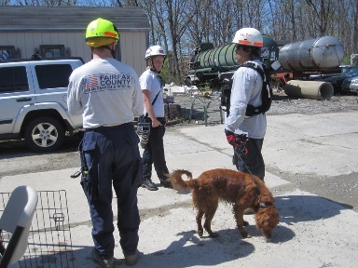
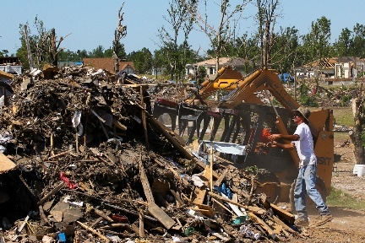
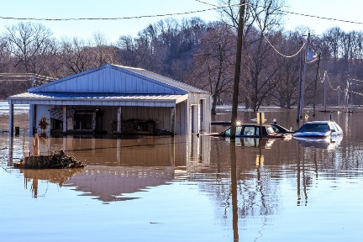
Unit Terminal Objective
Given a scenario, develop an Area Command organization.

Slide 3
Unit Enabling Objectives
Define the Area Command organization.
Identify primary functional responsibilities of Area Command.
List the principal advantages of using Area Command.
Explain considerations (when, where and how) for establishing an Area Command.

Slide 4

Definition of Area Command
Area Command is used to oversee the management of:
Multiple incidents that are each being handled by an Incident Command System organization; or
A very large incident that has multiple Incident Management Teams assigned to it.
Area Commander
Incident 1
Incident Commander
Incident 2
Incident Commander
Incident 3
Incident Commander

Slide 5
Area Command: Primary Functions
Develop broad objectives for the affected area.
Coordinate development of incident objectives and strategies for each incident.
Allocate or reallocate resources as priorities change.
Ensure that ICs/UC properly manage incidents.
Ensure effective communications and data coordination.
Ensure that incident objectives are met and do not conflict.
Identify and report needs for scarce resources.
Ensure that short-term recovery is coordinated with the EOC staff.

Slide 6
Responsibilities and Relationships
Emergency
Ops Center
(EOC)
Area
Command
Incident
Commander
1
Incident
Commander
2
Incident
Commander
3
An Area Command oversees management of multiple incidents, while EOCs coordinate support. MAC Groups provide policy guidance and strategic direction to Area Command and EOCs.

Slide 7
Unified Command vs. Area Command
What is the difference between Unified Command and Area Command?
What is the difference between Unified Command and Area Command?

Slide 8
Advantages of Area Command
Coordination between incidents.
Establishes broad objectives, ensures that incident objectives are met.
Setting priorities deconflicts resource requirements.
Communicates policies, priorities, constraints, and guidance.
Assist in maintaining shared situational awareness.
Plan for future requirements – demobilization, transition to recovery,
Reduces the workload of the EOCs/MAC Group.

Slide 9
Chain of Command & Reporting Relationships
Agency
Administrator(s)
Area
Commander/
Unified Command
Incident
Commander 1
Incident
Commander 2
Incident
Commander 3

Slide 10
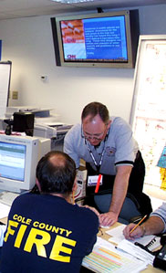
Area Command: Best Practices
Area Command should:
Receive its authority through a written delegation of authority.
Notify Incident Commanders
of its authorities and roles.
Be staffed with qualified and experienced personnel.
Operate under standard ICS principles.
Be as small as practical.

Slide 11
Activity 4.1:
Katrina Area Command Scenario
Allotted Time: 15 minutes

Slide 12
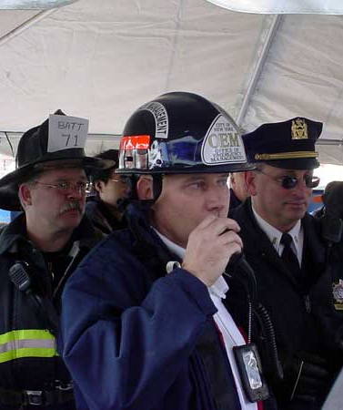
When Should Area Command Be Established?
As soon as possible when:
Several active incidents are in close proximity.
Critical life saving or property values are at risk due to incidents.
Incidents will continue into the next operational period.
Incidents are using similar and limited critical resources.
Difficulties are encountered with inter-incident resource allocation and coordination.

Slide 13
Area Command Organization
Area Commander
Assistant Area Commander
Planning
Area Command
Public Information Officer
Area Command
Situation Unit Leader
Area Command
Critical Resources Unit Leader
Area Command
Liaison Officer
Assistant Area Commander
Logistics
Incident 1
Commander
Incident 2
Commander
Incident 3
Commander

Slide 14
Area Command: Storm
Liberty County
Unified Area Command
Public Works/County Sheriff/Fire/EMS
Area Command
Public Information Officer
Area Command
Liaison Officer
Assistant Area Commander
Planning
Assistant Area Commander
Logistics
Area Command
Situation Unit Leader
Area Command
Critical Resources Unit Leader
Traffic Engineer
Weather Specialists
GIS Mapping Specialist
Springfield Unified Command Law Enforcement/
Fire/EMS/
Public Works
Dayton Unified Command Law Enforcement/
Fire/EMS/
Public Works
River Bend Unified Command Law Enforcement/
Fire/EMS/
Public Works

Slide 15
Area Command: July 4th Celebrations/ Terrorist Threat
July 4th Unified Area Command Law Enforcement
Fire/EMS/Public Health
Area Command
Investigation/Intel Officer
Area Command
Liaison Officer
Area Command
Public Information Officer
Assistant Area Commander
Planning
Assistant Area Commander
Logistics
Area Command
Situation Unit Leader
Area Command
Critical Resources Unit Leader
Terrorist Specialists
Central City July 4th Unified Command
Law Enforcement/
Fire/EMS/
Public Health
River Bend July 4th Unified Command
Law Enforcement/
Fire/EMS/
Public Health
Liberty Co. July 4th Unified Command
Law Enforcement/
Fire/EMS/
Public Health

Slide 16

Area Commander/Unified Area Command: Responsibilities
  Overall direction of assigned incidents.
  Ensure conflicts resolved, incident objectives established, strategies for scarce resources selected.
  Coordinate with local, state, tribal, territorial, and Federal depts/agencies, NGOs and private sector.
  No operational responsibilities but prioritizes scarce resources among the incidents.
Area
Commander
Area Command
Public Information
Officer
Area Command
Liaison Officer
Assistant Area
Commander Planning
Assistant
Area Commander
Logistics
Area Command
Situation
Unit Leader
Area Command
Critical Resources
Unit Leader

Slide 17
Area Commander: Critical Activities
Assess
Establish Priorities
Allocate Resources
Rapidly assess each incident.
Communicate priorities to Commanders.
Ensure plans support priorities and policies.
Allocate/ reallocate critical resources.
Plan resource demobilization.
Communicate priorities to Commanders.
Ensure plans support priorities and policies.
Allocate/ reallocate critical resources.
Plan resource demobilization.

Slide 18
Area Command Officers
Public Information Officer:
Public Info coordination between Incidents.
Media POC for Area Command.
Uses JIS through a JIC (if established).
Liaison Officer:
Maintains off-incident interagency contacts and coordination.
Area
Commander
Area Command
Public Information
Officer
Area Command
Liaison Officer
Assistant Area
Commander Planning
Assistant
Area Commander
Logistics
Area Command
Situation
Unit Leader
Area Command
Critical Resources
Unit Leader

Slide 19
Assistant Area Commander – Planning
Area
Commander
The Assistant Area Commander – Planning collects information from various incidents to assess and evaluate potential conflicts in establishing incident objectives, strategies, and priorities for allocating scarce resources.
Area Commander
Public Information
Officer
Area Commander
Liaison Officer
Assistant Area
Commander Planning
Assistant
Area Commander
Logistics
Area Command
Situation
Unit Leader
Area Command
Critical Resources
Unit Leader

Slide 20
Assistant Area Commander – Logistics
Area
Commander
The Assistant Area Commander – Logistics provides facilities, services, and materials at the Area Command level (by ordering resources needed to support the Area Command) and ensures the effective allocation of scarce resources and supplies among the incidents.
Area Command
Public Information
Officer
Area Command
Liaison Officer
Assistant Area
Commander Planning
Assistant
Area Commander
Logistics
Area Command
Situation
Unit Leader
Area Command
Critical Resources
Unit Leader

Slide 21
Area Command Aviation Coordinator
Assigned when aviation resources at multiple incidents compete for common airspace and scarce resources.
Coordinates with incident aviation organizations to:
    Evaluate potential conflicts,
    Develop common airspace management procedures,
    Ensure aviation safety, and
    Allocate scarce resources IAW Area Command priorities.

Slide 22
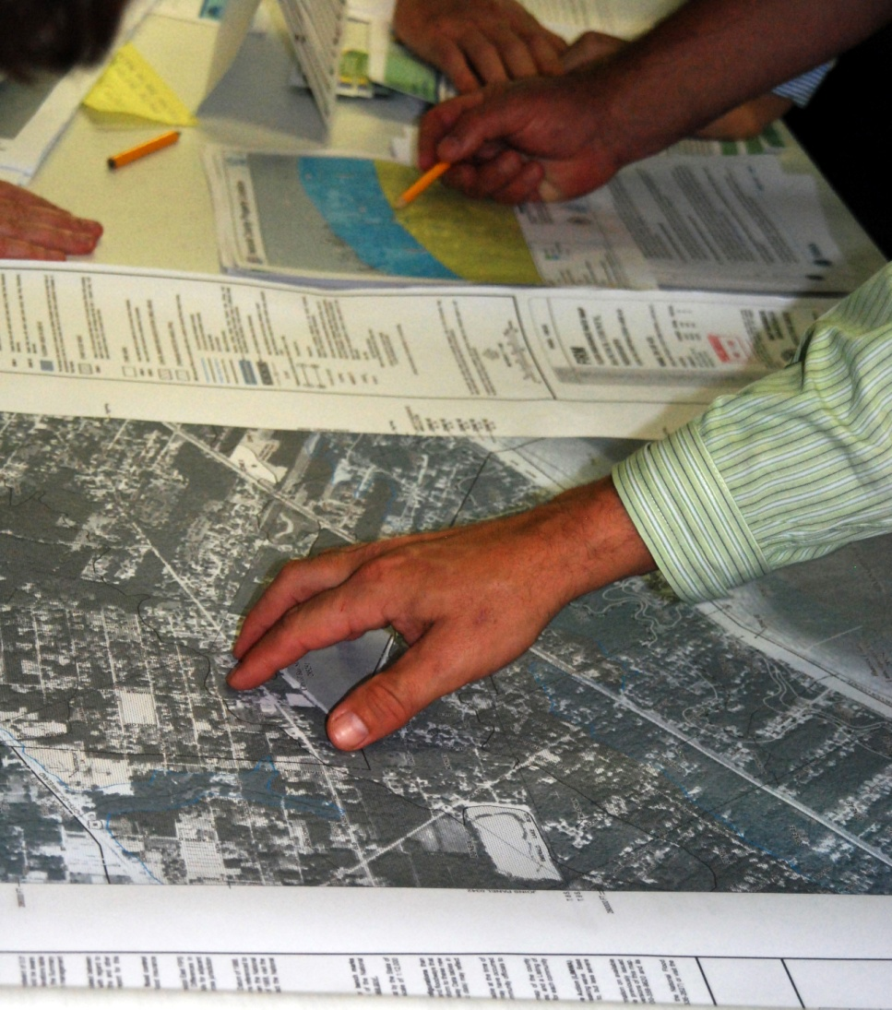
Area Command Technical Specialists
Assign technical specialists as additional command advisors, depending on the nature, scope, complexity, and location(s) of the incident(s), or according to specific needs the Incident Commanders or Unified Commands establish.

Slide 23
Agency Administrator Briefing
  General situation and incidents assigned
  Jurisdictional delegation of authority
  Assumption of command timing and notifications procedure
  Names and qualifications of Incident Commanders (indicating those under Unified Command)
  Limitations on the Area Commander's authority
  Current IAPs
  Policies, political factors, or other constraints
  Agency advisor
  Area Command facility
  Status of communications systems
  Critical resource designations
  Policy and expectations for interaction with the media
  Area Command reporting responsibility to agency
  Briefing and contact schedules

Slide 24
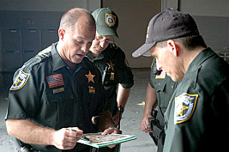
Area Commander Incident Briefing With IC/UC
Concise incident briefings (including IAPs and other documentation).
Area Command roles and responsibilities; conditions of Area Command’s delegation of authority.
Policy, direction, and priorities.
Conflict resolution procedures.
Communication procedures,
meeting schedules, etc.
Resource ordering process.
Critical resource needs.

Slide 25
Incident Commanders & Critical Priorities
Why must Incident Commanders accept the need for Area Command to establish critical priorities?

Slide 26
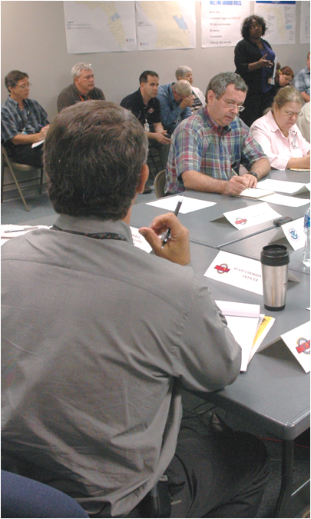
Area Command Meeting and Briefings
Incident situation
Incident priorities
Technical specialist reports
Identification of critical resource needs
Allocation and reallocation of resources
Public Information Officer report
Liaison Officer report
Demobilization of resources and transition to recovery

Slide 27
Demobilization and Transition to Recovery
Demobilization
Area Command coordinates the demobilization of critical resources with the ICs.
Area Command must ensure that personnel and equipment resources being released from demobilizing incidents can be made available to other active or growing incidents if needed.
Recovery
Area Command coordinates with EOCs to ensure necessary actions to support recovery efforts.

Slide 28
Activity 4.2:
Design an Area Command Organization and Process for a Simulated Incident.
Allotted Time: 2 hours

Slide 29
Objectives Review
How do you define the Area Command organization?
What are the primary functional responsibilities of Area Command?
What are the principal advantages of using Area Command?
What are the considerations (when, where and how) for establishing an Area Command?

