Slide 1
Unit 3:
Complex Incident Management

Slide 2
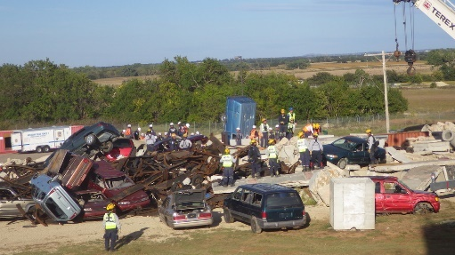
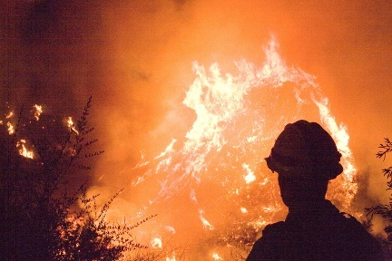
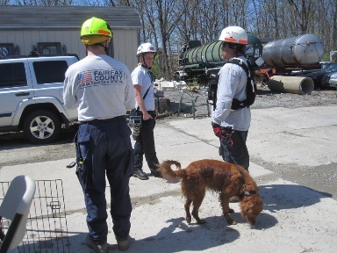
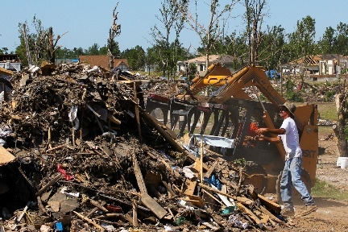
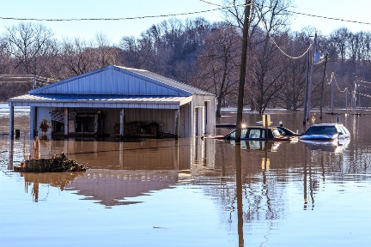
Unit Terminal Objective
Apply the appropriate structural option to manage a complex incident.

Slide 3
Unit Enabling Objectives
Identify the characteristics of a complex incident.
Explain the expansion options for complex incident organization and the conditions under which each would be applied.

Slide 4
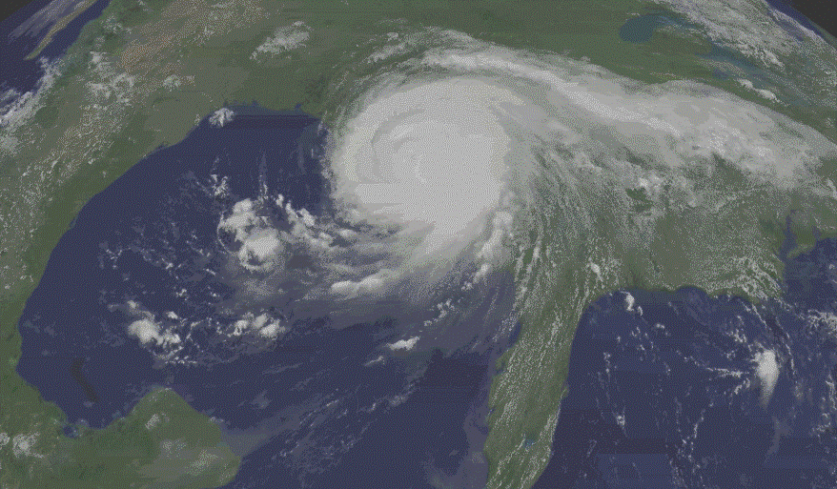
Facilitated Group Activity: Complex Incident Management
What are the characteristics of a complex incident?
What are the characteristics of a complex incident?
How does major or complex incident management differ?
How does major or complex incident management differ?

Slide 5
What Are Complex Incidents?
Involve multijurisdictional and/or multidisciplinary efforts of more than one agency and/or political jurisdiction.
May involve whole community efforts to include private industry and non-governmental organizations (NGOs).
Involve complex incident management and communication issues.
Require experienced, highly qualified supervisory personnel.
Require numerous tactical and support resources normally exceeding the jurisdiction’s internal resource capacity.
Span multiple operational periods (days, weeks, years).

Slide 6

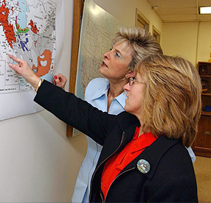

What Are Complex Incidents? (Cont.)
May involve multiple victims with injuries,
fatalities, or illnesses.
Include widespread damage to property/
environment/economy.
Result in psychological trauma.
Span multiple operational periods (days,
weeks, years).
Require extensive post-incident recovery
efforts. Are costly to control and mitigate.
Draw national media interest.
May require coordinated Federal assistance
and/or response.

Slide 7
Incidents Requiring Coordinated Federal Response
Federal assistance requested by appropriate State authorities due to resources overwhelmed.
Catastrophic incidents.
More than one Federal department or agency has become substantially involved in responding to an incident.
Presidential Directed.

Slide 8
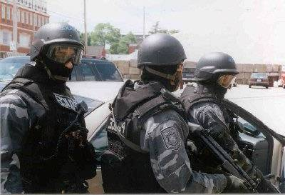
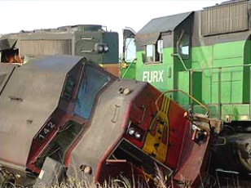
Determining Size & Structure of the ICS Organization
Specifics of the incident and identified objectives.
Number and type of resources that must be managed.

Slide 9
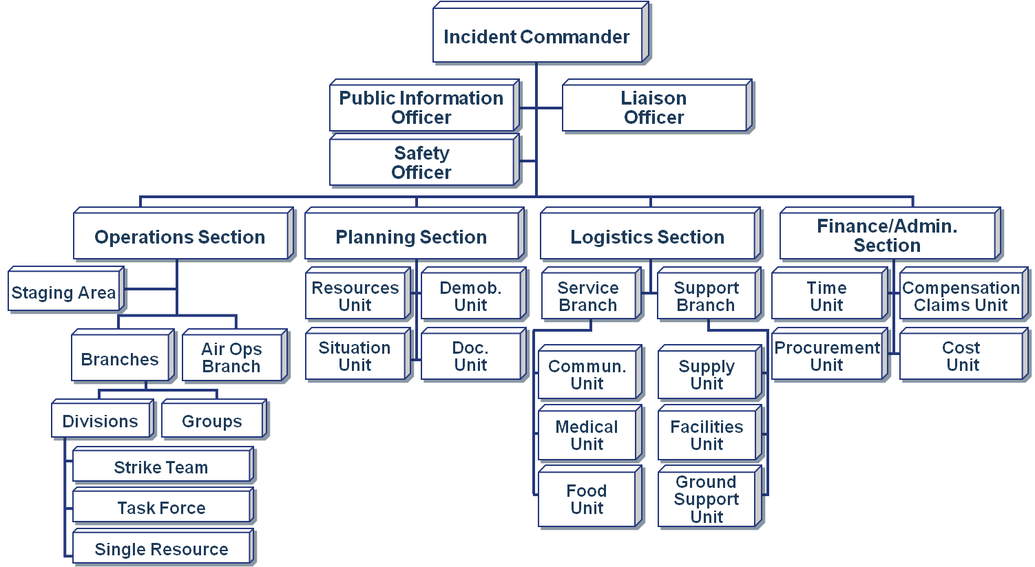
Characteristics: ICS Organization

Slide 10
Characteristics: Logistics & Planning
Complexity Affects Logistics
  A large number of tactical and support resources.
  Additional Incident facilities may be required.
  Specialized resources and support requirements.
  Resources not owned by the jurisdiction.
Complexity Affects Planning
  Multiple operational periods/dispersed ops.
  A Unified Command is likely.
  More robust planning section required.
  More extensive IAPs.
  Specialized planning functions conducted outside the planning section.

Slide 11
ICS Organizational Options
Options for managing a complex incident:
Combine several incidents into an incident complex.
Divide an incident into two or more single incidents.
Expand the planning capability.
Add a second Operations or Logistics section.
Establish the Intelligence/Investigations Function.

Slide 12

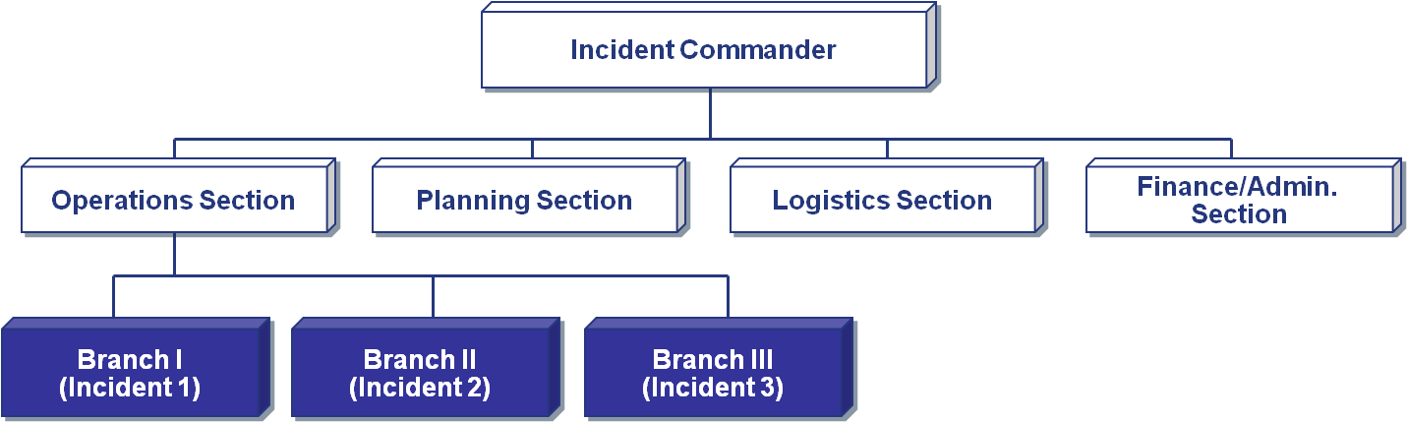
Option 1: Combining into an Incident Complex

Slide 13

Incident Complex: Definition
An incident complex is an organizational structure that exists when two or more individual incidents located in the same general area are assigned to a single Incident Commander or Unified Command.

Slide 14

Discussion Questions
What are examples of when it might be advantageous to establish an Incident Complex?
What is the difference between an Incident Complex and a complex incident?
What are examples of when it might be advantageous to establish an Incident Complex? What is the difference between an Incident Complex and a complex incident?

Slide 15
Incident Complex: Structure
Using Branches allows for more flexibility to establish Divisions or Groups if required later.

Slide 16
Option 2: Divide Incident into Two or More Single Incidents
Combine Several Incidents Into an Incident Complex
Divide an Incident Into Two or More Single Incidents
Expand the Planning Capability
Add a Second Operations or Logistics Section
Establish the Intelligence/Investigations Function
Combine Several Incidents Into an Incident Complex
Divide an Incident Into Two or More Single Incidents
Expand the Planning Capability
Add a Second Operations or Logistics Section
Establish the Intelligence/Investigations Function

Slide 17
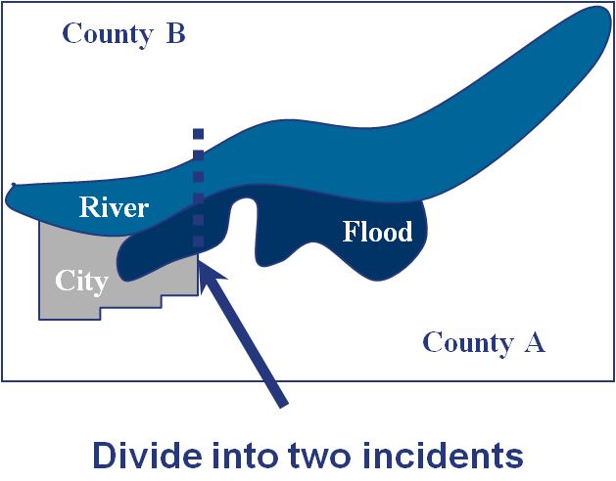
Dividing a Single Incident
A single incident may be divided when it:
Spreads into other jurisdiction(s) and Unified Command is not feasible.
Is difficult to manage from one location due to terrain and access.
Has objectives that are naturally separating into two operations.

Slide 18
Dividing a Single Incident (Cont.)
Incidents may be divided when:
The Planning Section, even with additional resources, can no longer adequately provide planning services.
The Logistics Section can no longer, or will soon not be able to, serve the widespread facilities and operations from a single Incident Base.
The Operations Section cannot manage
the number of resources required without exceeding span of control.

Slide 19
Considerations in Dividing an Incident
Determine how best to divide the incident.
Assign ICs and C&G Staff for each incident.
Designate additional supporting organizational facilities, locations, etc.
Designate an appropriate time for establishing two separate incidents (each with a unique name).
Coordinate planning strategies and use of critical resources for at least next operational period.
Consider the need for Area Command to be established over the incidents.

Slide 20
Option 3: Expand the Planning Capability
Combine Several Incidents Into an Incident Complex
Divide an Incident Into Two or More Single Incidents
Expand the Planning Capability
Add a Second Operations or Logistics Section
Establish the Intelligence/Investigations Function
Combine Several Incidents Into an Incident Complex
Divide an Incident Into Two or More Single Incidents
Expand the Planning Capability
Add a Second Operations or Logistics Section
Establish the Intelligence/Investigations Function

Slide 21
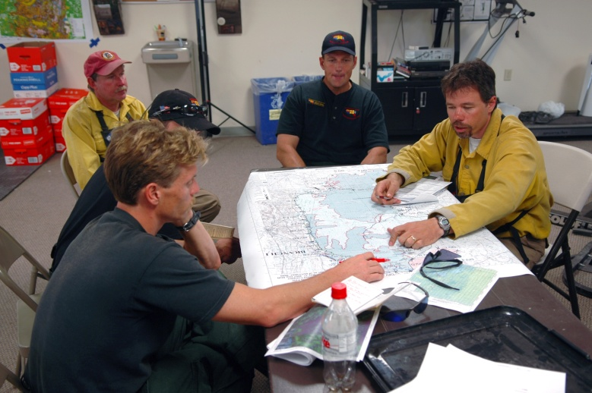
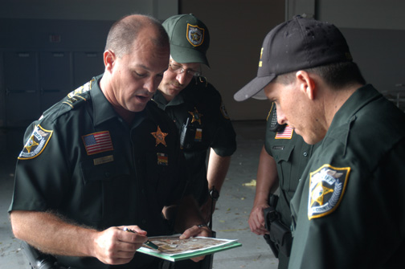
Tactical Planning Within Branches
Branch Tactical Planning means:
Detailed action plans are developed within Operations Section at Branch level.
Planning Section provides support.
An element outside of both Planning and Operations has planning responsibilities.

Slide 22
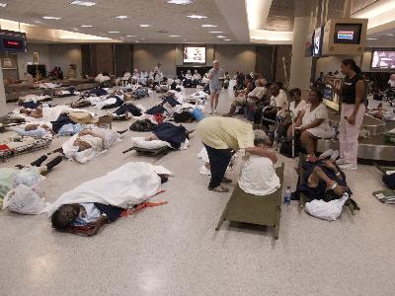
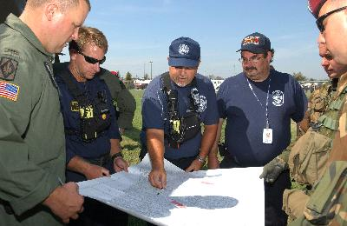
Branch Planning: Examples
In mass fatalities incidents, Medical Examiner/Morgue Operations Branch establish incident tactical plans.
In a structural collapse, the Search and Rescue Branch include planning component.
Intelligence/Investigations Function develop and implement a plan separate from IAP.

Slide 23
Accomplishing Branch Planning
When Branch Tactical Planning is used, the Planning Section provides:
General incident objectives.
Strategy for the Branch for the next operational period.
Branch resource summary for the next operational period.
Weather and safety information.
Changes to logistical support.
Personnel to support planning.

Slide 24
Discussion Questions
Why might you need to separate advanced planning from incident action planning critical during a complex
What are the challenges do you expect to encounter to ensuring during advanced planning nt?
Why might you need to separate advanced planning from incident action planning during a complex incident?
What are the challenges you expect to encounter during advanced planning?

Slide 25
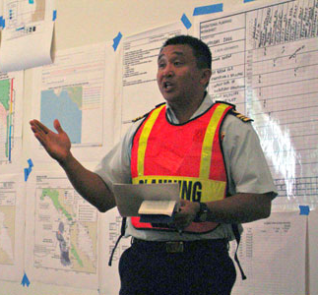

Separate Advanced Incident Planning
To ensure that advanced planning occurs, the Planning Section Chief may:
Assign a Deputy Planning Section Chief to manage advanced planning.
Assign technical specialists to perform advanced planning.
Establish a special unit within the Planning Section.

Slide 26
Advanced Planning Considerations
Advanced planning looks ahead at least 36 to 72 hours for:
The probable course of the incident.
Incident overall goal an objectives.
Adequacy of previous and present plans.
Future resource requirements and availability.
Strategy assessment and alternatives.
Environmental factors.
Effectiveness of the organizational structure
Political and economic issues.
Future demobilization timeline and plan.
Transition to long-term recovery needs.

Slide 27
Option 4: Add a Second Operations or Logistics Section
Combine Several Incidents Into an Incident Complex
Divide an Incident Into Two or More Single Incidents
Expand the Planning Capability
Add a Second Operations or Logistics Section
Establish the Intelligence/Investigations Function
Combine Several Incidents Into an Incident Complex
Divide an Incident Into Two or More Single Incidents
Expand the Planning Capability
Add a Second Operations or Logistics Section
Establish the Intelligence/Investigations Function

Slide 28
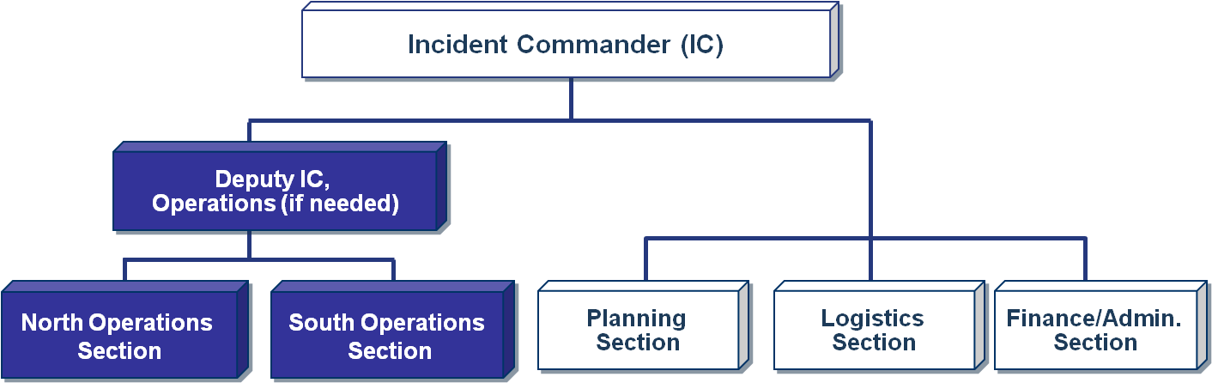
Adding an Operations Section
Adding an Ops Section is designed to address issues related to span of control and geography, not function.
Infrequently used.

Slide 29
Adding Ops Section: Considerations
Add a Deputy IC for Operations, if necessary.
Establish second Ops Section at beginning of operational period.
Ensure:
    C & G Staff can support the expansion.
    Adequate incident action planning.
    Adequate logistics support.
    All incident supervisory personnel are aware of the expanded organization.

Slide 30
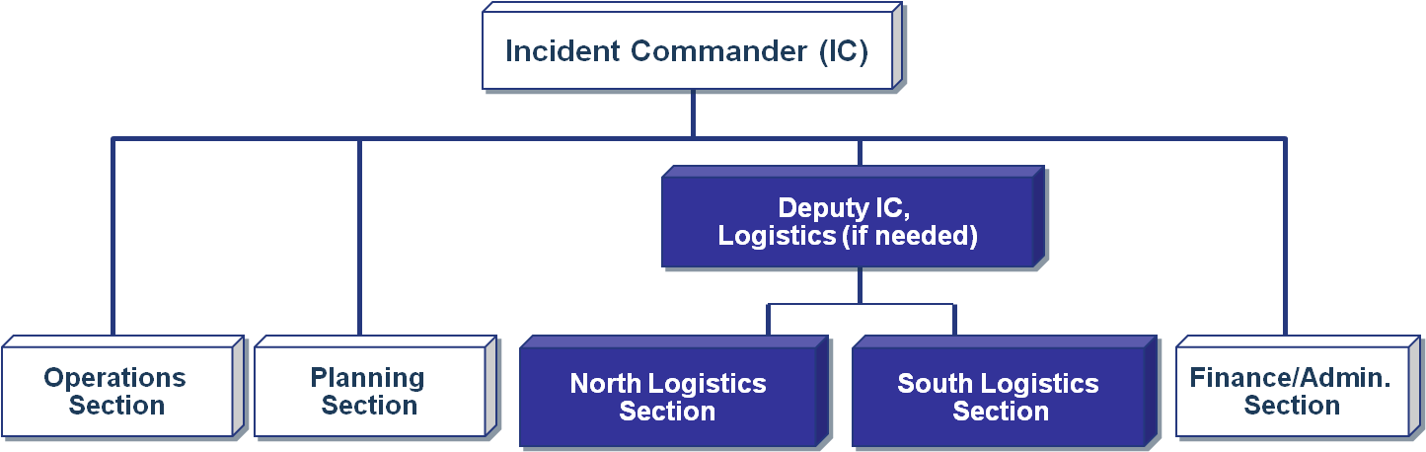
Adding a Logistics Section
If an incident is so geographically dispersed that it is not feasible for the Incident Base to support the incident logistical needs, it may be necessary to establish another Logistics Section. Again, infrequently used.

Slide 31
Adding Logistics Section: Considerations
Add a Deputy Incident Commander for Logistics, if necessary.
Establish the second Logistics Section at the beginning of an operational period.
Ensure:
    C&G Staff can support the expansion.
    Adequate incident action planning.
    All incident supervisory personnel are aware of the expanded organization.

Slide 32
Option 5: Establish the Intelligence/Investigations Function
Combine Several Incidents Into an Incident Complex
Divide an Incident Into Two or More Single Incidents
Expand the Planning Capability
Add a Second Operations or Logistics Section
Establish the Intelligence/Investigations Function
Combine Several Incidents Into an Incident Complex
Divide an Incident Into Two or More Single Incidents
Expand the Planning Capability
Add a Second Operations or Logistics Section
Establish the Intelligence/Investigations Function

Slide 33
I/I Function and Purpose
Determine the source or cause of the incident to control its impact and/or help prevent the occurrence of similar incidents.
Collect, analyze, and share information and intelligence.
Inform incident operations to protect the lives and safety of response personnel as well as the public.
Interface with counterparts outside the ICS organization to improve situational awareness.

Slide 34
Activity 3.1:
Create an Incident Complex Structure
Allotted Time: 90 minutes
Visual 3.34

Slide 35
Objectives Review
  What are the characteristics of a complex incident?
  What are the expansion options and conditions for complex incident organization?

