Slide 1
Unit 2:
Fundamentals Review for Command and General Staff

Slide 2
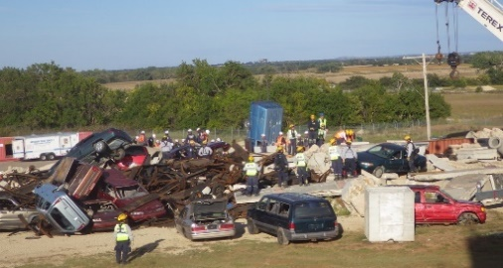
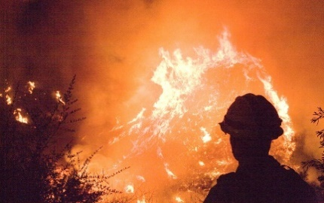
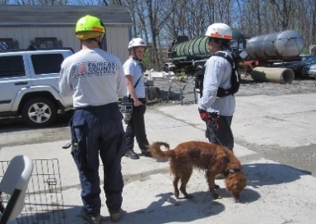
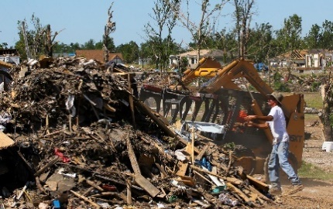
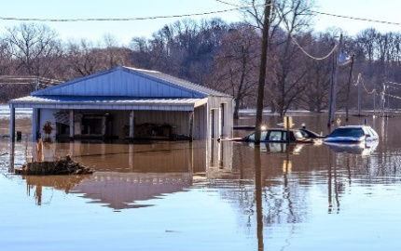
Unit Terminal Objective
Given a scenario and review materials, apply key NIMS doctrine concepts (NIMS Management Characteristics, Unified Command, Incident Command System structure and functional area responsibilities, IAP Preparation and the Operational Period Planning Cycle, and incident complexity) to the management of a complex incident or event.

Slide 3
Unit Enabling Objectives
Describe types of agency(ies) policies, guidelines, and agreements that influence management of incident or event activities.
Describe issues that influence incident complexity, complex incidents, and Incident Complex and the tools available to analyze complexity.
Describe the process for transfer of command.
Describe the primary guidelines and responsibilities of the Command and General Staff positions.

Slide 4
Unit Enabling Objectives (Cont.)
List the major steps in the Incident Action Planning Process.
Describe the purposes and responsibilities of Agency Representatives or technical specialists, reporting relationships, and how they can be used effectively within the incident organization.
Define the advantages of Unified Command and list the kinds of situations that may call for a Unified Command organization.
Describe how Unified Command functions on a multi-jurisdiction or multi-agency incident.

Slide 5
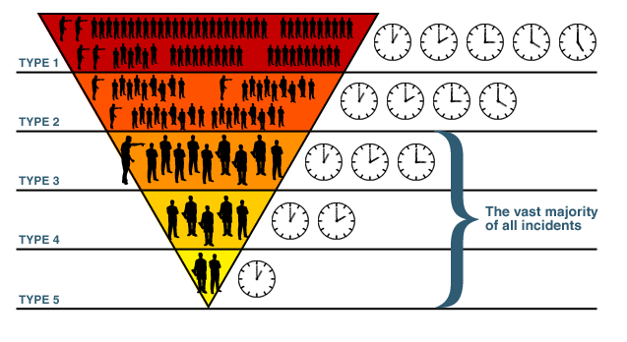
Incident Complexity and Types

Slide 6
Incident Complexity, Complex Incidents, and Incident Complex
Commonly misused terms.
Language matters – use the correct term and ensure that your audience understands what you intend.
Define each.
Differentiate between.

Slide 7
Activity 2.1: Review Activity
Allotted Time: 2 hours 45 minutes
Visual 2.7

Slide 8
Activity 2.1: Debrief
Group and Points to Cover
Group 1
Primary responsibilities of the Unified Command
Primary responsibilities of the Officers
Group 2
Operations Section Chief responsibilities
Tactical resource needs
Span of control
Ops Section organizational structure
Group 3
Primary responsibilities and challenges of the Planning Section Chief
Technical specialists
Primary responsibilities and challenges of the Logistics Section Chief
Primary responsibilities and challenges of the Finance/Admin Section Chief
Group | Points to Cover
Group 1 | Primary responsibilities of the Unified Command Primary responsibilities of the Officers
Group 2 | Operations Section Chief responsibilities Tactical resource needs Span of control Ops Section organizational structure
Group 3 | Primary responsibilities and challenges of the Planning Section Chief Technical specialists Primary responsibilities and challenges of the Logistics Section Chief Primary responsibilities and challenges of the Finance/Admin Section Chief

Slide 9
Activity 2.1: Debrief (Cont.)
Group | Points to Cover
Group 4 | Planning process responsibilities Types of policies, guidelines, or agreements Length of first operational period Initial incident objectives Major steps/meeting conducted ICS forms used
Group 5 | Unified Command advantages Jurisdictions/agencies included in the Unified Command structure Top three challenges associate with using Unified Command Strategies to address challenges
Group and Points to Cover
Group 4
Planning process responsibilities
Types of policies, guidelines, or agreements
Length of first operational period
Initial incident objectives
Major steps/meeting conducted
ICS forms used
Group 5
Unified Command advantages
Jurisdictions/agencies included in the Unified Command structure
Top three challenges associate with using Unified Command
Strategies to address challenges

Slide 10
Objectives Review
Describe types of agency(ies) policies, guidelines, and agreements that influence management of incident or event activities.
Describe issues that influence incident complexity, complex incidents, and Incident Complex and the tools available to analyze complexity.
Describe the process for transfer of command.
Describe the primary guidelines and responsibilities of the Command and General Staff positions.

Slide 11
Objectives Review (Cont.)
List the major steps in the Incident Action Planning Process.
Describe the purposes and responsibilities of Agency Representatives or technical specialists, reporting relationships, and how they can be used effectively within the incident organization.
Define the advantages of Unified Command and list the kinds of situations that may call for a Unified Command organization.
Describe how Unified Command functions on a multi-jurisdiction or multi-agency incident.

