Slide 1
E/L/G 0400 Advanced Incident Command System For Complex Incidents, ICS 400

Slide 2
Unit 1: Course Introduction

Slide 3
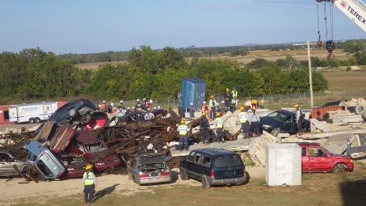
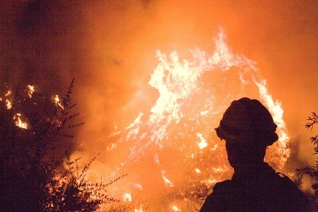
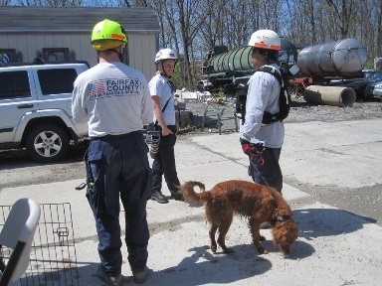
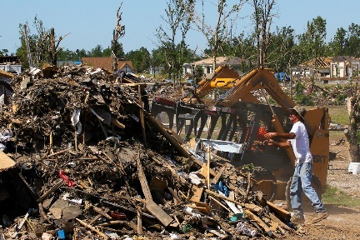
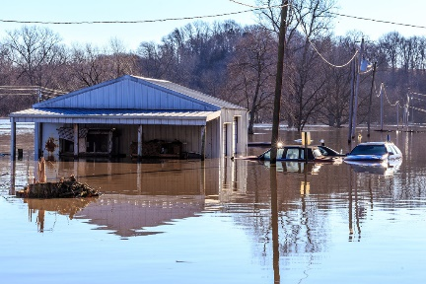
Unit Terminal Objective
Identify the course scope, objectives, and classroom logistics.

Slide 4
Unit Enabling Objectives
Explain the course structure.
Explain the requirements for completion of the course.

Slide 5
Administrative Considerations
Lodging
Transportation
Safety Procedures
Smoking Policy
Message and Telephone Location
Cell Phone, Texting and Email Policies
Restrooms and Drinking Fountains
Other Local Information
Facility Safety
Lunches / Breaks
Visual 1.5

Slide 6
Introductions
Instructor and student introductions
Incident response experiences
Disaster experience
Pre-test

Slide 7
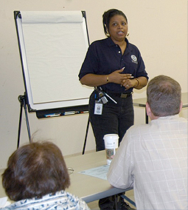
Expectations
Instructional Team
Student

Slide 8
Course Objectives
Given a scenario and review materials, apply key NIMS doctrine concepts (NIMS Management Characteristics, Unified Command, Incident Command System structure and functional area responsibilities, IAP Preparation and the Operational Period Planning Cycle, and incident complexity) to the management of a complex incident or event. (Unit 2)
Apply the appropriate structural option to manage a complex incident. (Unit 3)

Slide 9
Course Objectives (Cont.)
Given a scenario, develop an Area Command organization. (Unit 4)
Identify the complex incident management issues that can result from a lack of multiagency coordination. (Unit 5)
Summarize the course objectives. (Unit 6)

Slide 10
Course Structure
Unit 1:
Course Introduction
Unit 2:
Fundamentals Review
Unit 3:
Complex Incident Management
Unit 4:
Area Command
Unit 5:
Interconnectivity of NIMS Command & Coordination Structures
Unit 6:
Course Summary
Handout 1-1: Course Agenda

Slide 11
Course Design
Course length of 2 days.
Combination of lecture, discussion, and activities.
Prerequisites –
IS-0100.c
IS-0200.c
E/L/G 0300
IS-0700.b
IS-0800
Closed-book Final Exam
Visual 1.11

Slide 12
Successful Course Completion
Participate in unit activities.
Achieve 75% or higher on the Final Exam.
Complete the end-of-course evaluation.

Slide 13
Objectives Review
What are the course scope and objectives?
To complete the course, what are the requirements?
Visual 1.13

