Slide 1
Team Trust
Creating High-Performance Work Teams

Slide 2
Why Teams?
Structure
Feedback
More effective than traditional hierarchical structures
Higher quality of feedback in all directions (360-degree)
Decisions
Communication
More efficient decision making practices
Communication is encouraged within trust-centered relationships
Participation
Sustainability
Individual participation increases in low-risk environments
Improved organizational stability leads to sustainability
(Cole, 1982; Kuipers & Procter, 2018)

Slide 3
Exception vs. Rule
The practice of creating teams is an exception - creating teams for the sake of “teamwork” is a recipe for disaster!
Most high-performance work teams form naturally due to the nature of work to be accomplished.

Slide 4
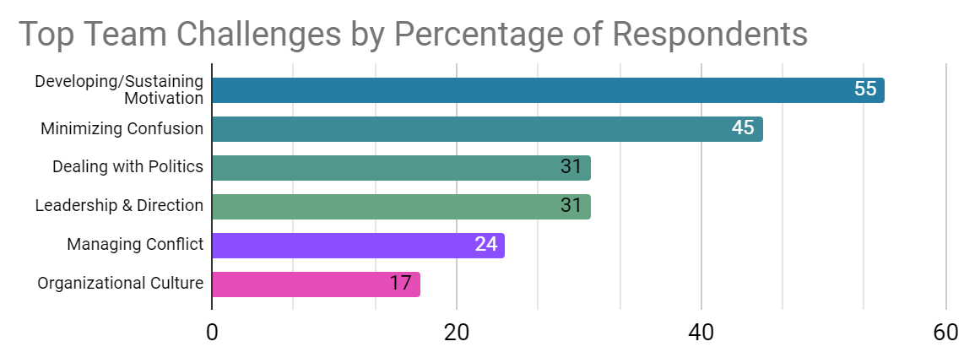
Top Team Challenges
(Thompson, 2016)

Slide 5
What Makes a Team Tick?
Entitativity
Resilience
Identity
Definition
Definition
Definition
Degree in which people perceive themselves and others to be collective
Perseverance despite adversity
Degree in which people feel their group membership is an important part of who they are
Characteristics
Taking action, staying focused, handling uncertainty, and reacting positively
Characteristics
Characteristics
Humility, trust, fulfillment of group needs
Group pride, fulfillment of personal needs
(Crawford & Salaman, 2012; Pettit & Launt, 2011)

Slide 6
Causes of Team Dysfunction
Inattention to Results
Fear of Conflict
Absence of Trust
Avoidance of Accountability
Lack of Commitment
(Lencioni, 2002)

Slide 7
Causes of Team Dysfunction
Inattention to Results
Fear of Conflict
Absence of Trust
Avoidance of Accountability
Lack of Commitment
Lack of vulnerability leads to limited formation
of team trust
(Lencioni, 2002)

Slide 8
Causes of Team Dysfunction
Inattention to Results
Fear of Conflict
Absence of Trust
Avoidance of Accountability
Lack of Commitment
Absence of trust prevents cognitive conflict
while fueling affective conflict
Lack of vulnerability leads to limited formation
of team trust
(Lencioni, 2002)

Slide 9
Causes of Team Dysfunction
Inattention to Results
Fear of Conflict
Absence of Trust
Avoidance of Accountability
Lack of Commitment
Without opinions being heard (cognitive
conflict), members fail to commit
Absence of trust prevents cognitive conflict
while fueling affective conflict
Lack of vulnerability leads to limited formation
of team trust
(Lencioni, 2002)

Slide 10
Causes of Team Dysfunction
Inattention to Results
Fear of Conflict
Absence of Trust
Avoidance of Accountability
Lack of Commitment
Members avoid accountability for outcomes
in which they have no ownership
Without opinions being heard (cognitive
conflict), members fail to commit
Absence of trust prevents cognitive conflict
while fueling affective conflict
Lack of vulnerability leads to limited formation
of team trust
(Lencioni, 2002)

Slide 11
Causes of Team Dysfunction
Inattention to Results
Fear of Conflict
Absence of Trust
Avoidance of Accountability
Lack of Commitment
Individual desires take precedence over
team goals
Members avoid accountability for outcomes
in which they have no ownership
Without opinions being heard (cognitive
conflict), members fail to commit
Absence of trust prevents cognitive conflict
while fueling affective conflict
Lack of vulnerability leads to limited formation
of team trust
(Lencioni, 2002)

Slide 12
Trust Begins with Leadership
When organizational interests do not appear to align with personal interests, trust within the organization is diminished.
(Do, 2018)

Slide 13
Activity
15 questions – respond honestly and without over-thinking…
Make a note of the statement number and your score for each question. Scores are:
3 – Usually
2 – Sometimes
1 – Rarely

Slide 14
Activity Questions
Team members are passionate and unguarded in their discussion of issues.
Team members call out one another’s deficiencies or unproductive behaviors.
Team members know what their peers are working on and how they contribute to the collective good of the team.

Slide 15
Activity Questions
Team members quickly and genuinely apologize to one another when they say or do something inappropriate or possibly damaging to the team.
Team members willingly make sacrifices (such as budget, turf, head count, time, etc.) for the good of the team.
Team members openly admit their weaknesses and mistakes.

Slide 16
Activity Questions
Team meetings are compelling and not boring.
Team members leave meetings confident that their peers are completely committed to the decisions that were agreed on, even if there was initial disagreement.
Morale is significantly affected by the failure to achieve team goals.

Slide 17
Activity Questions
During team meetings, the most important – and difficult – issues are put on the table to be resolved.
Team members are deeply concerned about the prospect of letting down their peers.
Team members know about one another’s personal lives and are comfortable discussing them.

Slide 18
Activity Questions
Team members end discussions with clear and specific resolutions and calls to action.
Team members challenge one another about their plans and approaches.
Team members are slow to seek credit for their own contributions, but quick to point out those of others.

Slide 19
Activity Summary
Absence of Trust | Fear of Conflict | Lack of Commitment | Avoidance of Accountability | Inattention to Results
#4 _____ | #1 _____ | #3 _____ | #2 _____ | #5 _____
#6 _____ | #7 _____ | #8 _____ | #11 _____ | #9 _____
#12 _____ | #10 _____ | #13 _____ | #14 _____ | #15 _____
Total _____ | Total _____ | Total _____ | Total _____ | Total _____
Understanding the column totals:
8-9 – Indicates that dysfunction is likely not a problem
6-7 – Indicates the dysfunction could be a problem
3-5 – Indicates the dysfunction likely needs to be addressed
Ultimately, every team needs constant attention and work; otherwise, the team will deviate toward dysfunction regardless of score…
(Lencioni, 2002)

Slide 20
Trust
“The confidence among team members that their peers’ intentions are good and that there is no reason to be protective.”
-Patrick Lencioni

Slide 21
The Origin of Trust
Witnessed Vulnerability
Experience
Personal and professional
Recognition of the vulnerability of others
Personal Vulnerability
Weaknesses, skill deficiencies, mistakes, requests for help

Slide 22
The Origin of Trust
Witnessed Vulnerability
Experience
Personal and professional
Recognition of the vulnerability of others
Personal Vulnerability
Weaknesses, skill deficiencies, mistakes, requests for help
Pathway to Trust…
Humility > Vulnerability > Trust

Slide 23
Addressing Absence of Trust
Recognize that the absence of trust leads to all other dysfunctions – then act on it!
Get to know one another – vulnerability is not instantaneous…
Personal histories exercises
Ice-breakers
Personality and behavioral preference profiles
Leaders must take the first step and demonstrate vulnerability
Followers are significantly less inclined to demonstrate vulnerability to a leader

Slide 24
Addressing Fear of Conflict
Cognitive conflict is productive – affective conflict is not.
Mine for conflict when underlying concerns are probable
Devil’s advocate (but rotate the role…)
Leaders must demonstrate restraint while offering real-time permission
Time matters, but results matter more
Allow respectful debate on relevant matters without forcing an end
If members do not have the opportunity to voice their concerns/opinions, we are responsible for the lack of commitment
If members do not take the opportunity, they are responsible for their own lack of commitment…

Slide 25
Addressing Lack of Commitment
Recognize the two causes:
Desire for consensus
Need for certainty
Create a culture of oneness
Once all voices are heard, a decision is made.
Once a decision is made, all team members are expected to champion the decision.
Any decision is better than no decision
Make a decision and, if necessary, change course as the situation warrants
Do not falter and fail to make a decision – it only creates uncertainty and stress!

Slide 26
Addressing Avoidance of Accountability
Don’t make accountability a “buzz word”
Demand accountability at all levels
Leaders must demonstrate radical accountability
Accountability should be horizontal first, then vertical if necessary
Make expectations known
People need a target for performance
Accountability should not be disciplinary
Mistakes and errors are an opportunity for learning and growth
Reduce bureaucracy and mentor one another
Celebrate successes (1,501 Ways to Reward Employees, B. Nelson)

Slide 27
Addressing Inattention to Results
Celebrate success
Public recognition
Group-based rewards or incentives
Money is a temporary satisfier – it is not the go-to solution!
Recognize that expectancy is a reality
Vroom’s Expectancy Theory
Member perspective: Effort > Performance > Reward

Slide 28
One more word on trust…
The emotions expressed by a group are commonly indicative of the emotions of the group’s members. The absence of trust by one member may also be conversely indicative of an absence of trust throughout the group.
(Do, 2018)
Humility
Vulnerability
Trust

Slide 29
Questions?

Slide 30
References
Cole, R. E. (1982). Diffusion of participating work structures in Japan, Sweden and the United States. In P.S. Goodman et al. (Eds.), Change in Organizations (pp. 166-225). Jossey-Bass.
Crawford, M. T., & Salaman, L. (2012). Entitativity, identity, and the fulfillment of psychological needs. Journal of Experimental Social Psychology, 48(3), 726-730.
Do, B. (2018). An affect-based model of recipients’ responses to organizational change events. Academy of Management Review, 43(1), 65–86. https://doi.org/10.5465/amr.2014.0335
Kuipers, B., & Procter, S. (2018). Understanding teams in order to understand organizational change: The OTIC model of organizational change. Journal of Change Management, 18(1), 1–9.

Slide 31
References
Lencioni, P. (2002). The Five Dysfunctions of a Team. Jossey-Bass.
Pettit, N. C., & Launt, R. B. (2011). Through whose eyes? The impact of identification on judgements of group status. Group Processes & Intergroup Relations, 14(4), 533-547
Thompson, L. (2016). Leading high impact teams. Team leadership survey from the Kellogg School of Management Executive Program [Survey data set]. Northwestern University.

